Slide 1

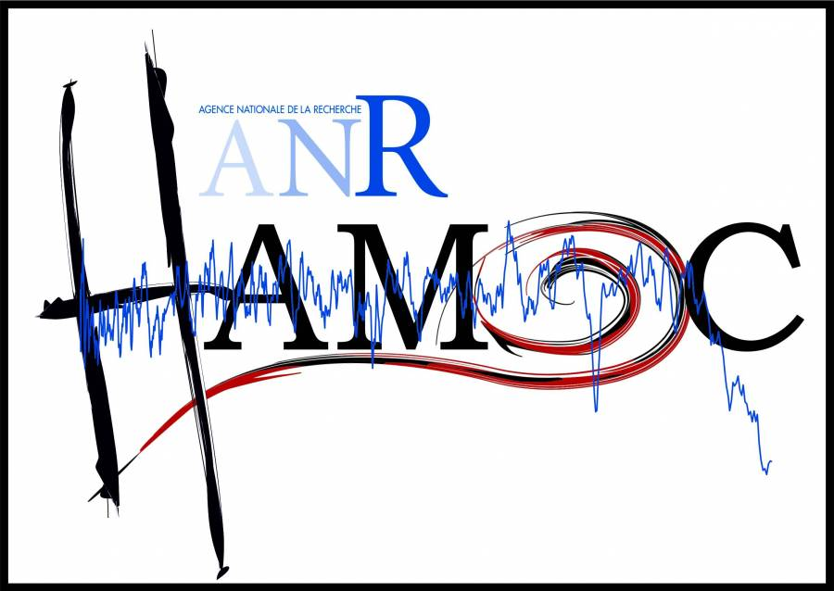

Can freshwater input in the Mediterranean Sea impact large-scale climate?
Didier Swingedouw, Pierre Sepulchre, Christophe Colin, Giovanni Sgubin

Slide 2
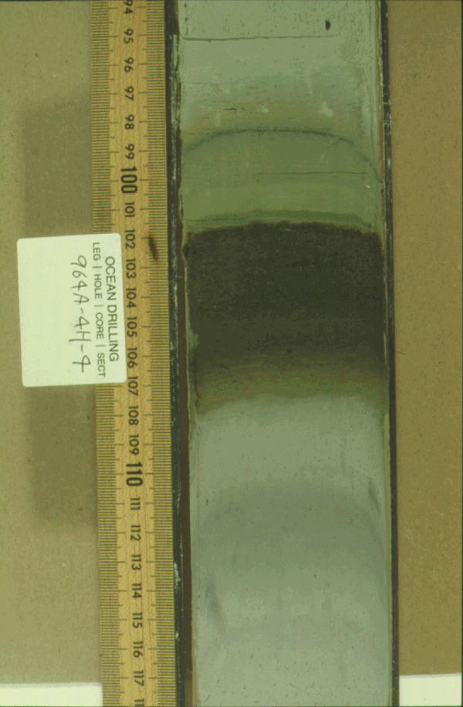
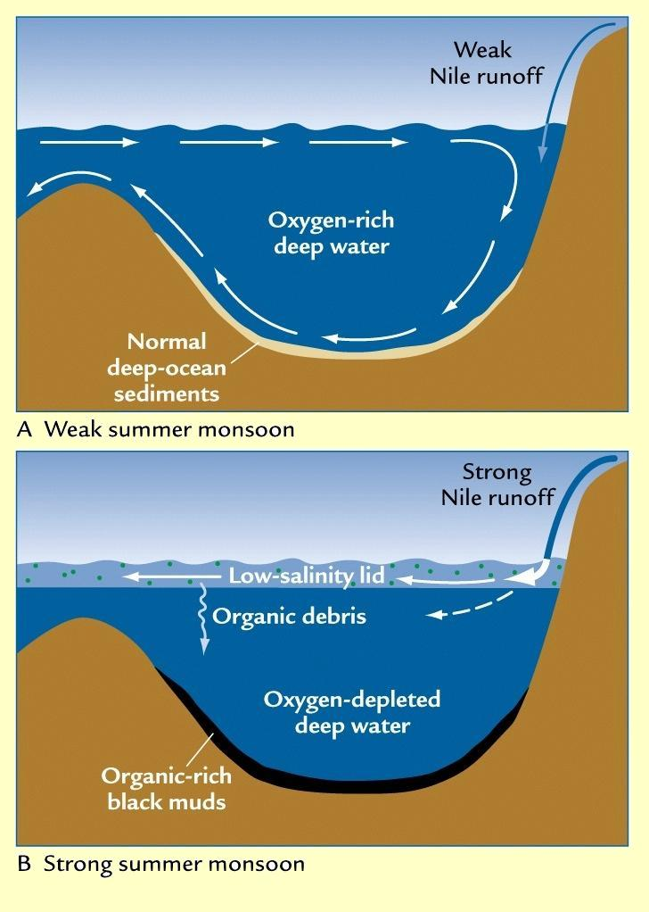
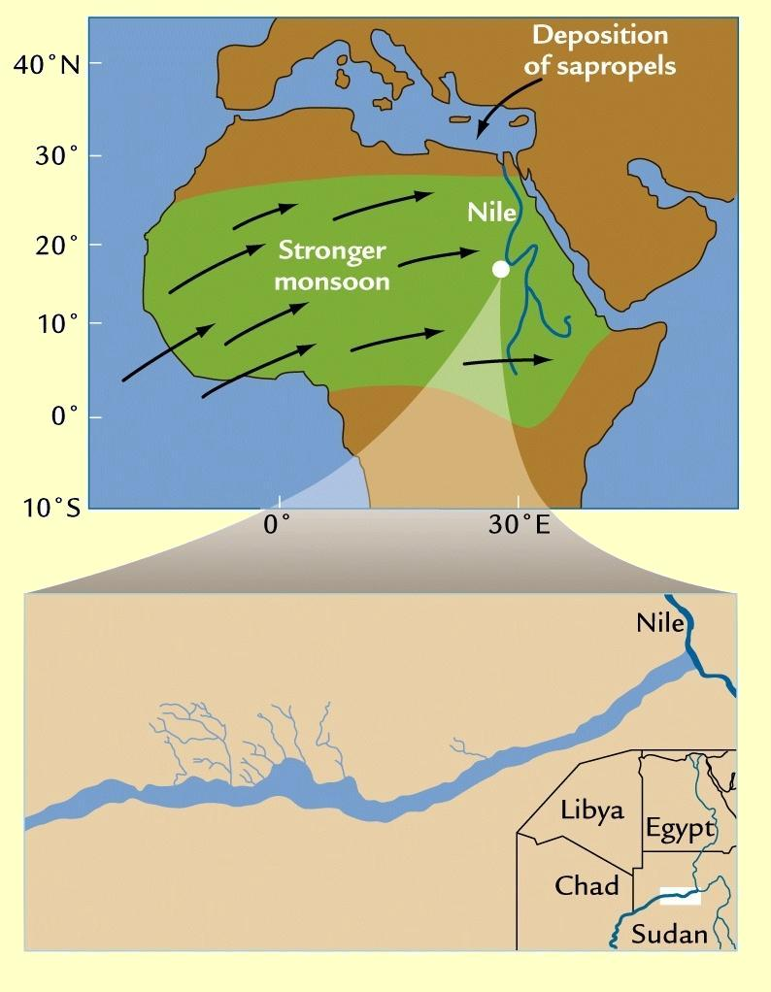
Holocene Sapropel event
Marine sediment cores from the Mediterranean indicate large sapropelic deposit during early Holocene (10-6 kyr BP) (Bethoux and Pierre 1999, Delange et al. 2008)
Such Sapropelic deposit may be related with fresh surface water in the Mediterranean, potentially related with large increase of River Nile flow, in link with Green Sahara at the same period.
Notes:
Sapropels are sediment layers with high concentrations of organic carbon,

Slide 3
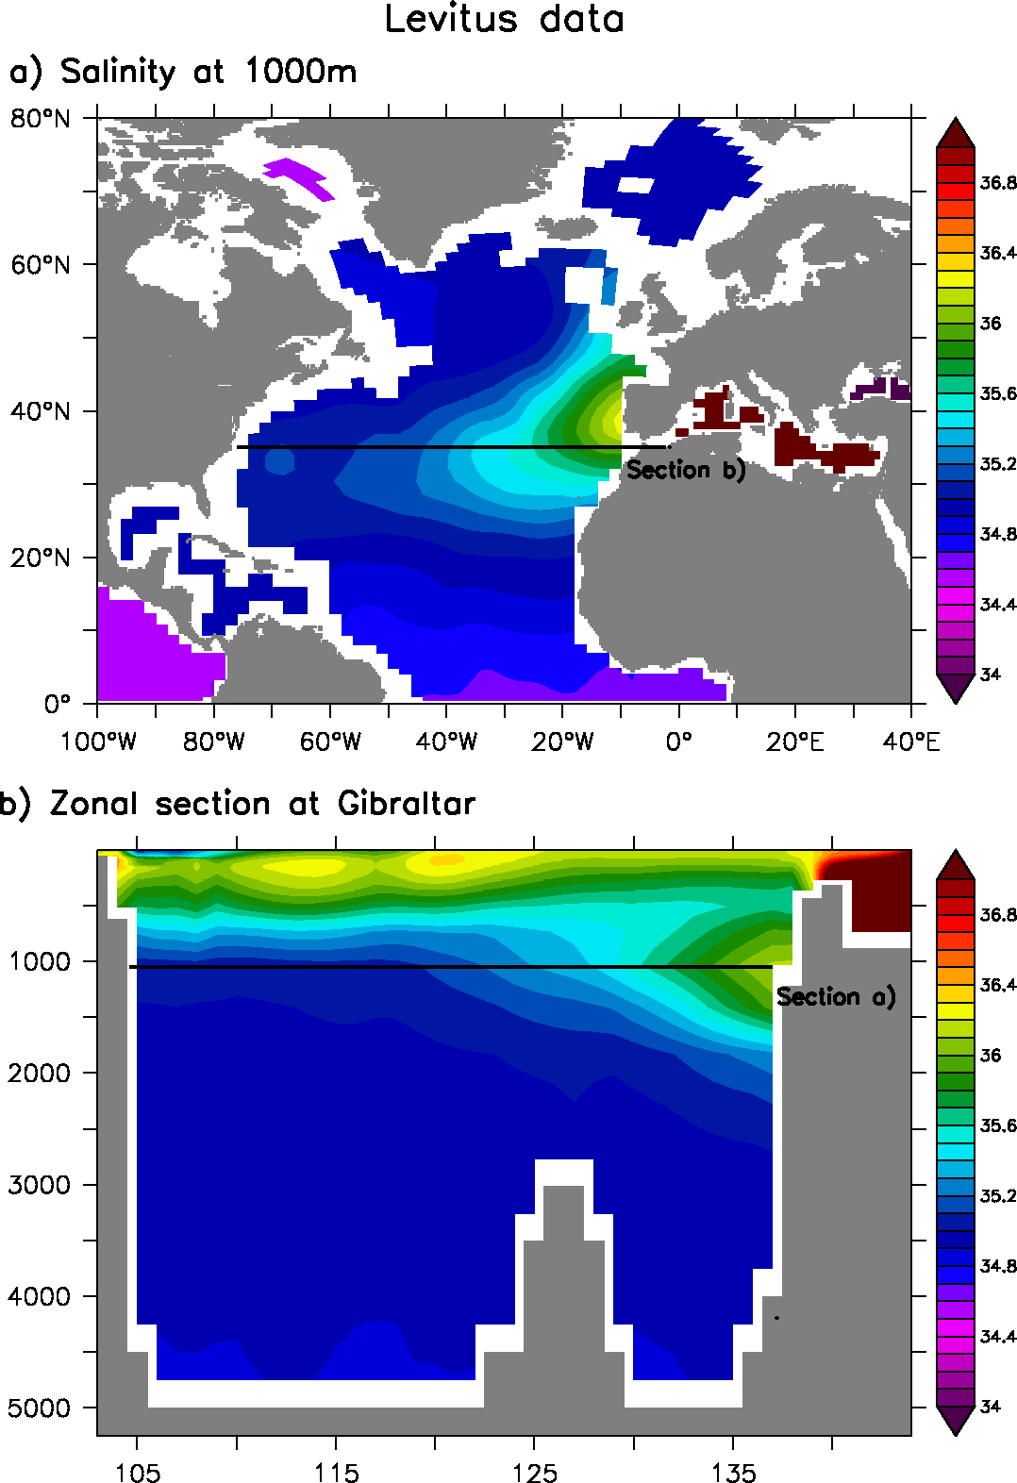
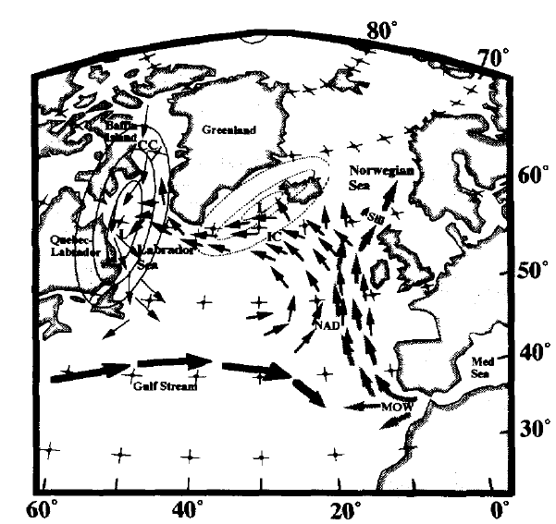
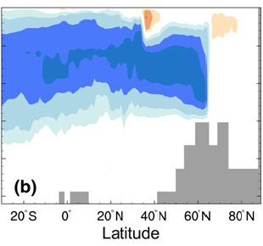
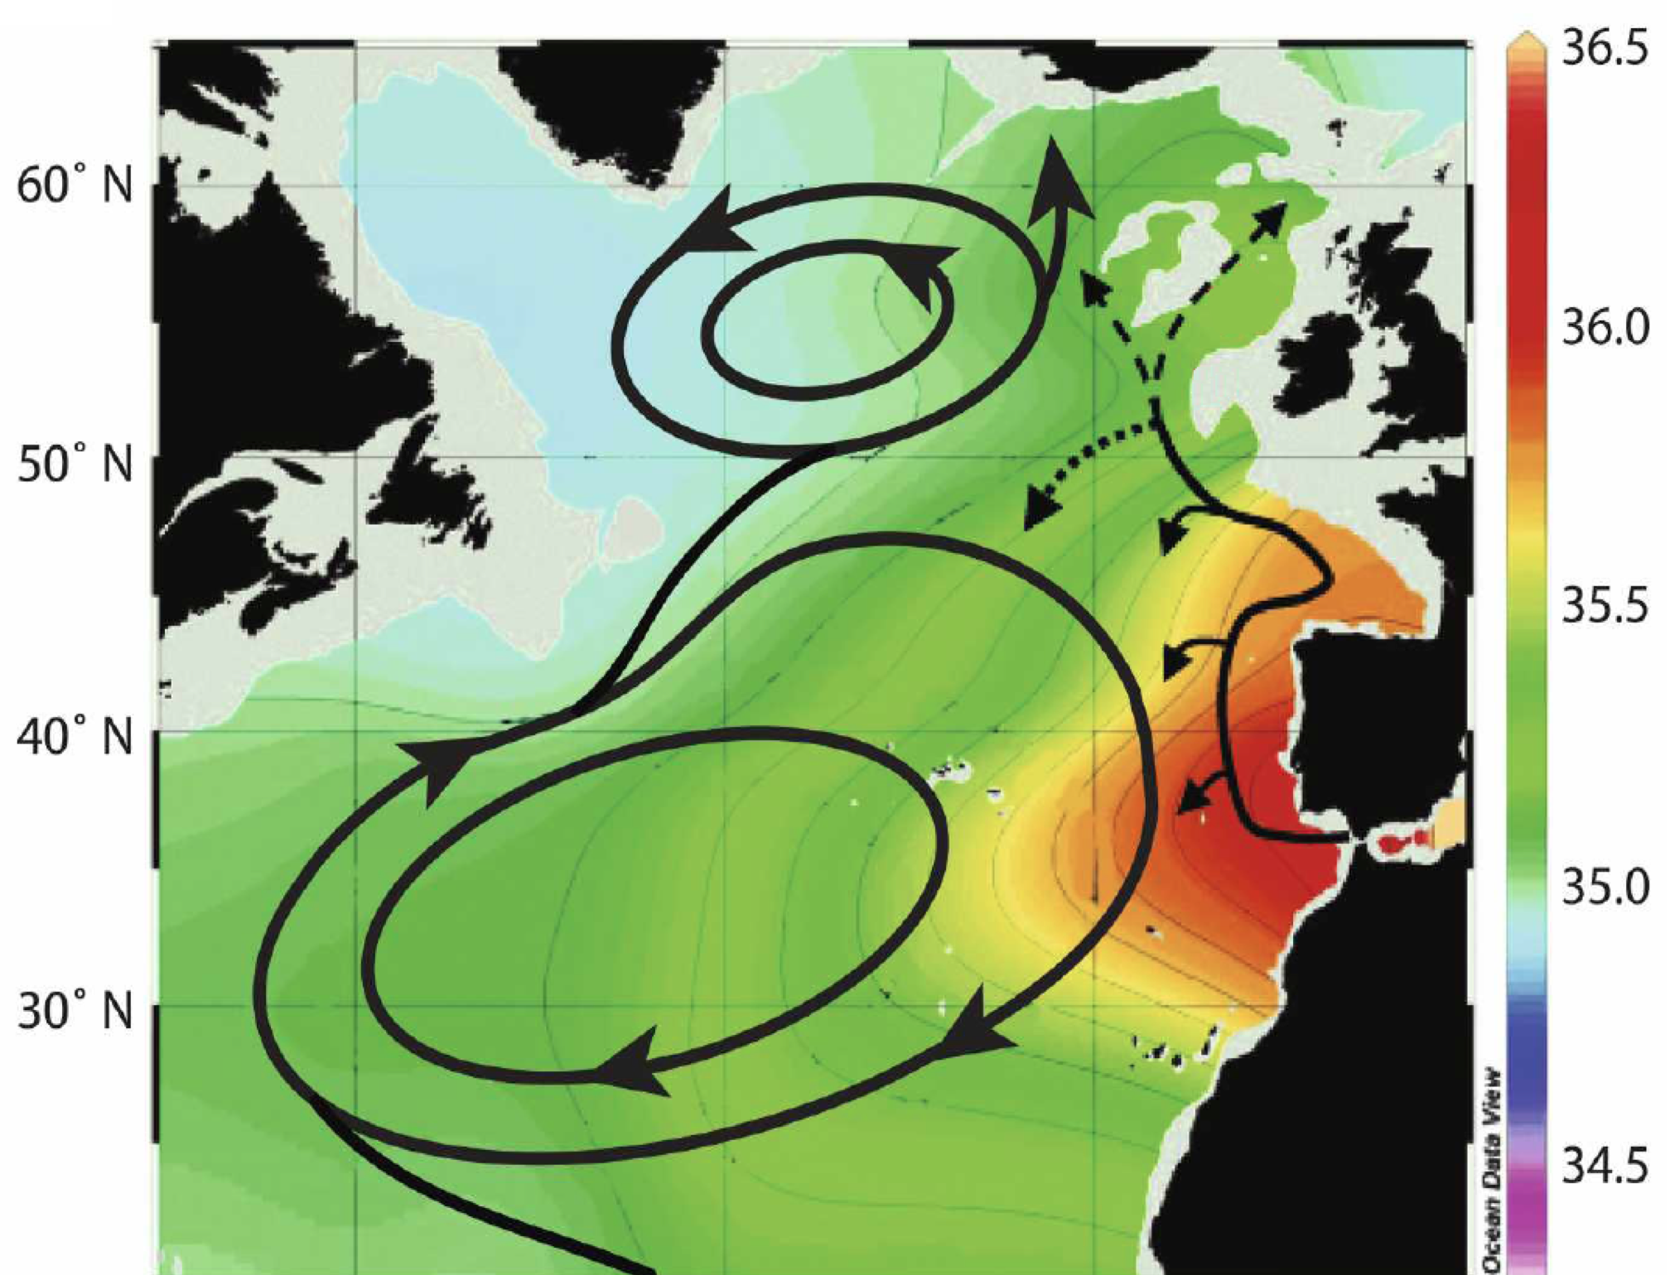

MOW impact on the AMOC?
Johnson (1997) process
Such changes in surface may strongly affect the Mediterranean outflow (MOW) and potentially the Atlantic Meridional Overturning Circulation (AMOC)
Johnson (1997) using qualitative arguments: Aswan Dam ➔ reduced Nil flow ➔ increased MOW ➔ increased AMOC ➔ increased evaporation in Labrador ➔ new ice age!
Rahmstorf (1998) using simple climate model: salty Med ➔ increased AMOC
Ivanovitch et al. (2013) using HadCM3: still a decrease of AMOC, except at the surface…
Ivanovitch et al. 2013 (HadCM3,
Halving Med salinity)
Depth (m)
Depth
Latitude
Lozier and Stewart2008
8O°W
O°
Longitude
Notes:
Lozier & Stewart JPO (2008): “The impacts of an intermittent penetration of MOW into the subpolar gyre, including the possible effect on water mass transformations, remain to be investigated.”

Slide 4
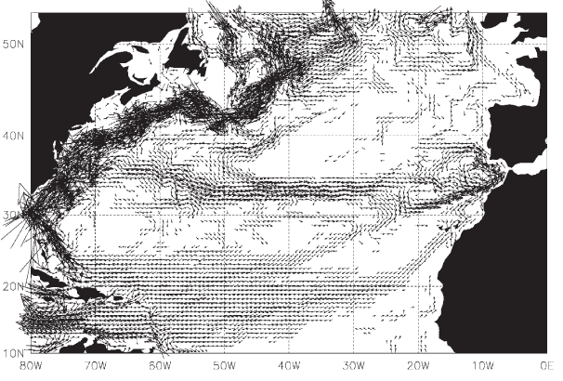
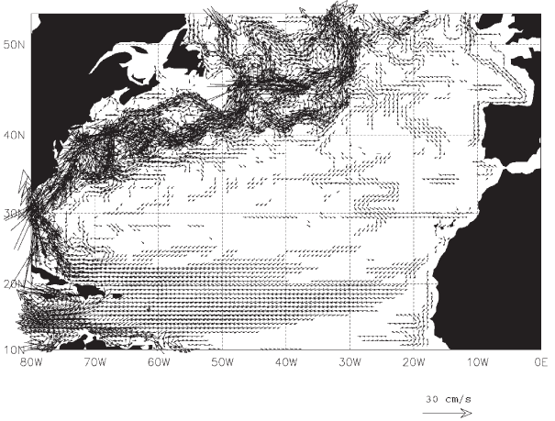
Effect of MOW on surface ocean circulation
Jia (2000), New et al. (2001) using of high-resolution (<0.5°) ocean GCMs, one with active MOW, the other without MOW
With active MOW, there is clear branch of surface water going towards the Mediterranean
Without any MOW, this branch disappears
What could the impact of these 3D large-scale circulation changes on tropical salinity transport, and then AMOC and climate?
Active MOW
No MOW
New et al. 2001
Notes:
Impact of MOW on Azores current

Slide 5
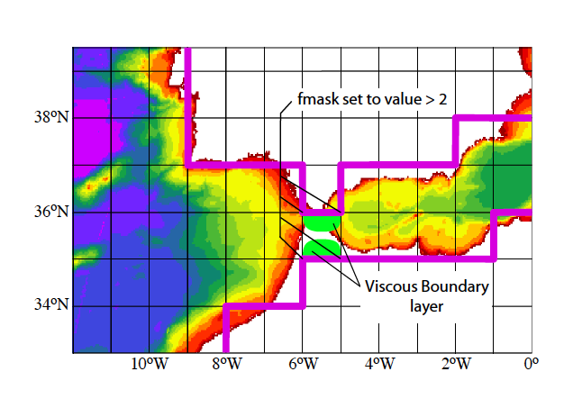
Experimental design
Objective: What is the impact of a MOW disappearance on large-scale ocean and climate in a state-of-the art climate model?
IPSL-CM5A-LR:
  Ocean-atmosphere GCM (2° resolution)
  Representation of Gibraltar by enhancing number of grid points there and playing with viscosity for having coherent transport (modelled MOW=2.2 Sv, obs.≈1.8 Sv)
100 mSv of freshwater put homogenously over the Mediterranean area for 300 years (HosMed)
(Nil=3 mSv ; Amazon=200 mSv)
Notes:
Nil : 2 830 m3/s = 0.003 Sv
Amazone 209 000 m3/s = 0.2 Sv
Facteur 100…

Slide 6
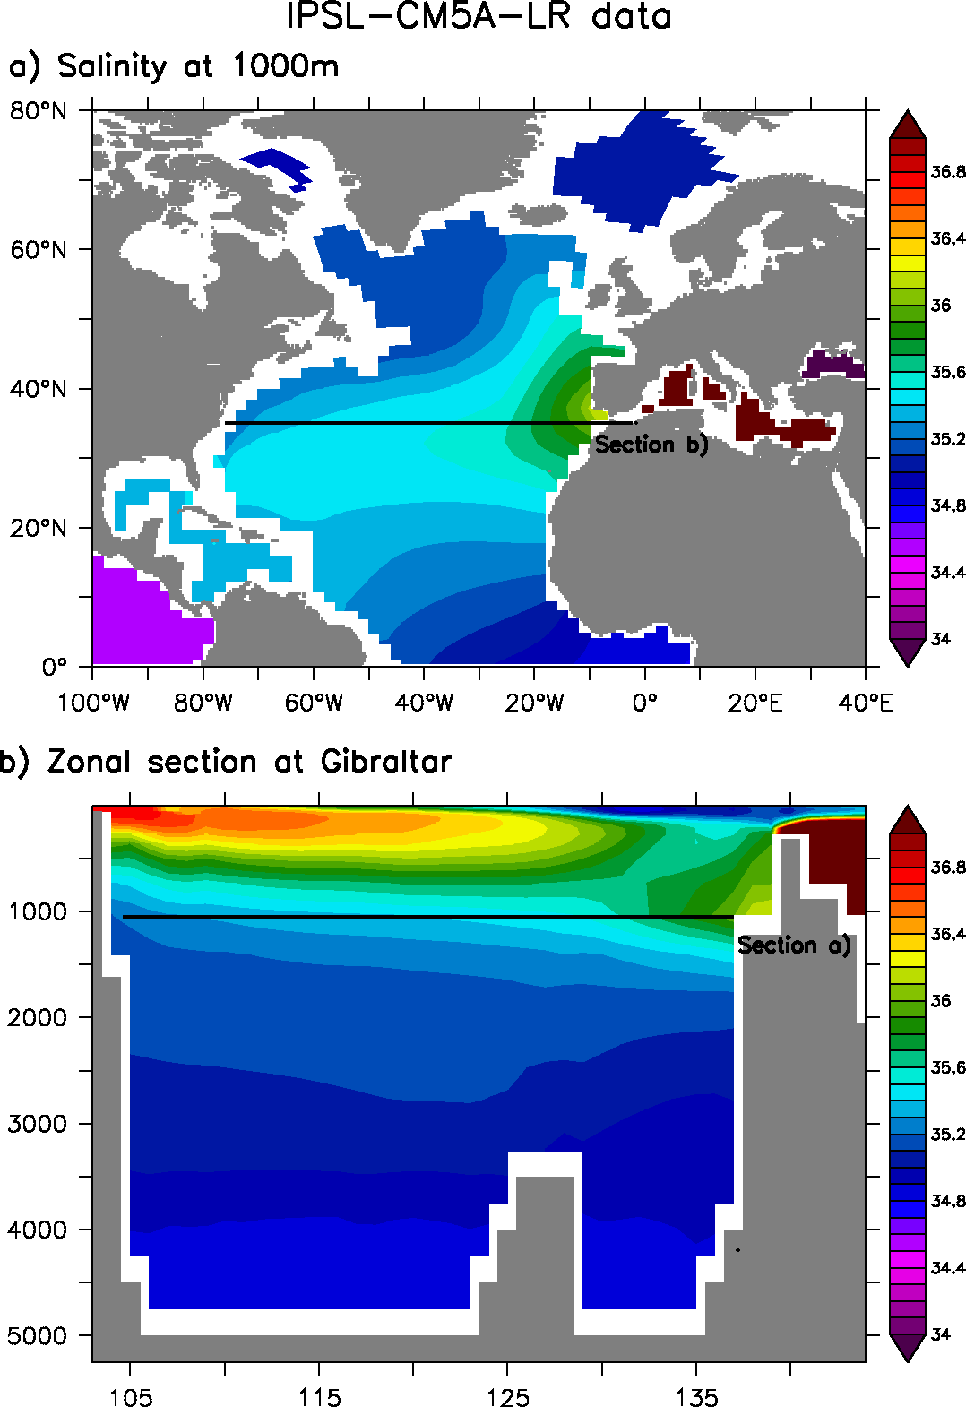
MOW within IPSL-CM5A-LR
Control simulation IPSL-CM5A-LR
Profondeur (m)
Profondeur (m)
8O°W
O°
Longitude
Longitude
8O°W
O°
Notes:
Value of flows ? Obs vs data
GLORYS: outflow= 1.91 Sv in 5 yr => 0.46 south; 1.26 North
Model outflow = 2.20 Sv => 1.56 South ; 0.17 North
Issue with model pathway?

Slide 7
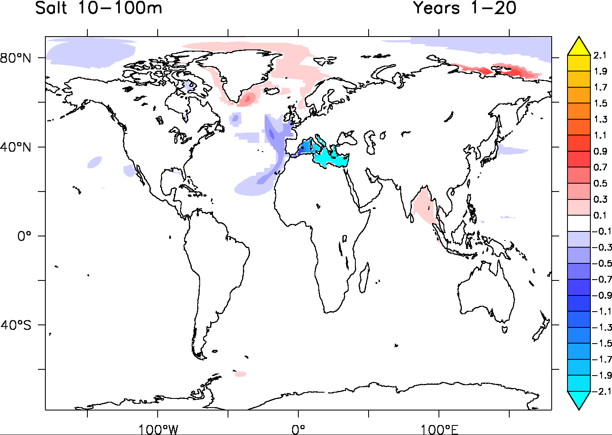
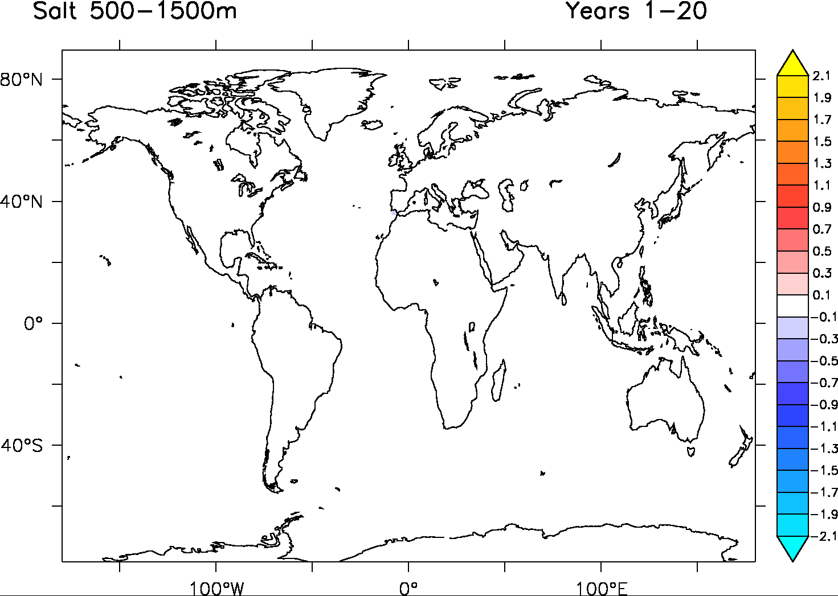
Salinity response
SSS: HosMed-Control
Freshwater leakage

Slide 8
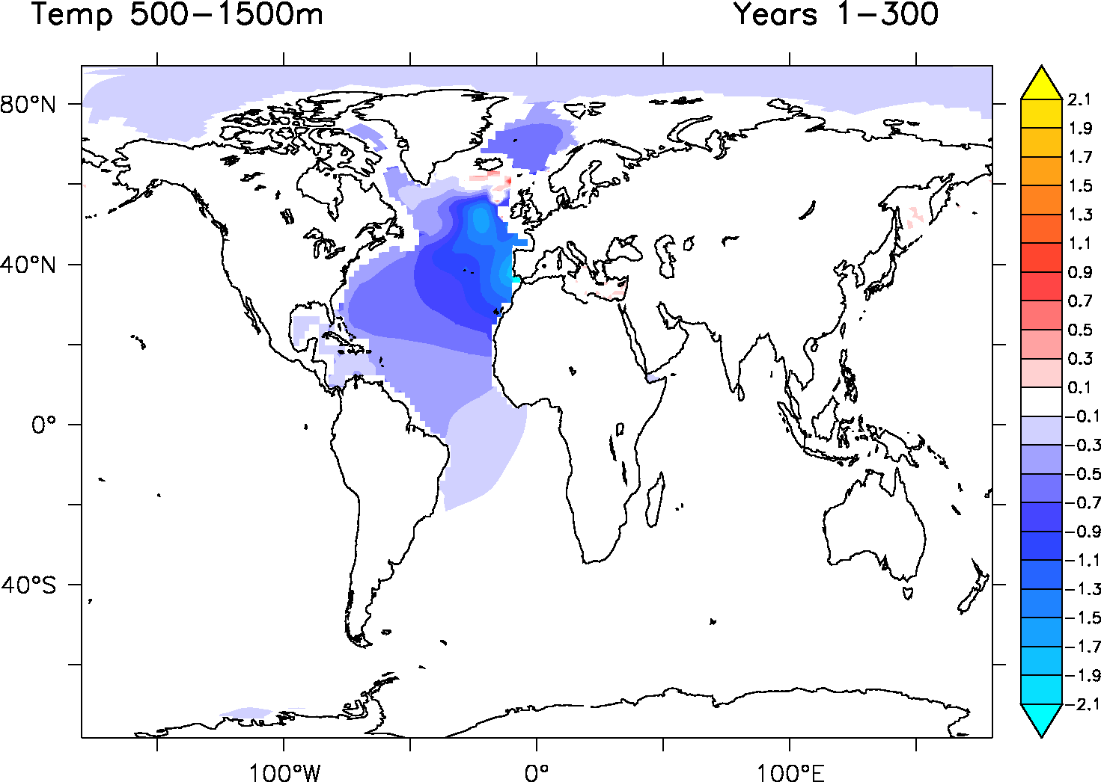
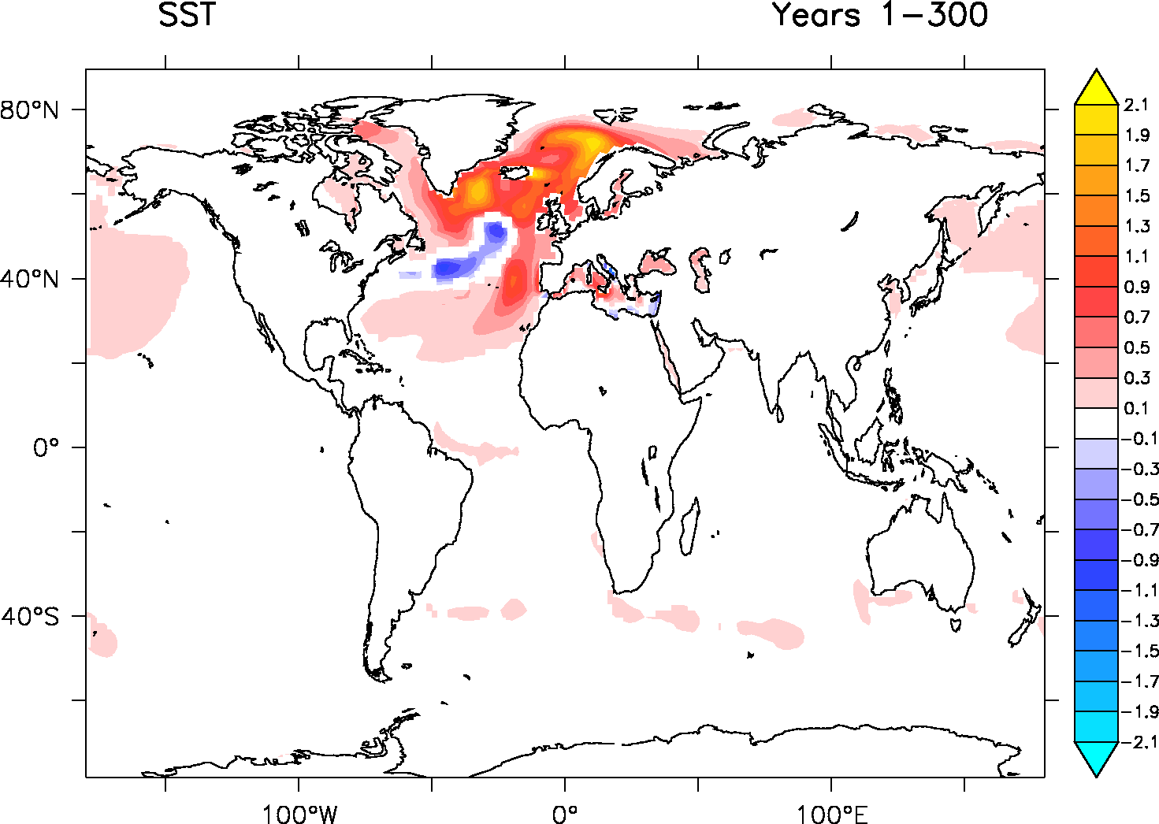
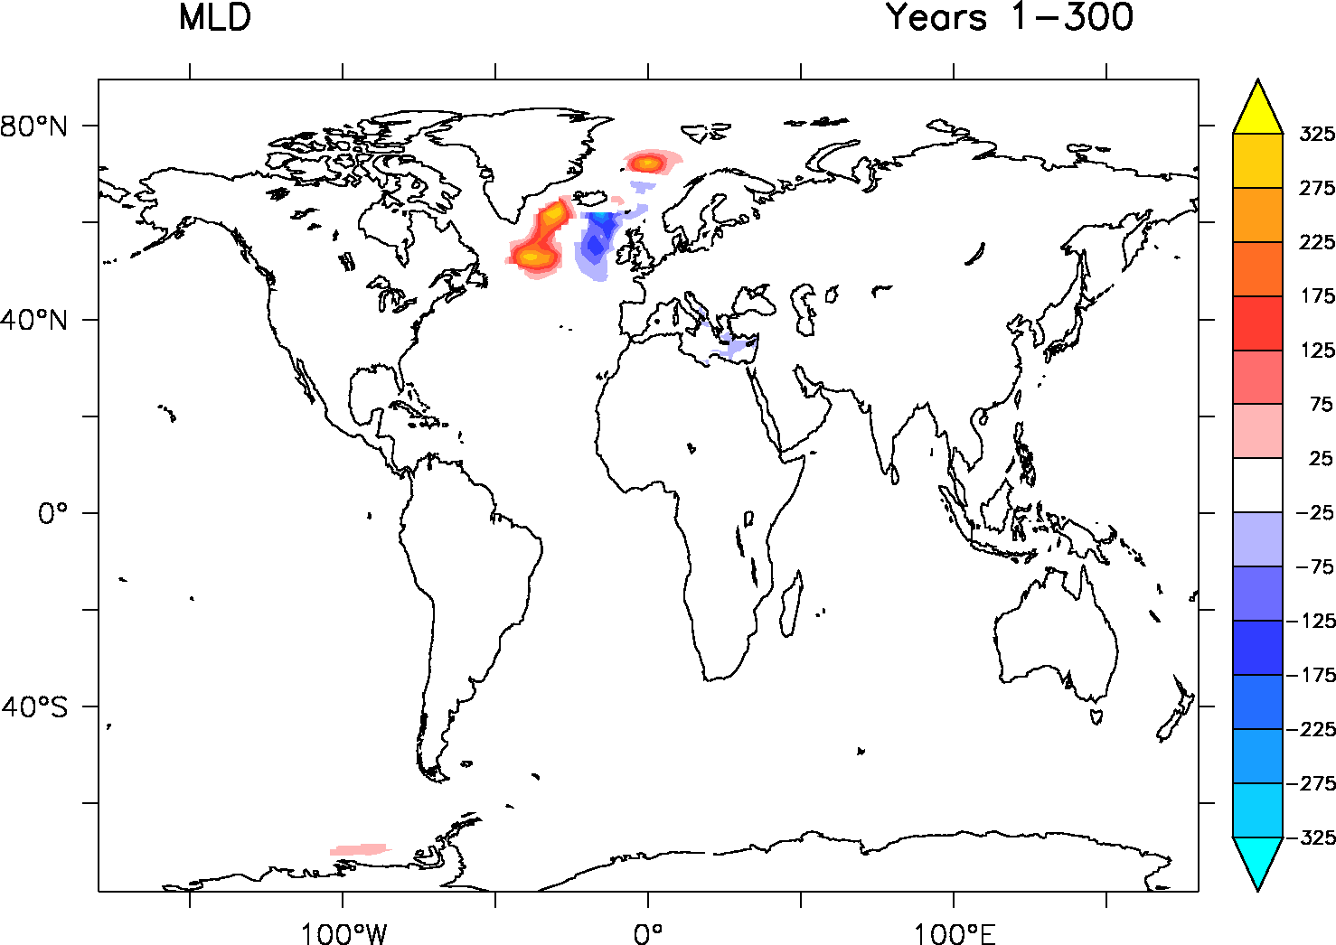
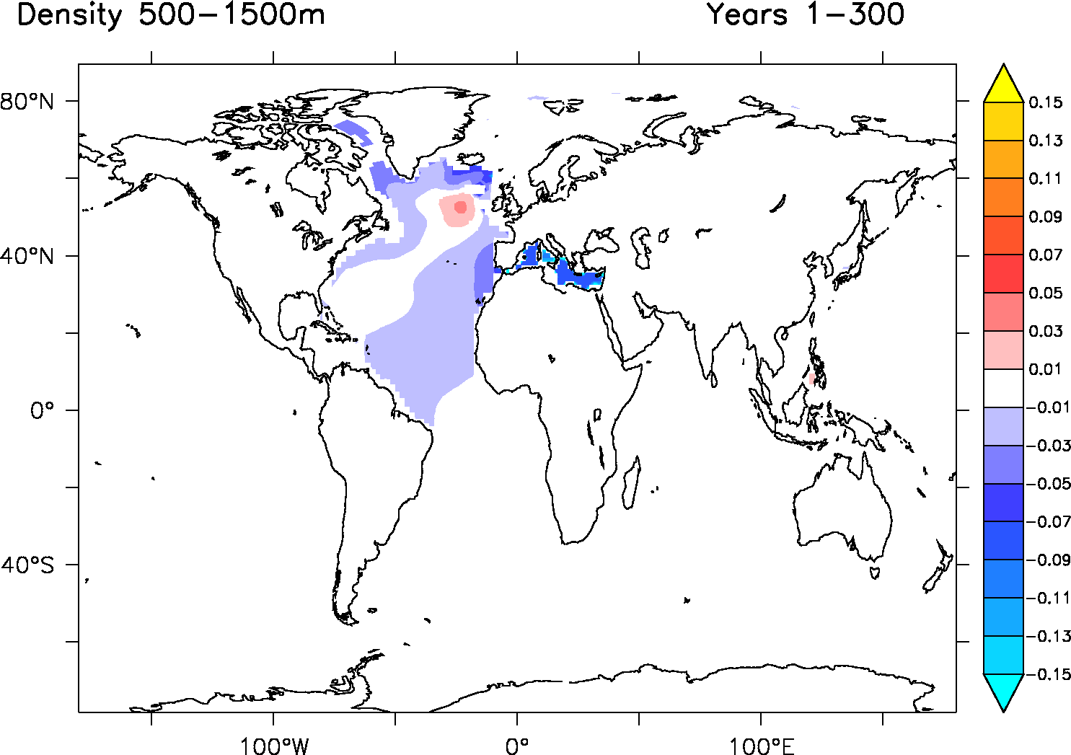
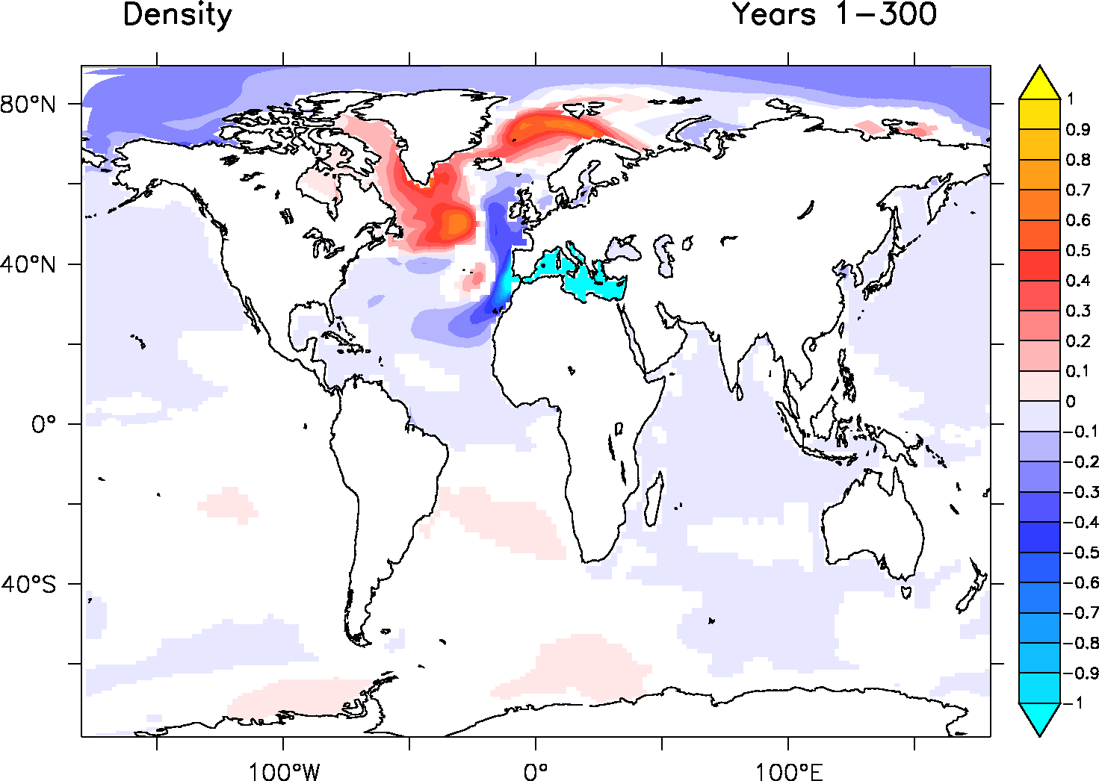
Oceanic response
Surface Density
Thermal wind balance

Slide 9
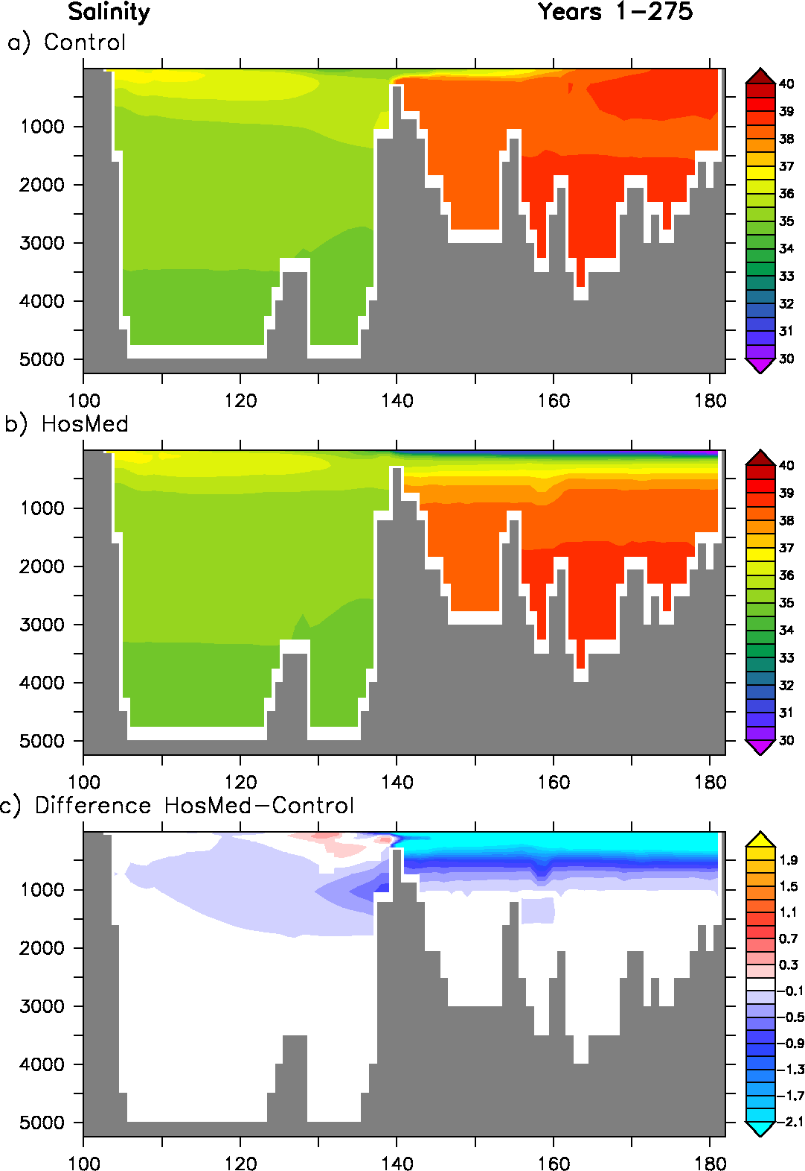
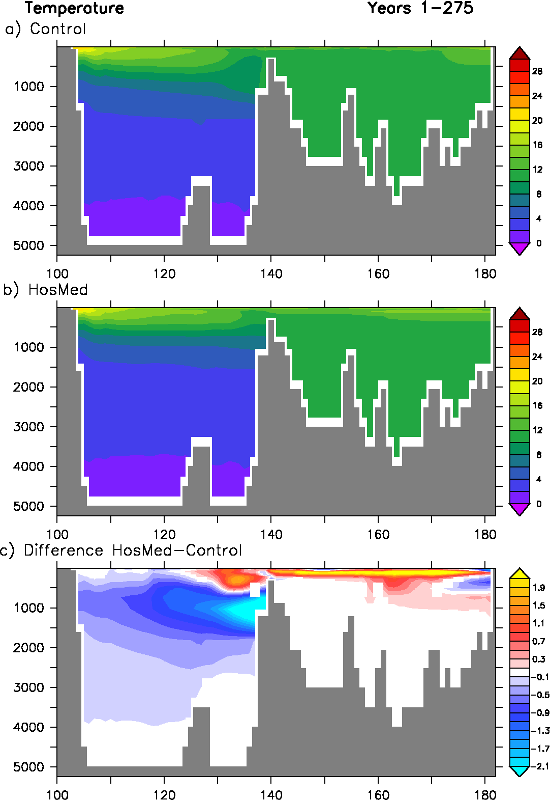
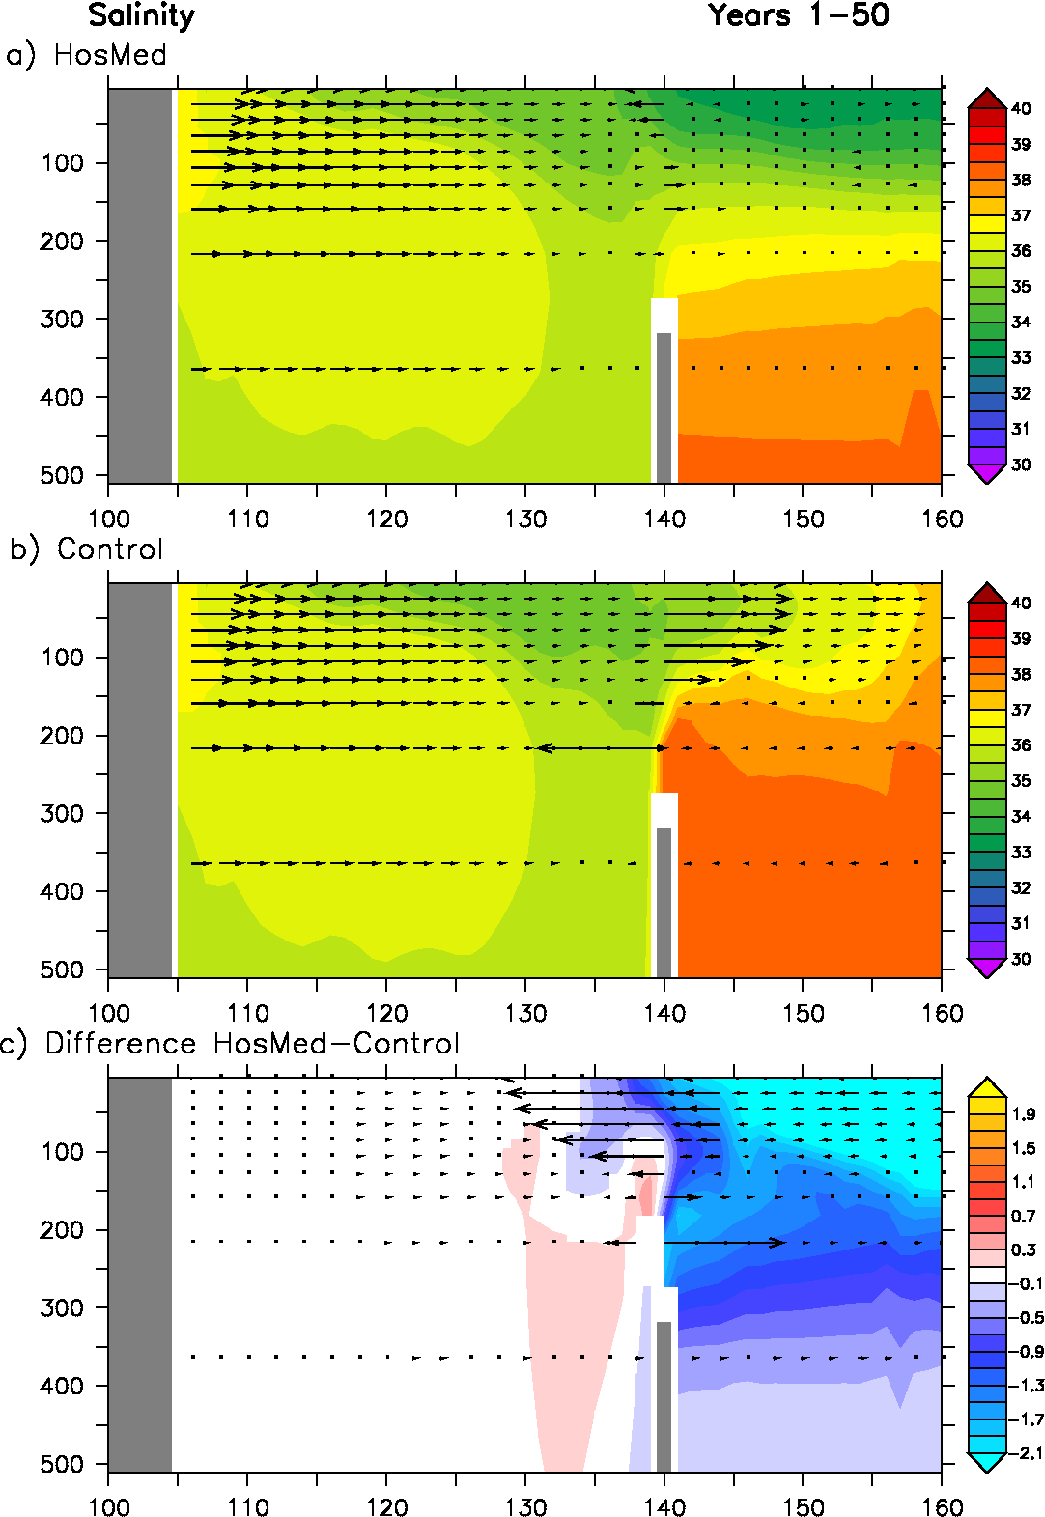
Zonal section along Gibraltar
Gibraltar
America
Méditerranean
Longitude
Longitude

Slide 10
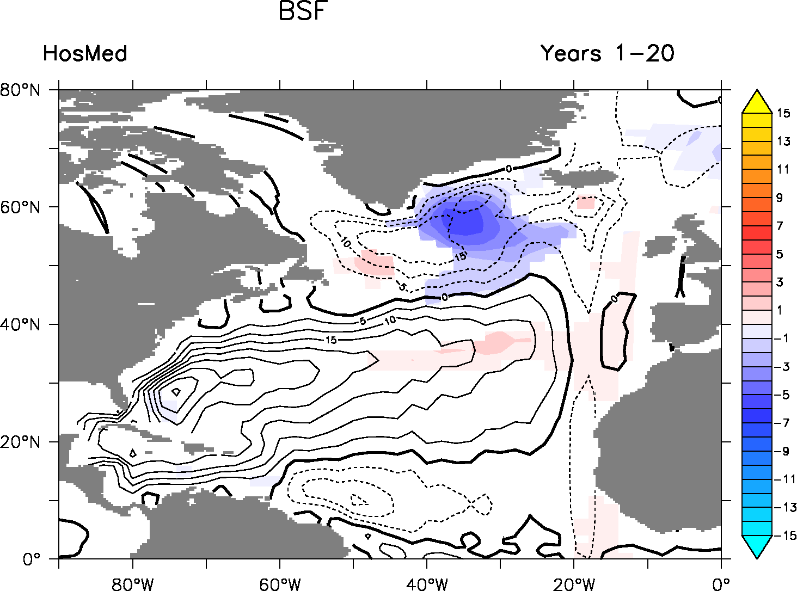
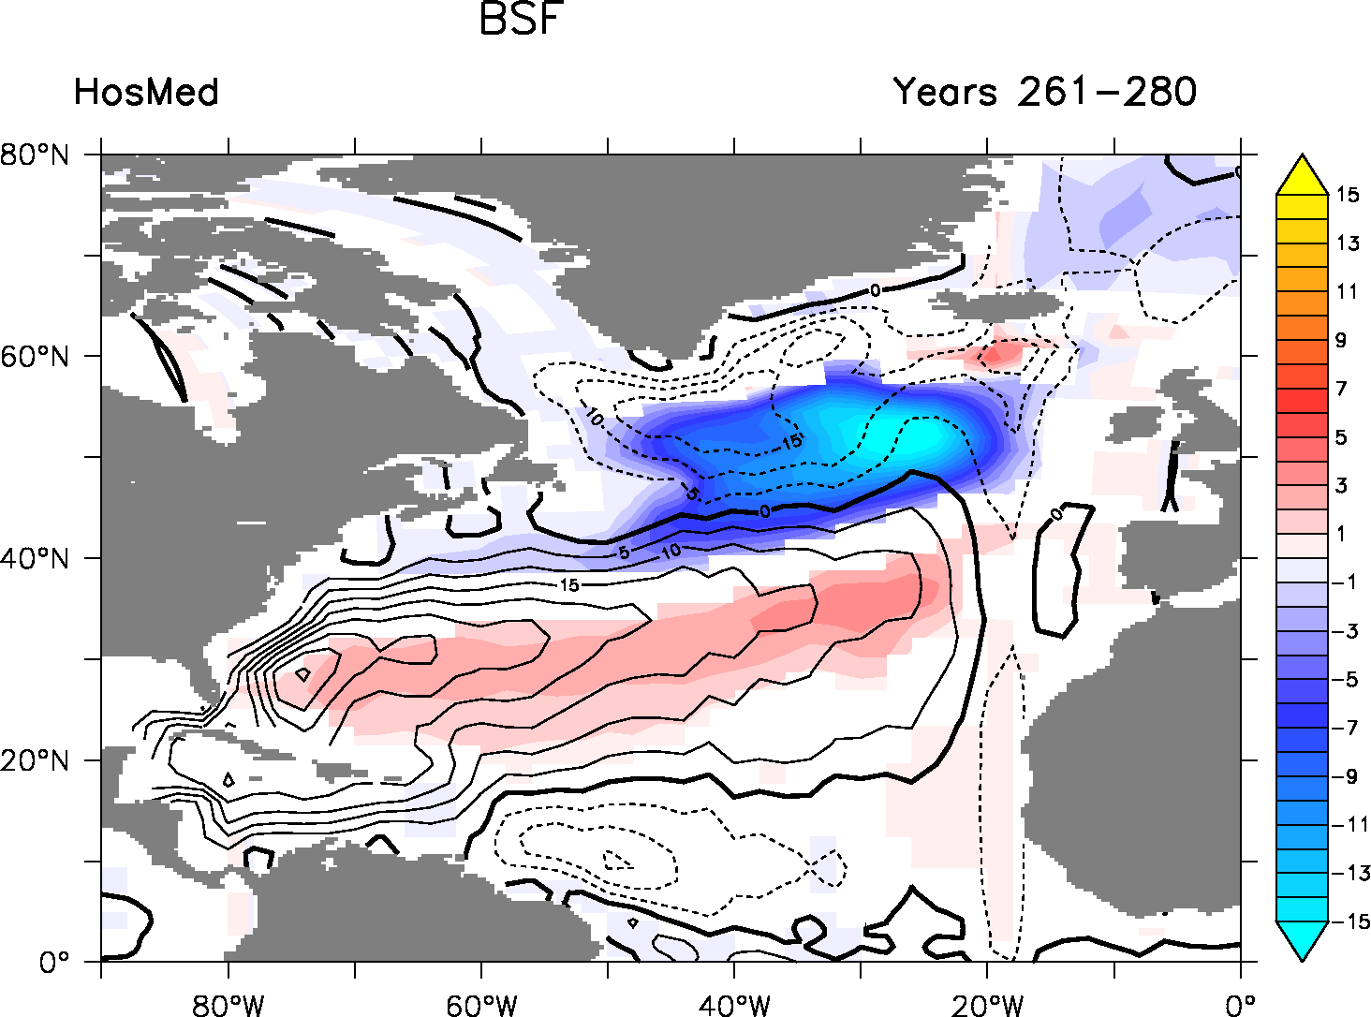
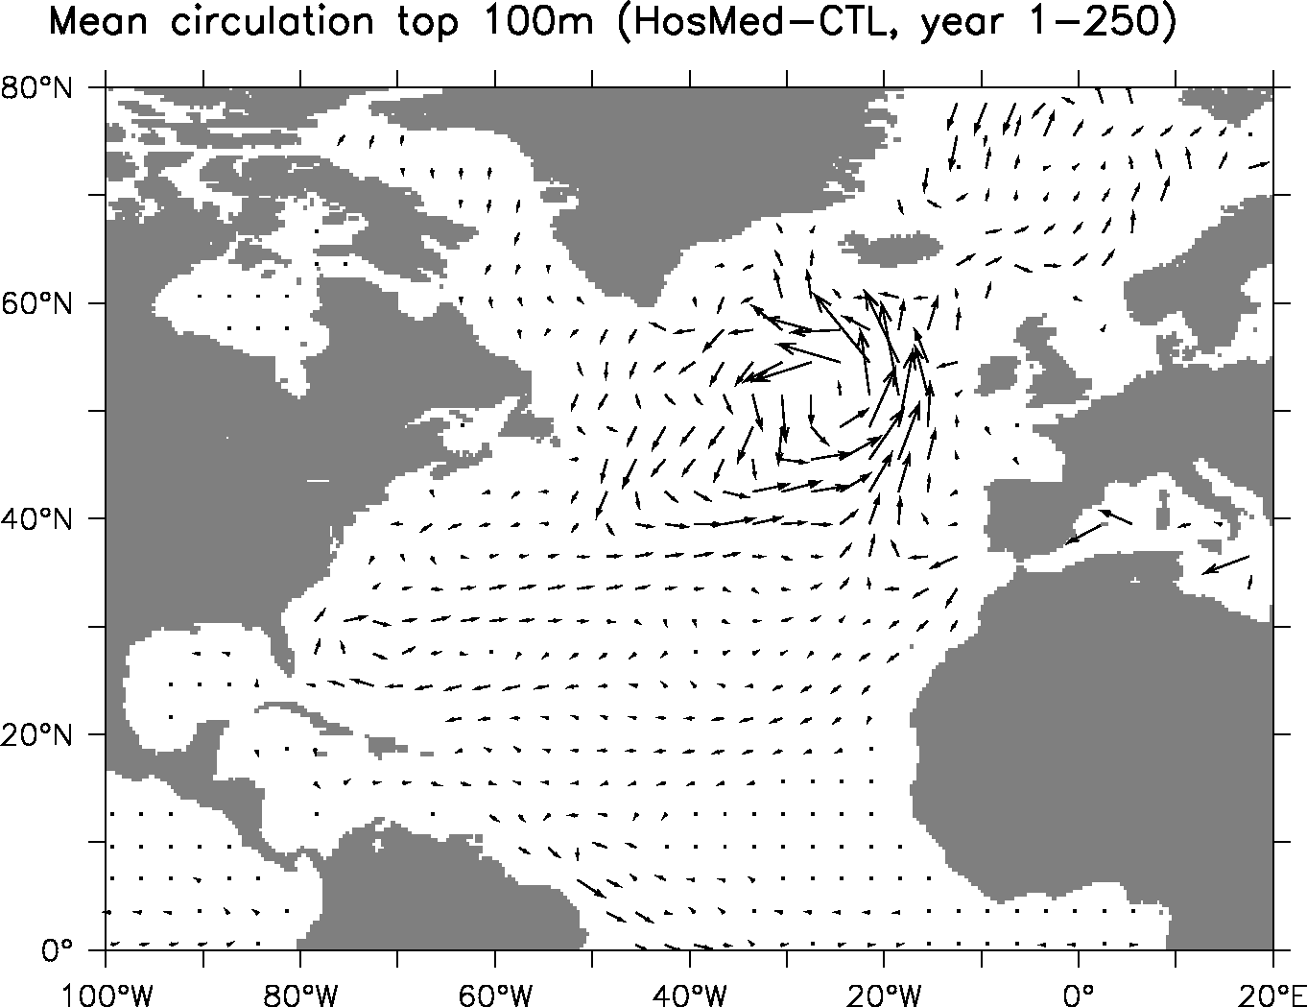
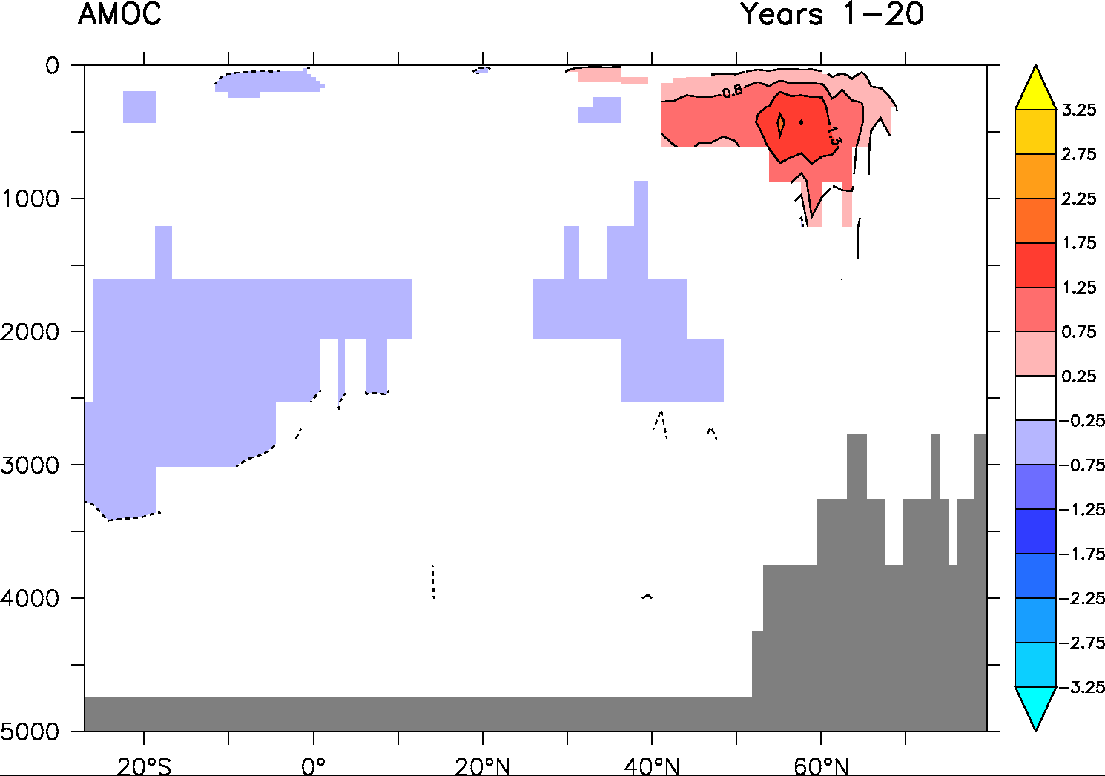
Ocean circulation changes
Barotropic streamfunction
Subpolar gyre is intensified
AMOC is increased in surface decreased in subsurface
Mean circulation top 100m (HosMed-CTL, year 1-300)

Slide 11
Two opposing mechanisms for AMOC
1) No MOW: direct impact on density distribution in the ocean
Lower zonal density gradient at depth (≈500-1500m)
Thermal wind relationship: weakened AMOC at depth
2) No MOW: impact on subtropical gyre geometry
Increased subtropical surface water transport in the North Atlantic
Increased surface salinity and convection in the North Atlantic
Increased AMOC and subpolar gyre

Slide 12
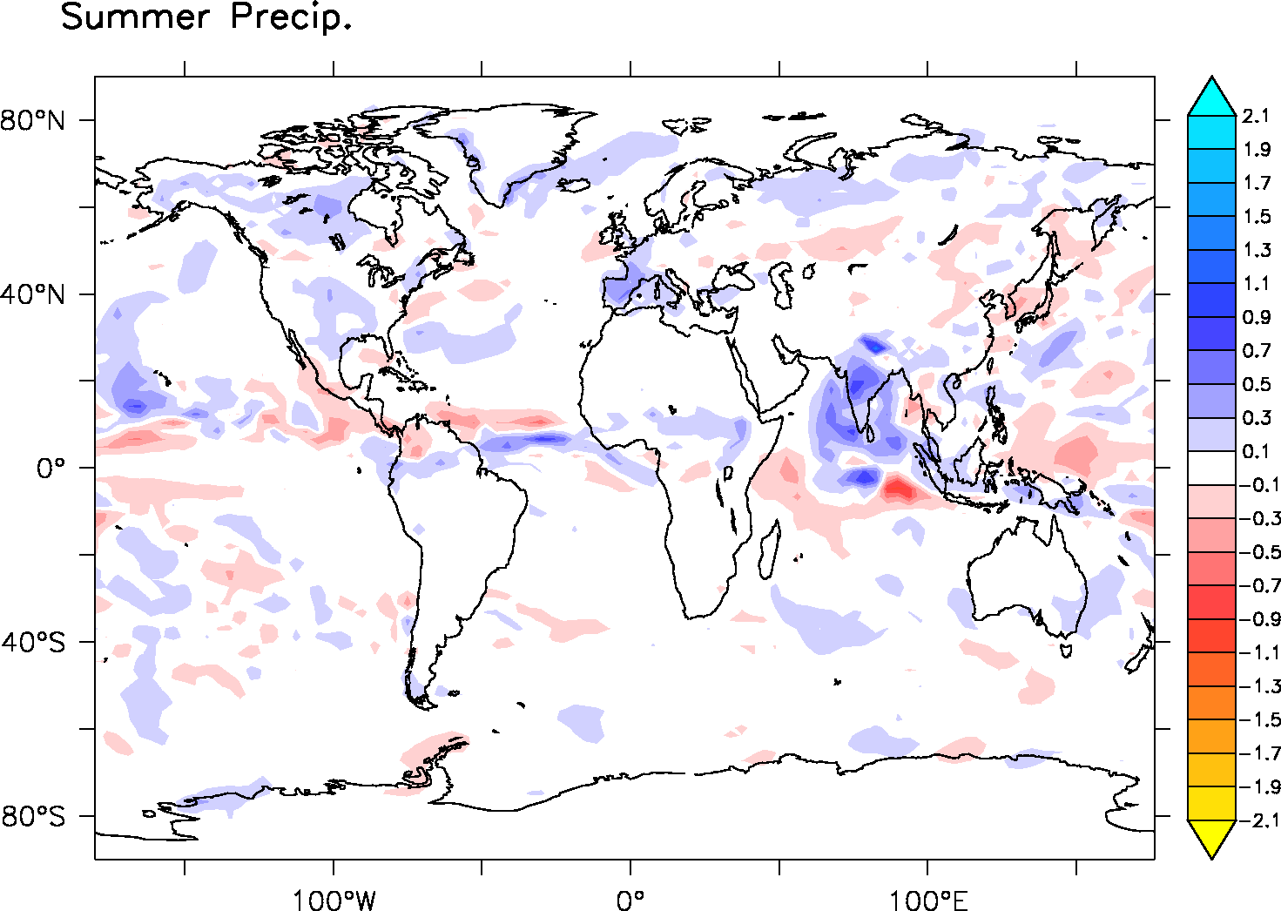
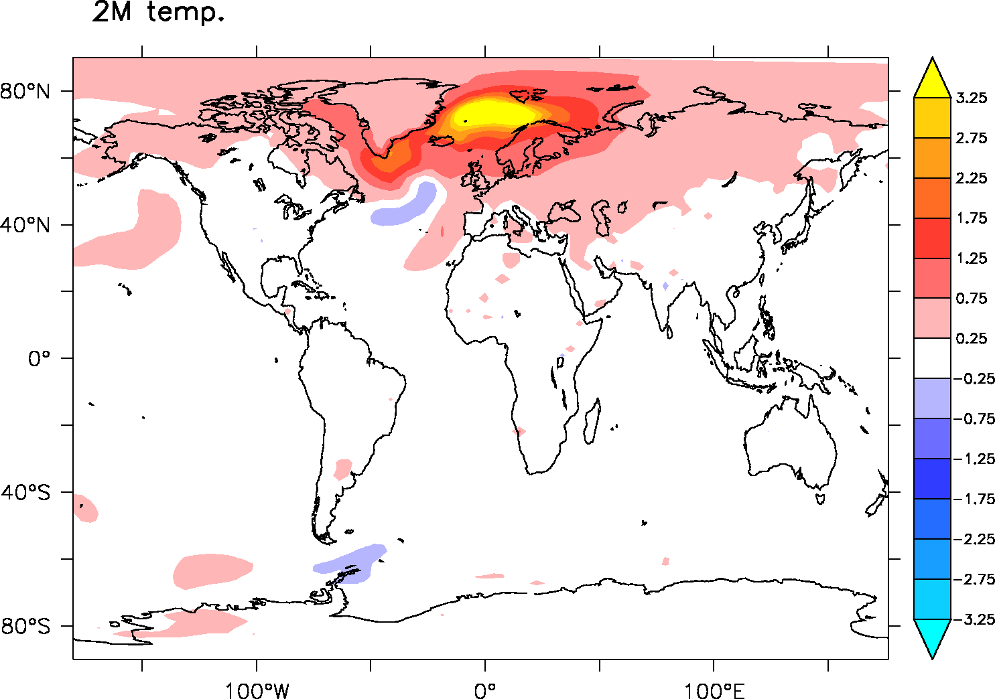
Climatic impact
HosMed – Control (Years 1-300)
+2%

Slide 13
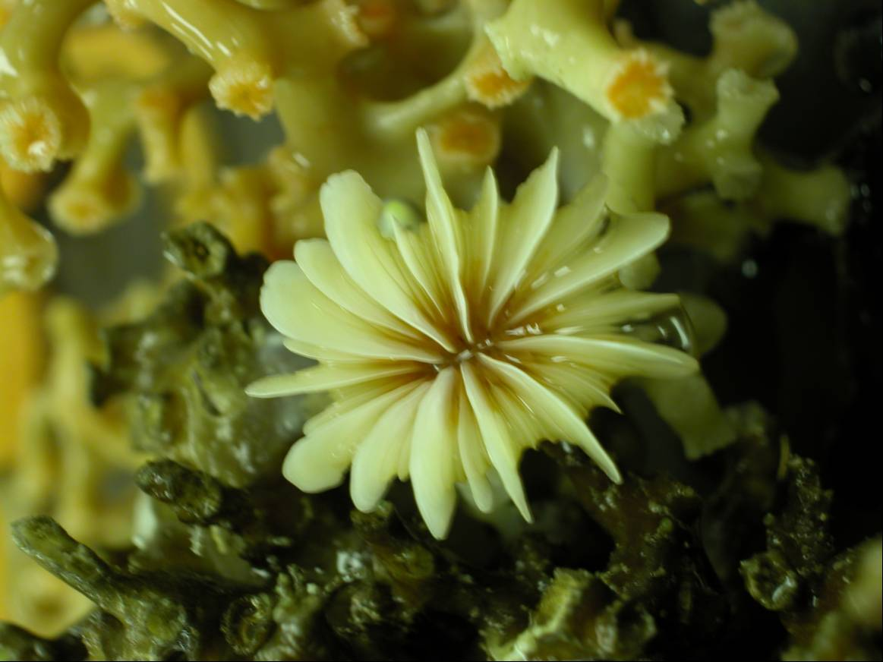
Perspective
Rockall coral ε_{Nd} data
Plateau de Rockall
LIA
Comparison with new data
Off-line simulation including tracers (ε_{Nd}, δ¹³C ) to allow better comparison
Longer simulation?
Higher resolution using OGCM (1/4°)
-11
STG
ε_{Nd}
-13
-15
Climatic Optimum
SPG
MCA
-17
10000
8000
6000
4000
2000
0
Age (ans) cal BP
8O°W
Colin et al. (2010); Copard et al. (2010, 2011, 2012); Montero-serrano et al. (2013)

Slide 14
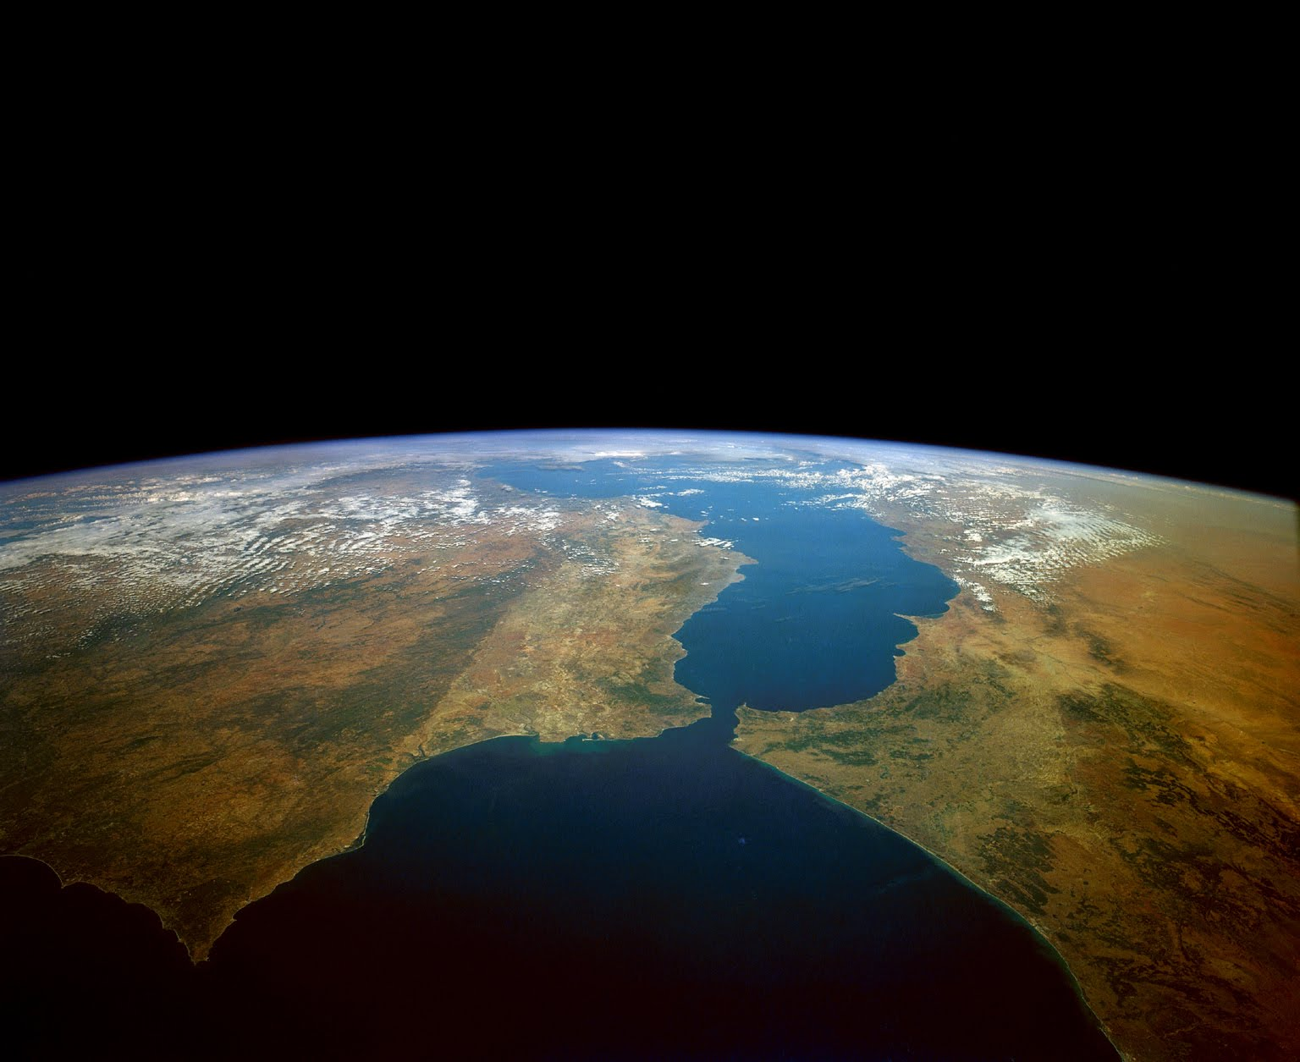
Thank you! didier.swingedouw@u-bordeaux1.fr

Slide 15
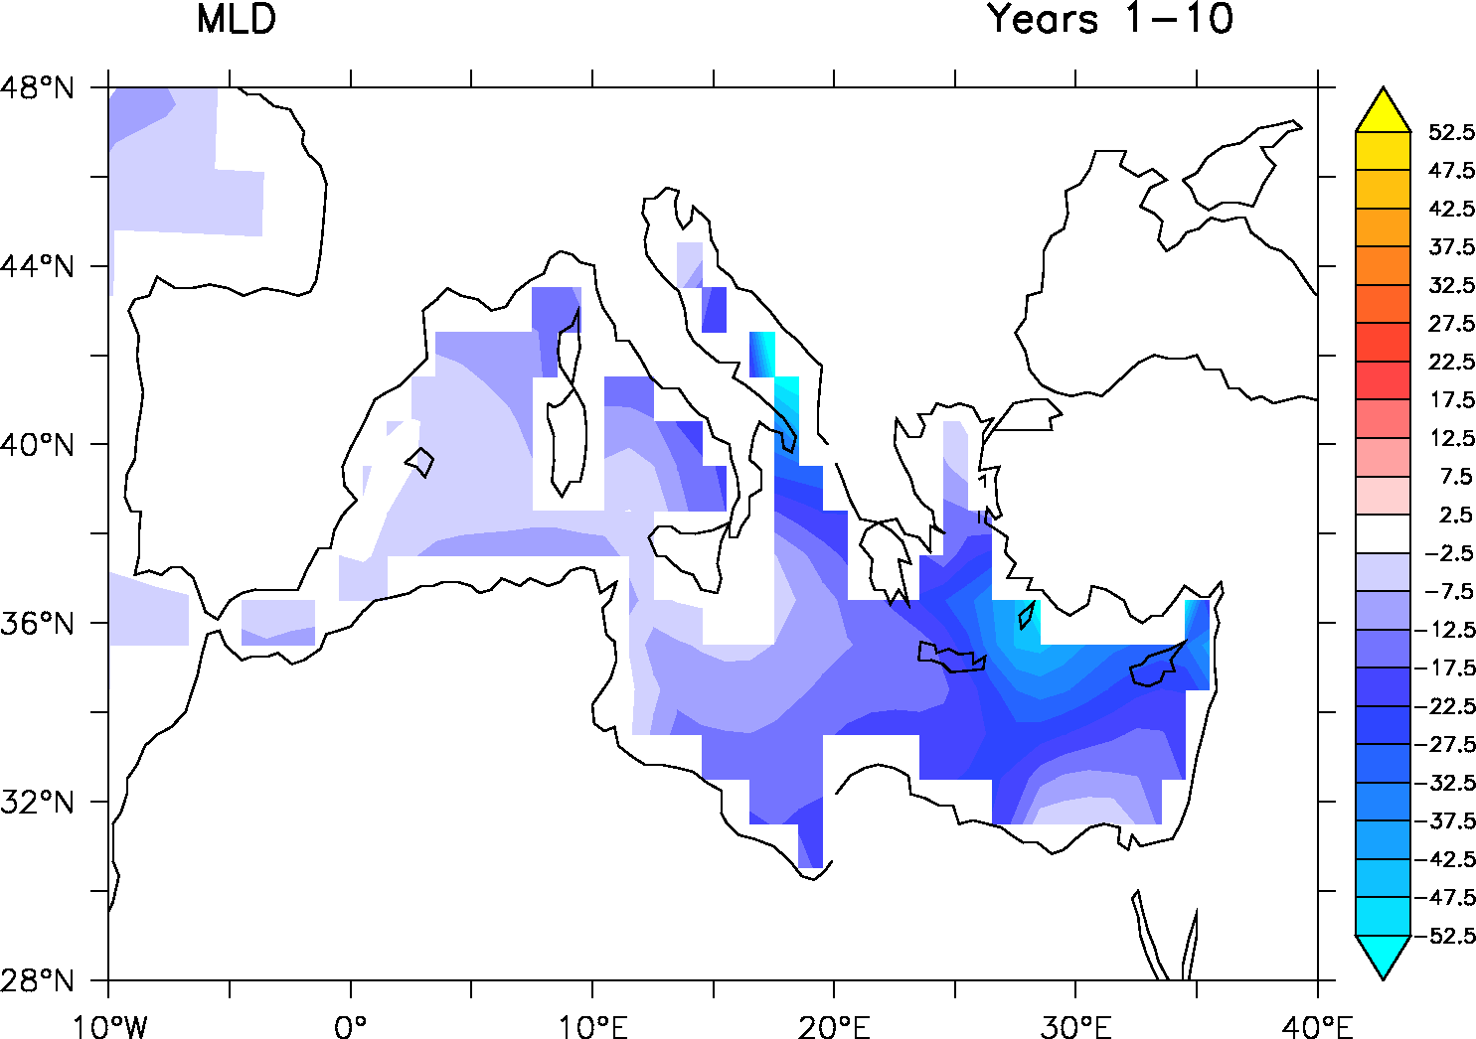
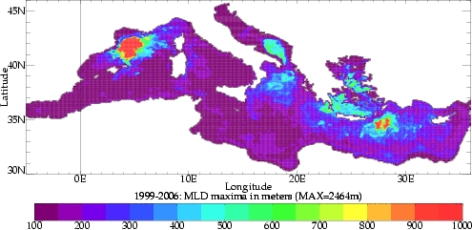
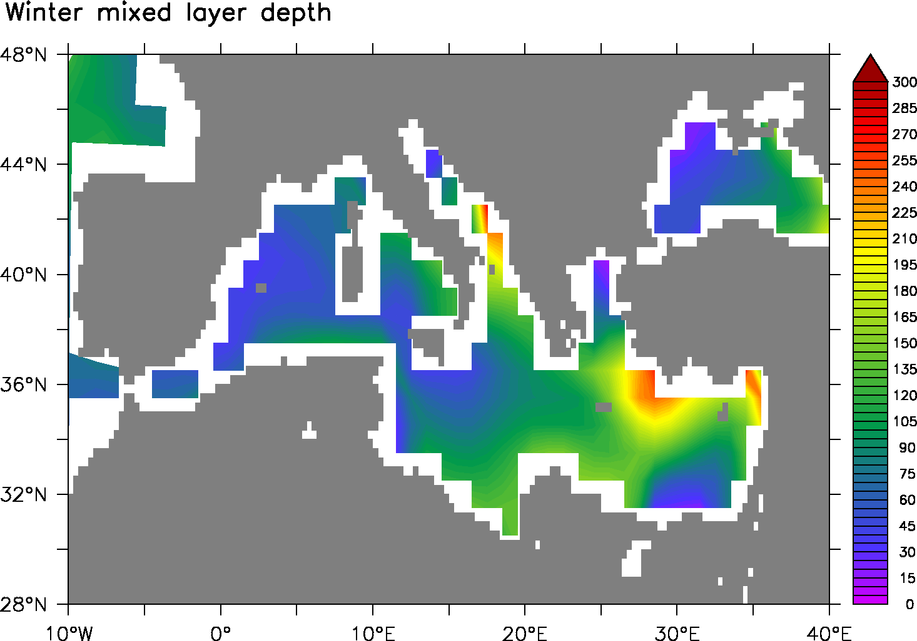
Mediterranean convection

Slide 16
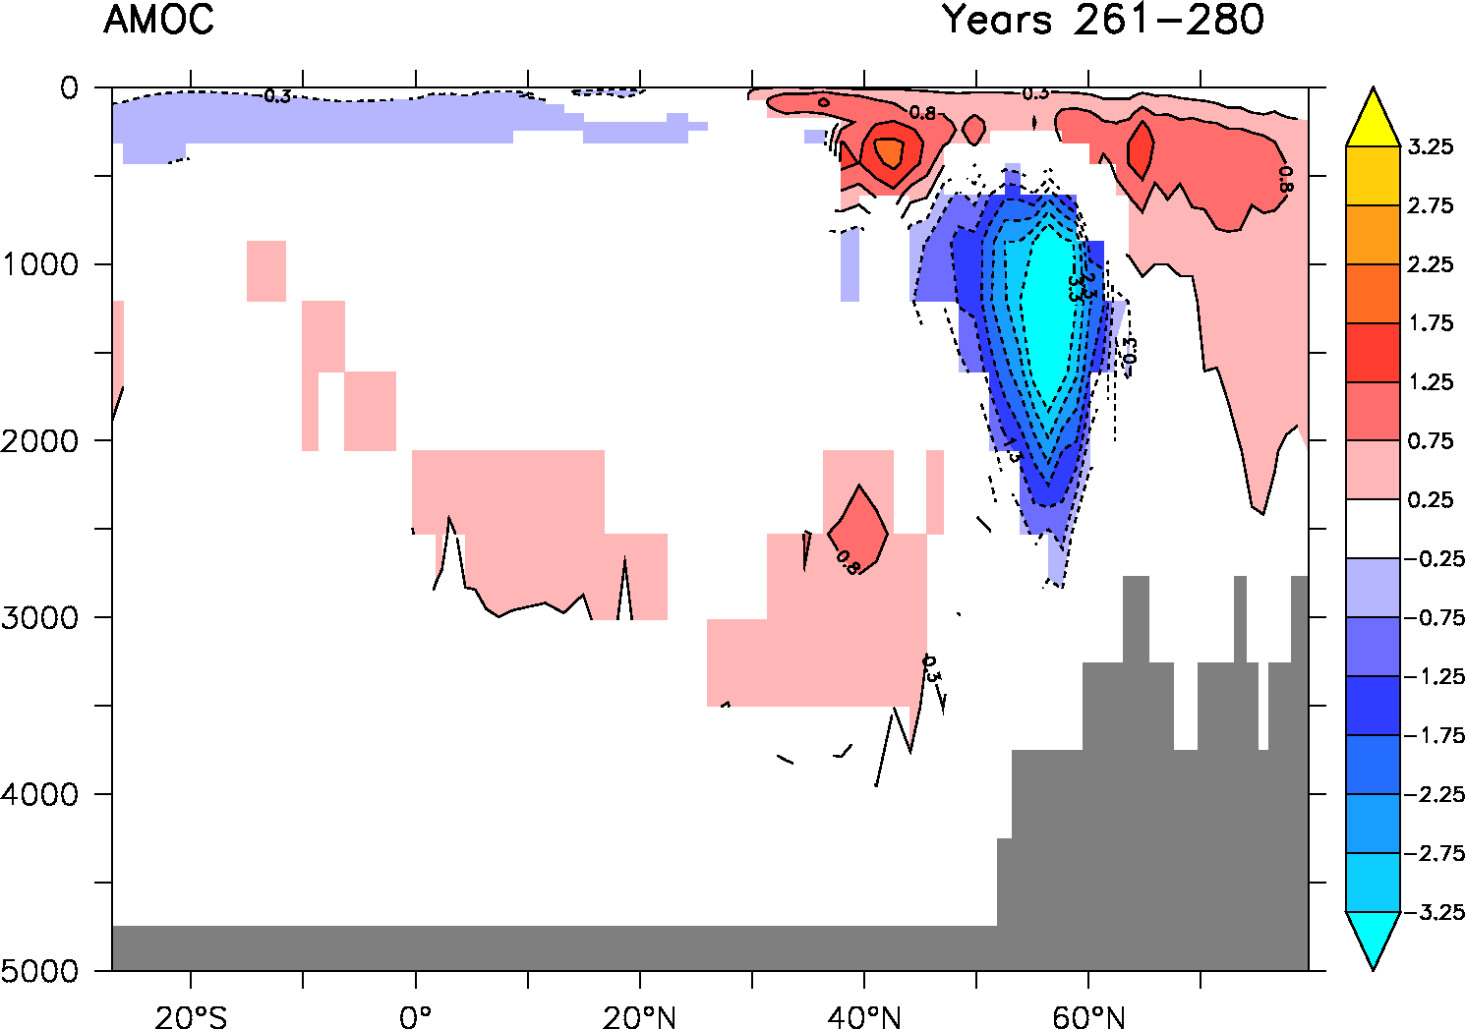
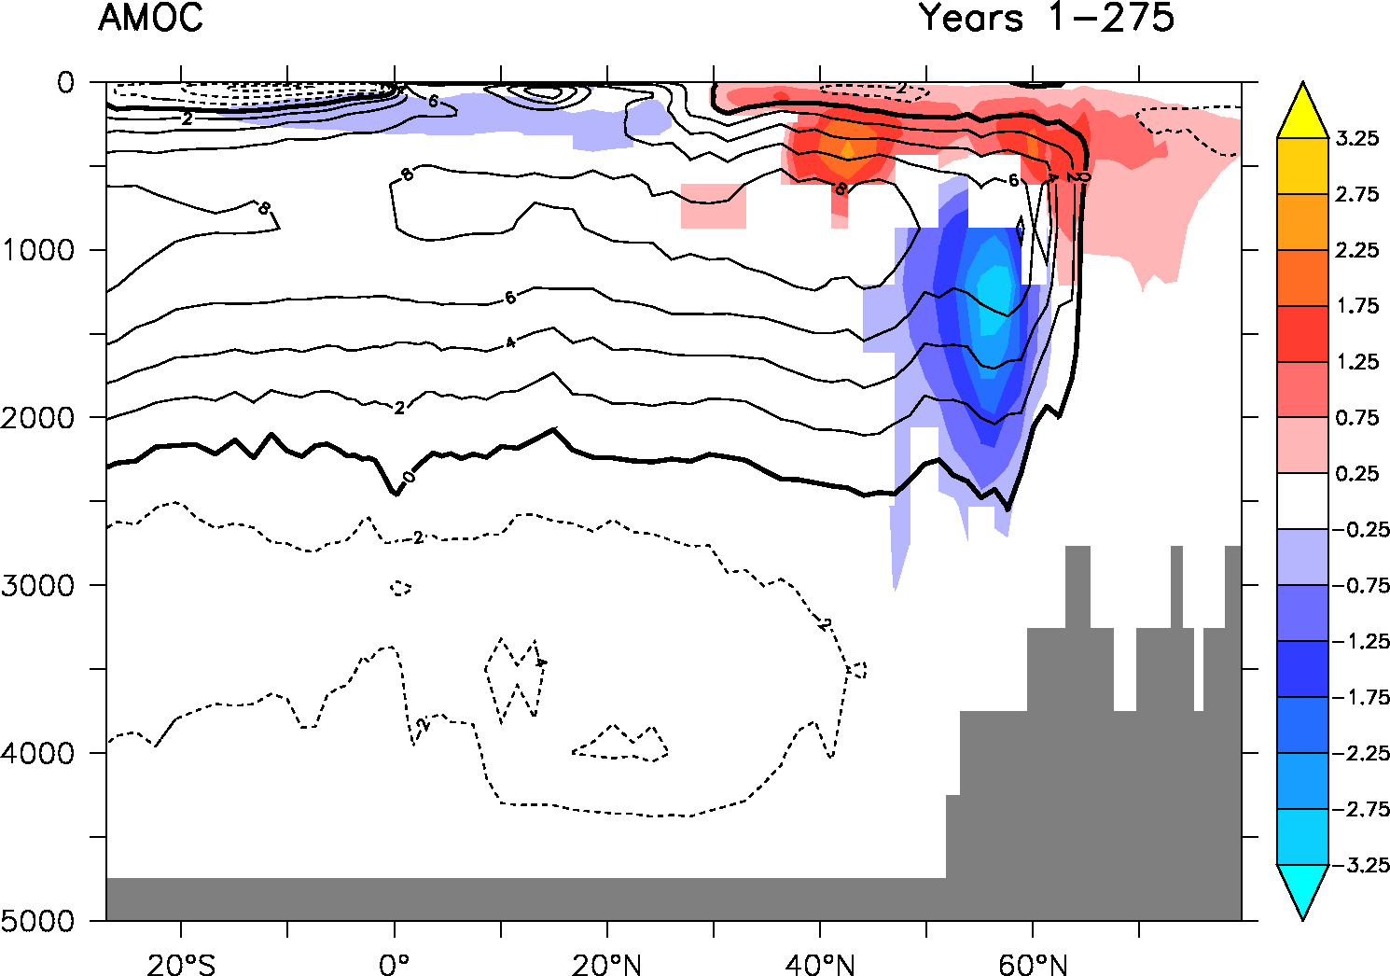
AMOC impact
Ivanovitch et al. 2013 (HadCM3, Halving Med salinity)
IPSL-CM5A-LR
Profondeur (m)
Latitude
A time scale issue?

Slide 17
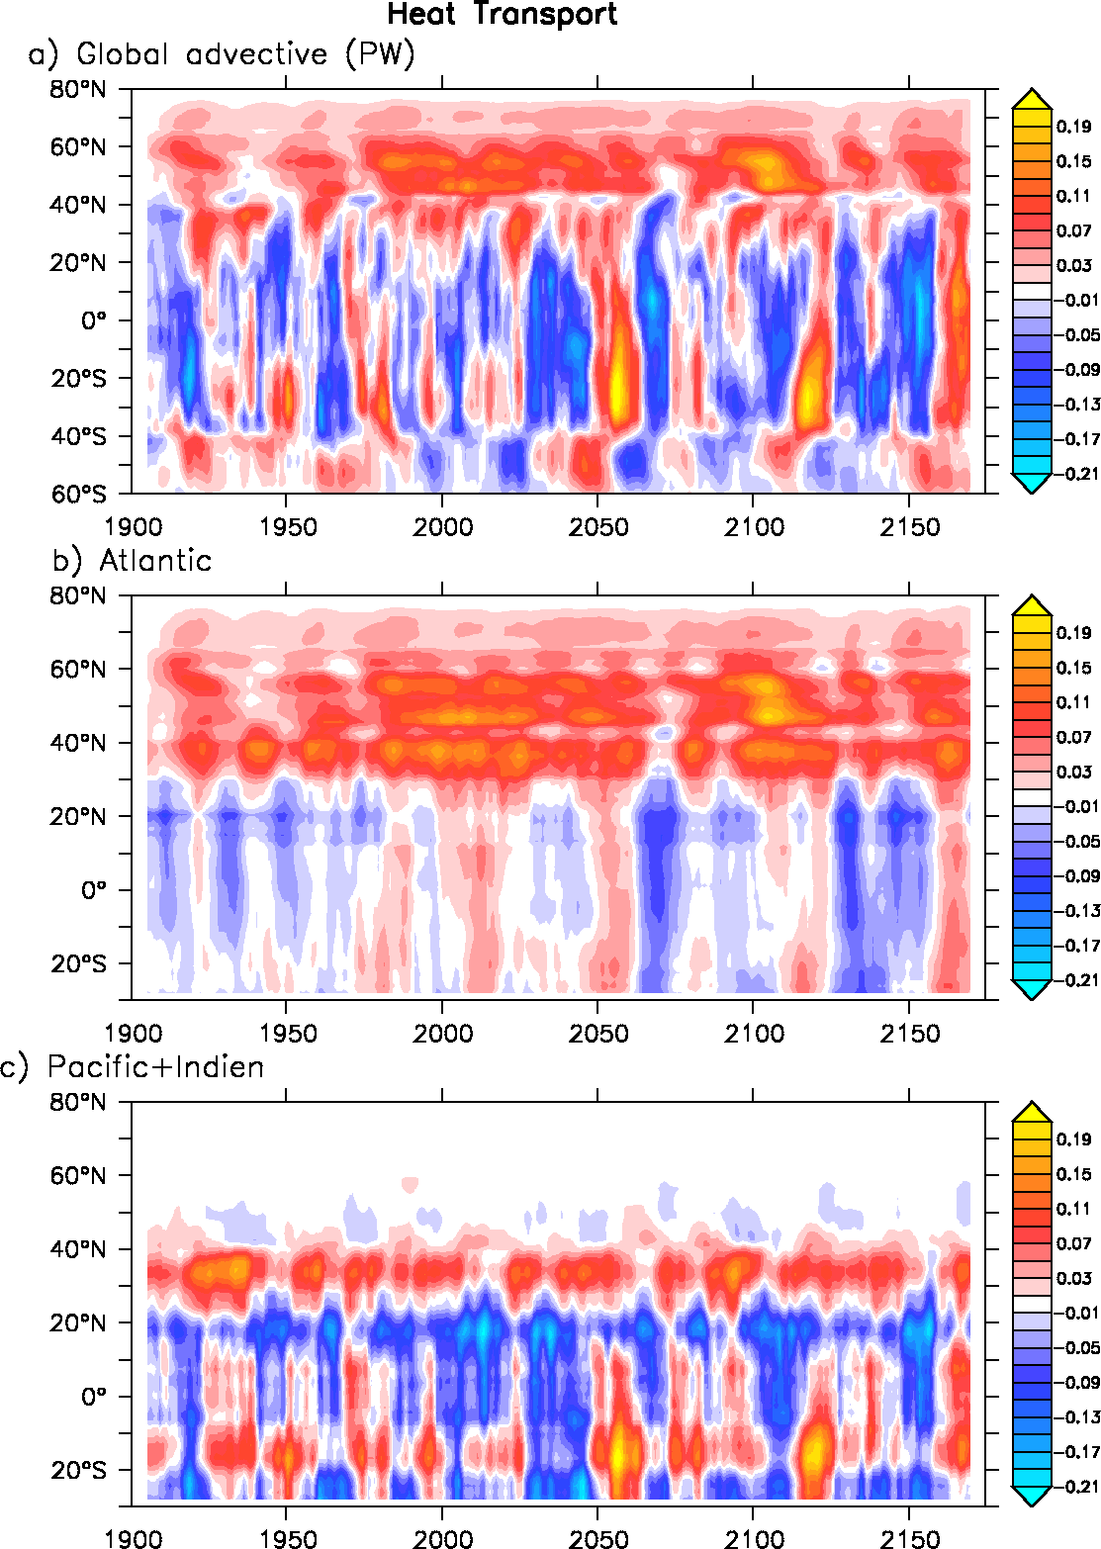
Heat transport changes

Slide 18
Gibraltar Strait parametrisation in NEMO
In climate modeling, it often occurs that a crucial connections between water masses is broken as the grid mesh is too coarse to resolve narrow straits. For example, coarse grid spacing typically closes off the Mediterranean from the Atlantic at the Strait of Gibraltar. In this case, it is important for climate models to include the effects of salty water entering the Atlantic from the Mediterranean. Likewise, it is important for the Mediterranean to replenish its supply of water from the Atlantic to balance the net evaporation occurring over the Mediterranean region.
This problem occurs even in eddy permitting simulations. For example, in ORCA 1/4°several straits of the Indonesian archipelago (Ombai, Lombok...) are much narrow than even a single ocean grid-point.
The methods that is be used in NEMO to handle such improperly resolved straits is by either artificially reducing the surface of the strait grid-cells or, locally increasing the lateral friction.

