Slide 1
Initialisation, predictability and future of the AMOC
Didier Swingedouw
Juliette Mignot, Romain Escudier, Sonia Labetoulle, Eric Guilyardi
Christian Rodehacke, Erik Behrens, Matthew Menary, Steffen Olsen, Yongqi Gao, Uwe Mikolajewicz, Arne Biastoch

Slide 2
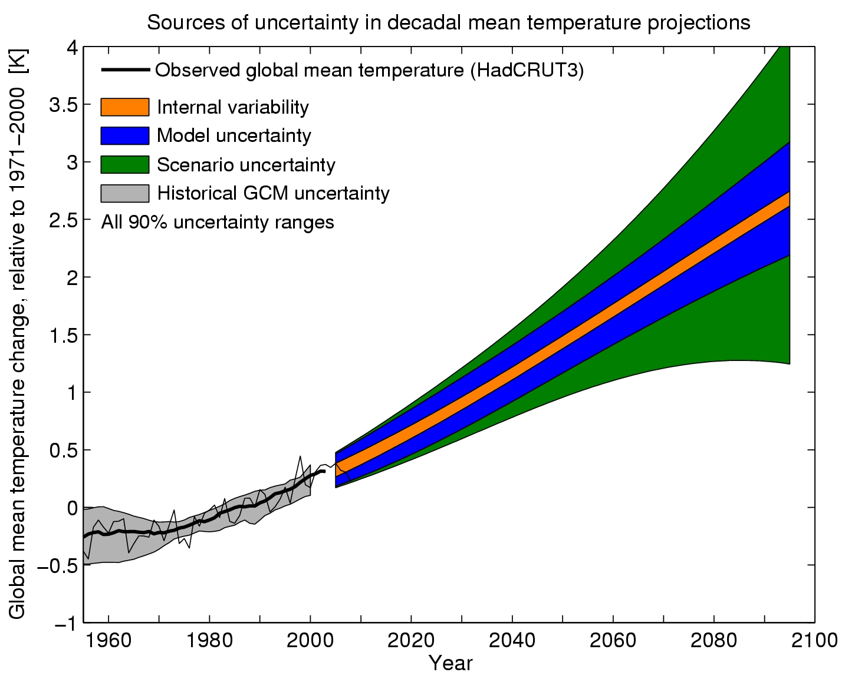
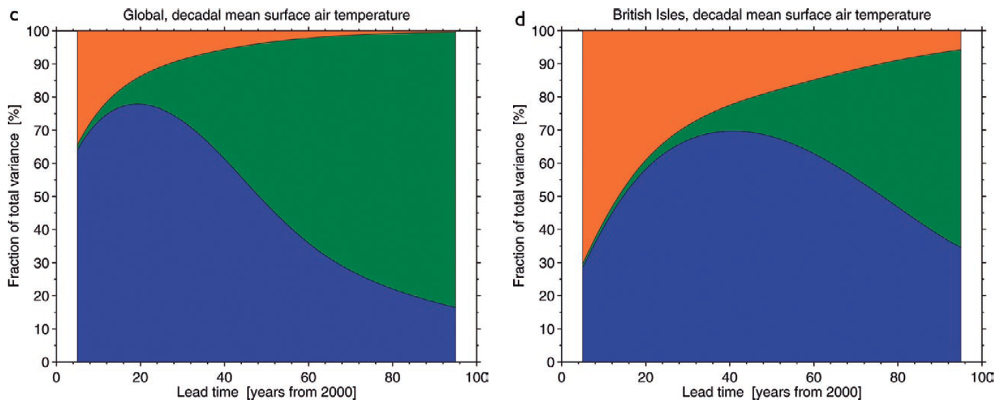
Uncertainty in future climate
Hawkins & Sutton 2009

Slide 3
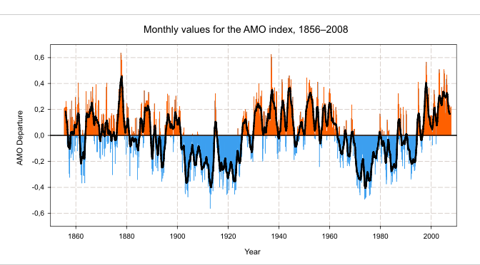
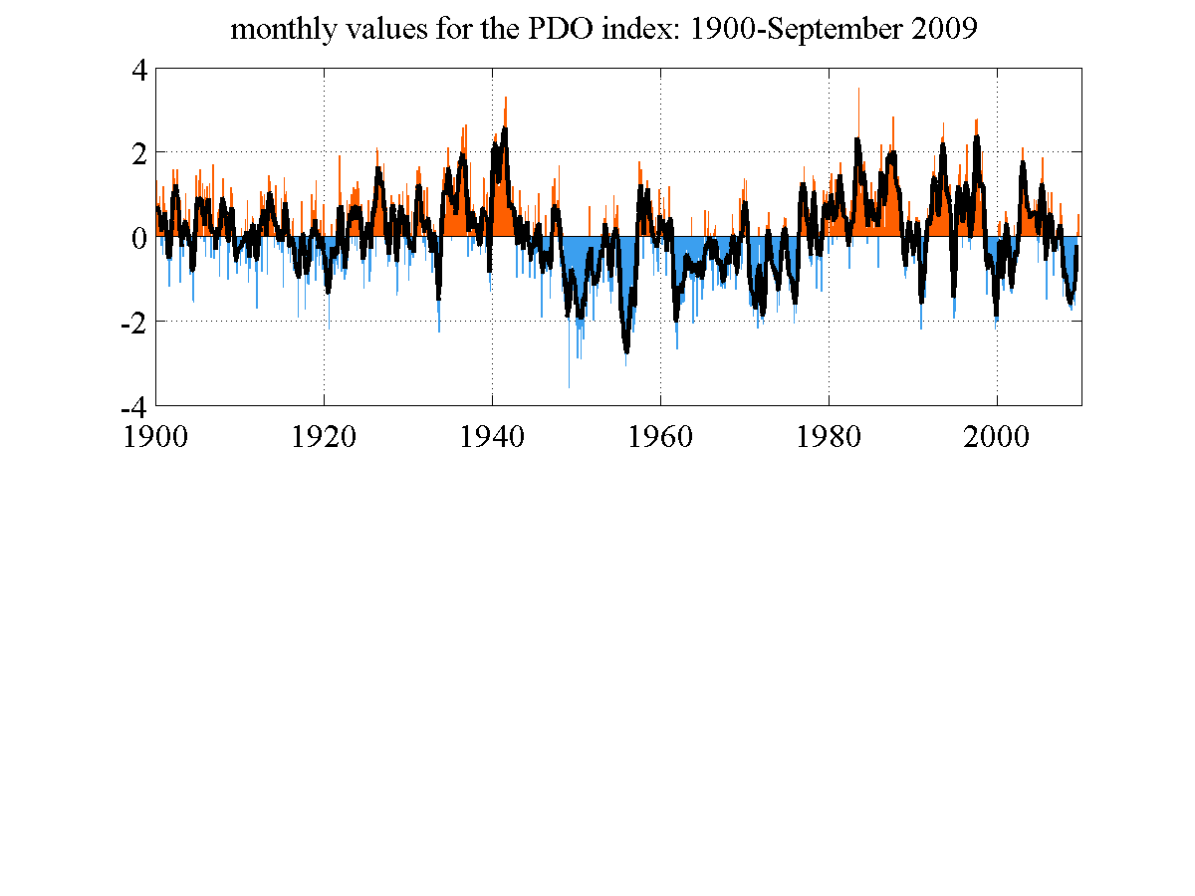
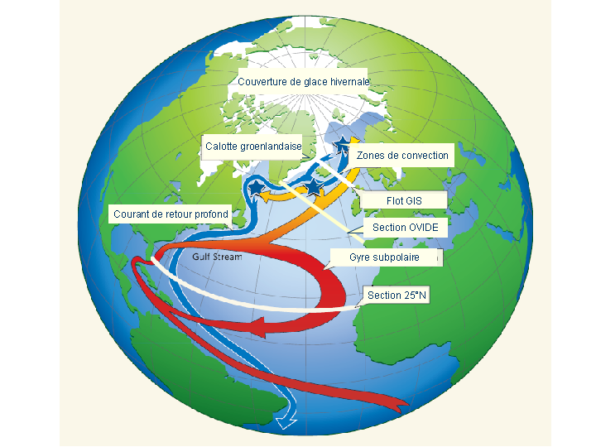
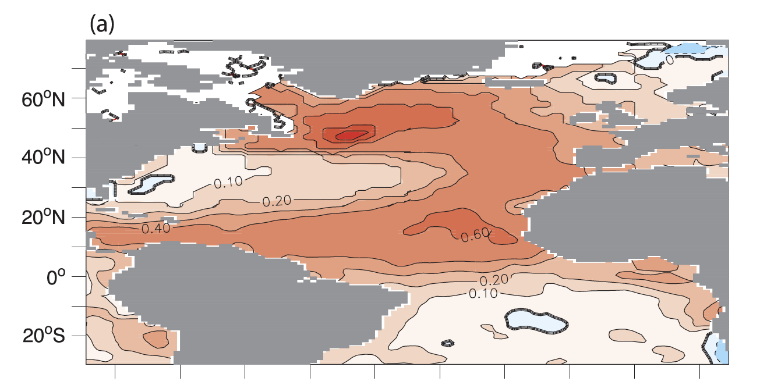
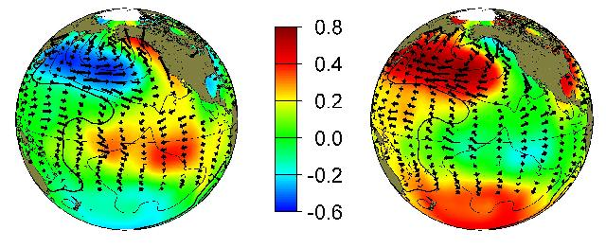
Mutidecadal variability
Atlantic Multi-decadal Oscillation
Pacific Decadal Oscillation
Notes:
The "Pacific Decadal Oscillation" (PDO) is a long-lived El Niño-like pattern of Pacific climate variability. While the two climate oscillations have similar spatial climate fingerprints, they have very different behavior in time. Fisheries scientist Steven Hare coined the term "Pacific Decadal Oscillation" (PDO) in 1996 while researching connections between Alaska salmon production cycles and Pacific climate (his dissertation topic with advisor Robert Francis). Two main characteristics distinguish PDO from El Niño/Southern Oscillation (ENSO): first, 20th century PDO "events" persisted for 20-to-30 years, while typical ENSO events persisted for 6 to 18 months; second, the climatic fingerprints of the PDO are most visible in the North Pacific/North American sector, while secondary signatures exist in the tropics - the opposite is true for ENSO. Several independent studies find evidence for just two full PDO cycles in the past century: "cool" PDO regimes prevailed from 1890-1924 and again from 1947-1976, while "warm" PDO regimes dominated from 1925-1946 and from 1977 through (at least) the mid-1990's. Shoshiro Minobe has shown that 20th century PDO fluctuations were most energetic in two general periodicities, one from 15-to-25 years, and the other from 50-to-70 years.
http://ingrid.ldeo.columbia.edu/%28/home/alexeyk/mydata/TSsvd.in%29readfile/.SST/.PDO/
Major changes in northeast Pacific marine ecosystems have been correlated with phase changes in the PDO; warm eras have seen enhanced coastal ocean biological productivity in Alaska and inhibited productivity off the west coast of the contiguous United States, while cold PDO eras have seen the opposite north-south pattern of marine ecosystem productivity.
Causes for the PDO are not currently known. Likewise, the potential predictability for this climate oscillation are not known. Some climate simulation models produce PDO-like oscillations, although often for different reasons. The mechanisms giving rise to PDO will determine whether skillful decades-long PDO climate predictions are possible. For example, if PDO arises from air-sea interactions that require 10 year ocean adjustment times, then aspects of the phenomenon will (in theory) be predictable at lead times of up to 10 years. Even in the absence of a theoretical understanding, PDO climate information improves season-to-season and year-to-year climate forecasts for North America because of its strong tendency for multi-season and multi-year persistence. From a societal impacts perspective, recognition of PDO is important because it shows that "normal" climate conditions can vary over time periods comparable to the length of a human's lifetime .

Slide 4
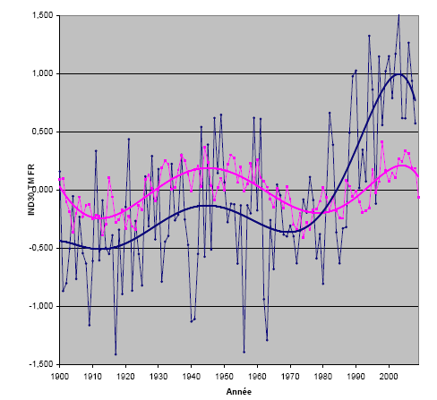
Regional climate variability
AMO index
Température moyenne sur 30 stations représentatives en France
Figure de Christophe Cassou

Slide 5
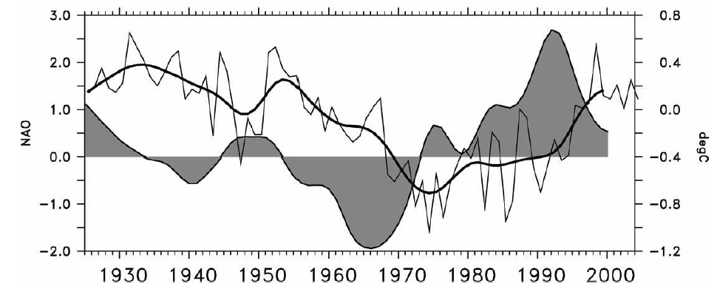
AMOC in the last decades
Latif et al. 2006: NAO forces the AMOC through heat flux in the Labrador Sea
Keenlyside et al. 2008: initialisation through SST anomalies allows to capture this mechanism
Other mechanisms in the North Atlantic? Salinity?
NAO and AMOC indexes (Latif et al. 2006)
NAO
AMOC (SST dipole)

Slide 6
What do we expect from initialisation?
Climatic index
Observations
Model free
Model initialised
Time
Assumptions:
Climatic oscillations correctly represented in model (frequency, amplitude)?
There exists ways to phase the two signals using coupled models?

Slide 7
Questions
Can we initialize the AMOC over the recent decades and why?
Does it induce any predictability of the climate?
Future? Impact of a Greenland freshwater release?

Slide 8
Outlook
Decadal variability of the AMOC in the IPSL-CM5
Initialisation of the AMOC in the IPSL-CM5
Predictability of climate in IPSL-CM5
Impact of Greenland melting on the AMOC: a multi-models evaluation

Slide 9
Outlook
Decadal variability of the AMOC in the IPSL-CM5
Initialisation of the AMOC in the IPSL-CM5
Predictability of climate in IPSL-CM5
Impact of Greenland melting on the AMOC: a multi-models evaluation

Slide 10
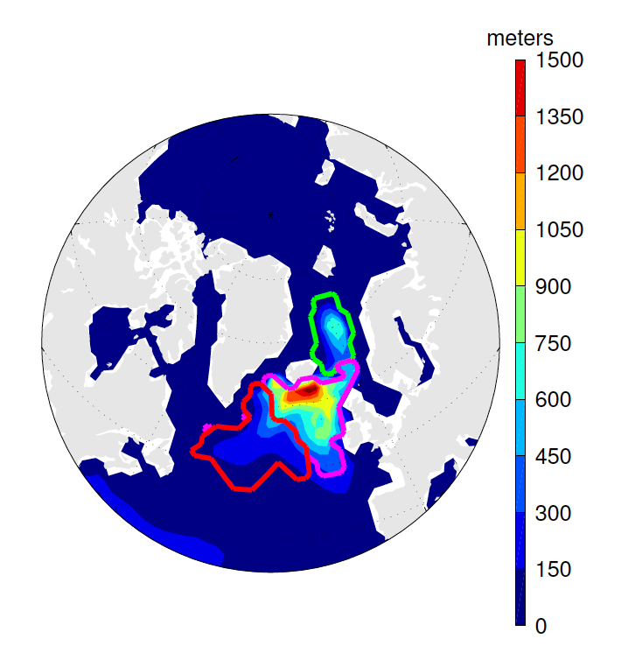
Tool: IPSL-CM5 coupled model
Mixed layer depth in JFM
Low resolution version of the model
  Ocean: NEMO-ORCA2 (149x182xL31)
  Atmosphere: LMDz (96x96xL39)
  Sea ice: Lim2
  Biogeochemistry in the ocean: PISCES
Important biases to be kept in mind
  Only 10.3 Sv of AMOC
  Almost no convection in the Labrador Sea

Slide 11
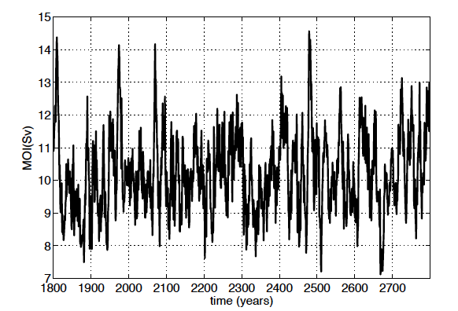
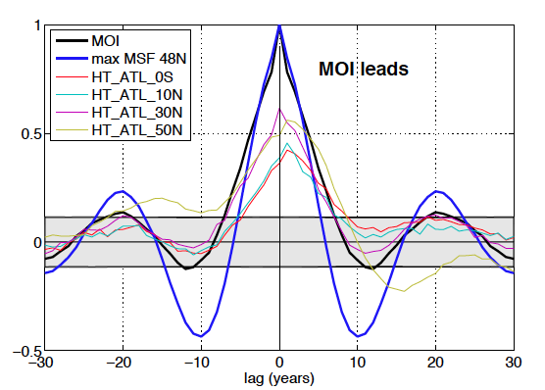
Decadal variability in the IPSL-CM5 model
1000 years AMOC max (preind. simulation)
  20-year cycle for the AMOC
  Impact on the ocean heat transport at different latitudes in the Atlantic Ocean
Cross-correlation with AMOC max.
Escudier et al. sub.

Slide 12
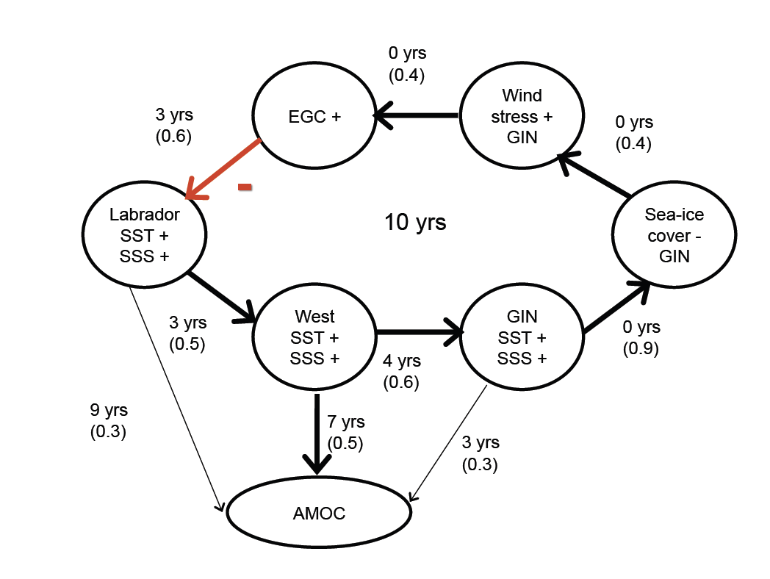
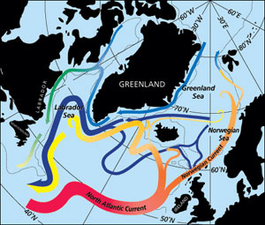
20-yr cycle mechanisms
Escudier et al. sub.

Slide 13
20-yr cycle mechanisms

Slide 14
20-yr cycle mechanisms

Slide 15
20-yr cycle mechanisms

Slide 16
20-yr cycle mechanisms
Low

Slide 17
20-yr cycle mechanisms
Low

Slide 18
20-yr cycle mechanisms

Slide 19
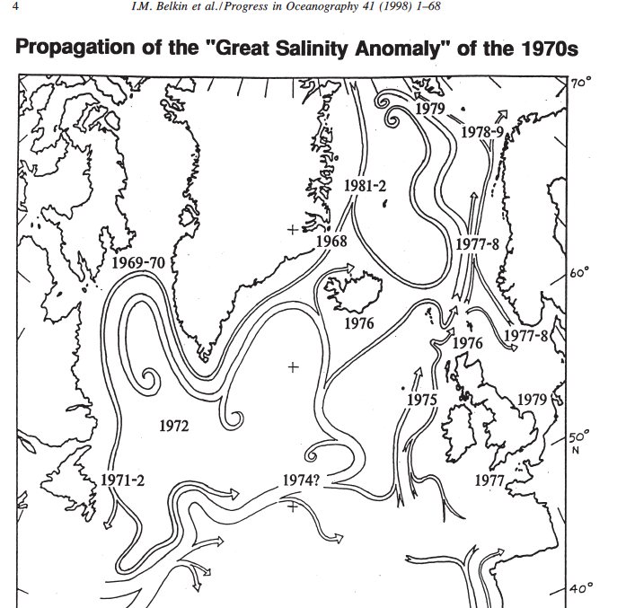
Agreement with GSAs anomalies?

Slide 20
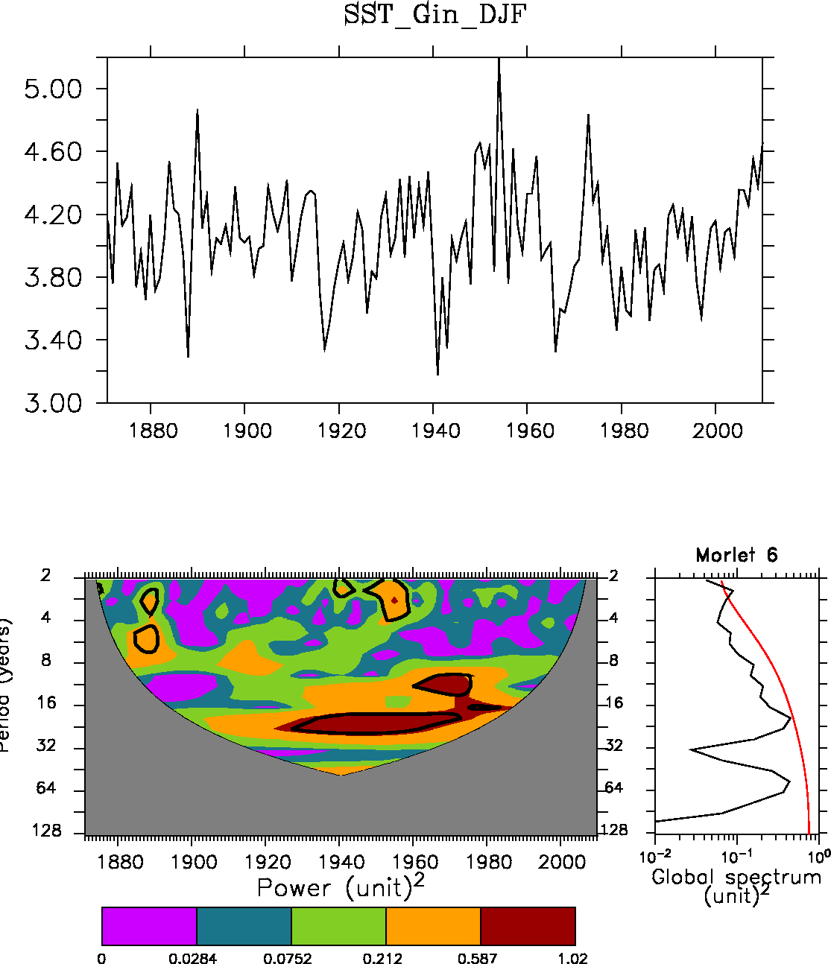
A 20-yr cycle in the subpolar gyre?
DJF SST in GIN Seas (HadISST)
20-yr variability in the GIN Seas in HadISST
Also present in 1000 yrs data from Greenlandic cores (Chylek et al. 2011) and marine core north of Iceland (Sicre et al. 2008)
We assume that this cycle is not totally unrealisitic in the real ocean
Step 2: can we phase observed and modeled AMOC?

Slide 21
Outlook
Decadal variability of the AMOC in the IPSL-CM5
Initialisation of the AMOC in the IPSL-CM5
Predictability of climate in IPSL-CM5
Impact of Greenland melting on the AMOC: a multi-models evaluation

Slide 22
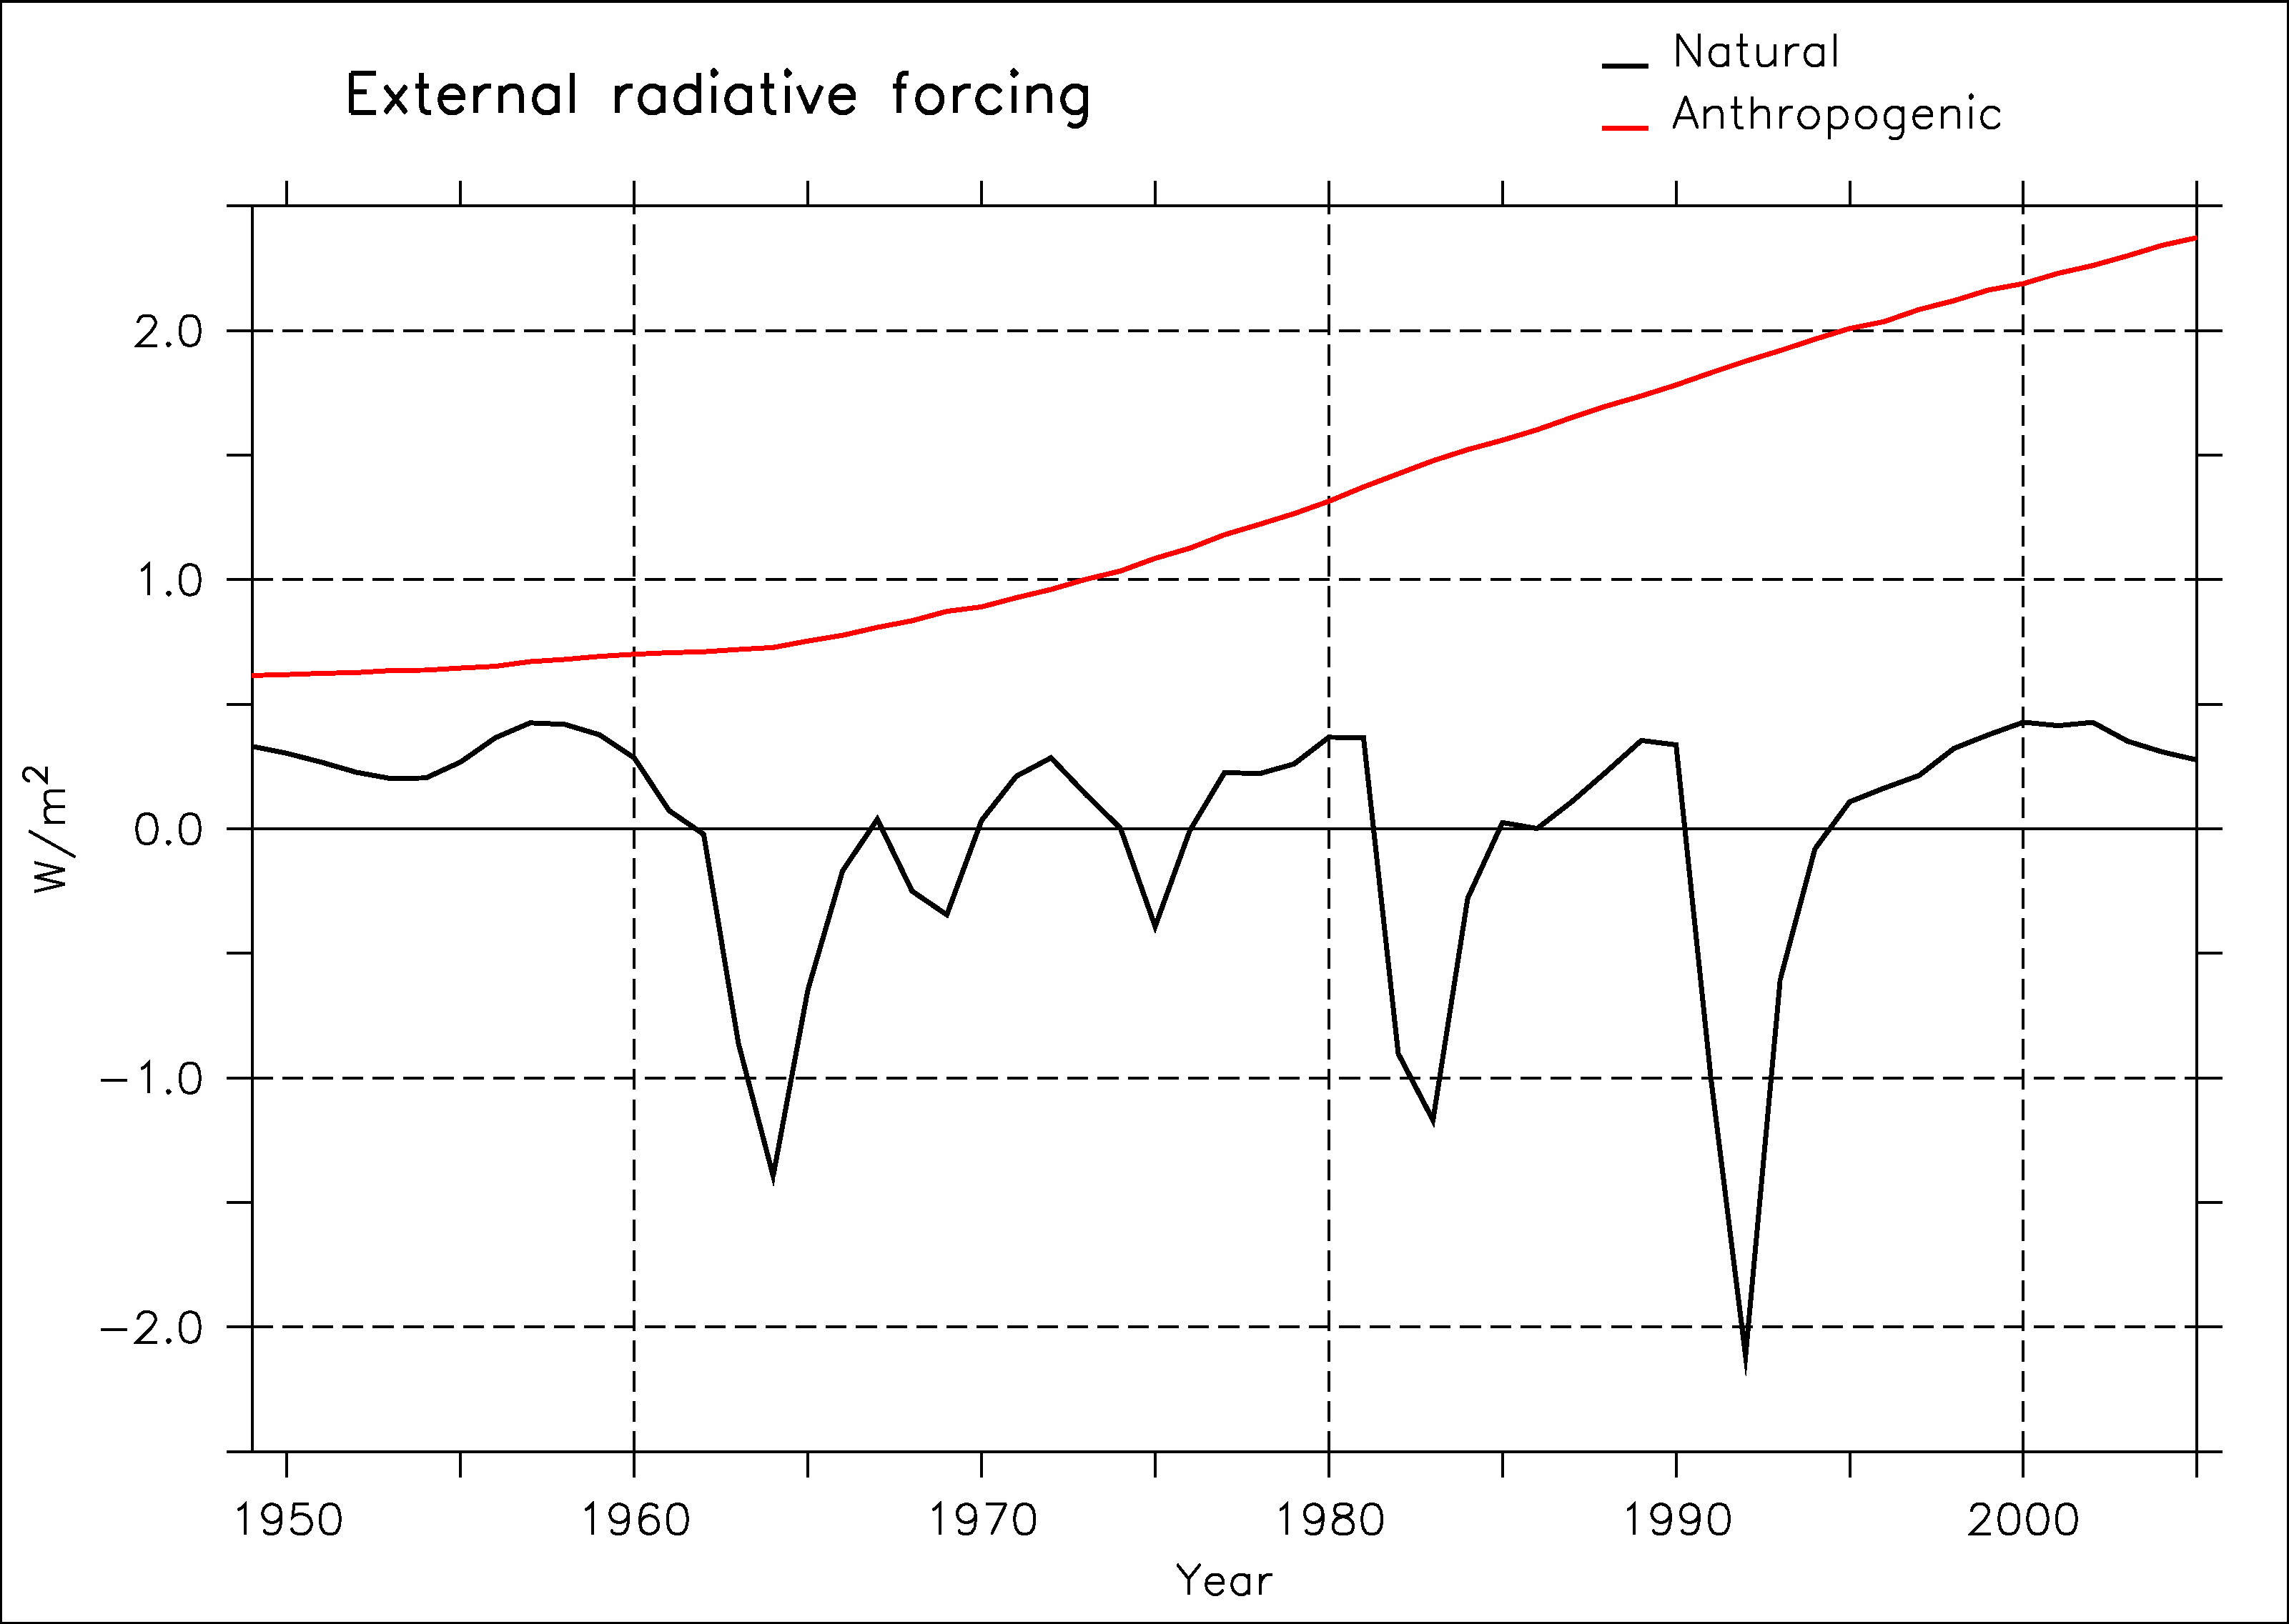
Experimental design
We initialise the IPSL-CM5 with SST anomalies (Reynolds et al. 2007) superimposed on each historical simulation over the period 1949-2005: 5-members ensemble (different initial conditions)
With one of the initialised members, we launch a 3-members ensemble every 5 years (with white noise on SST)
We include historical radiative forcing
Agung
Pinatubo
El Chichon

Slide 23
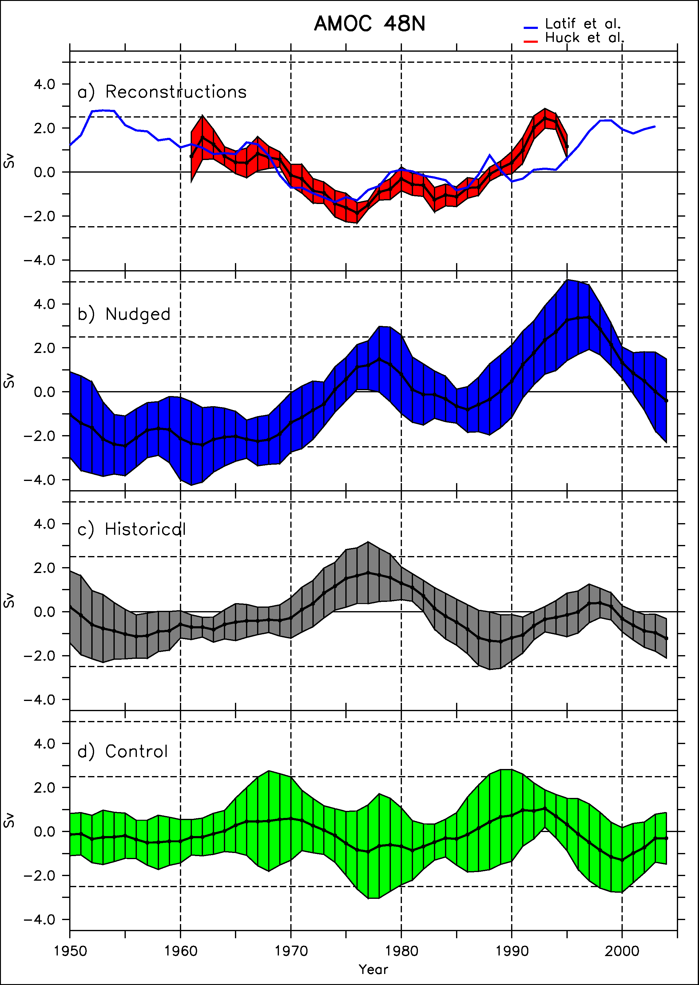
AMOC Initialisation
Reconstruction
Obs. (Huck et
Nudged
Reconstruction of the AMOC using NODC hydrographic data (Huck et al. 2008)
5-member ensemble of nudged simulations and control-historical ones
5-member historical simulations
Agreement apart from 1975
Historical
Control

Slide 24
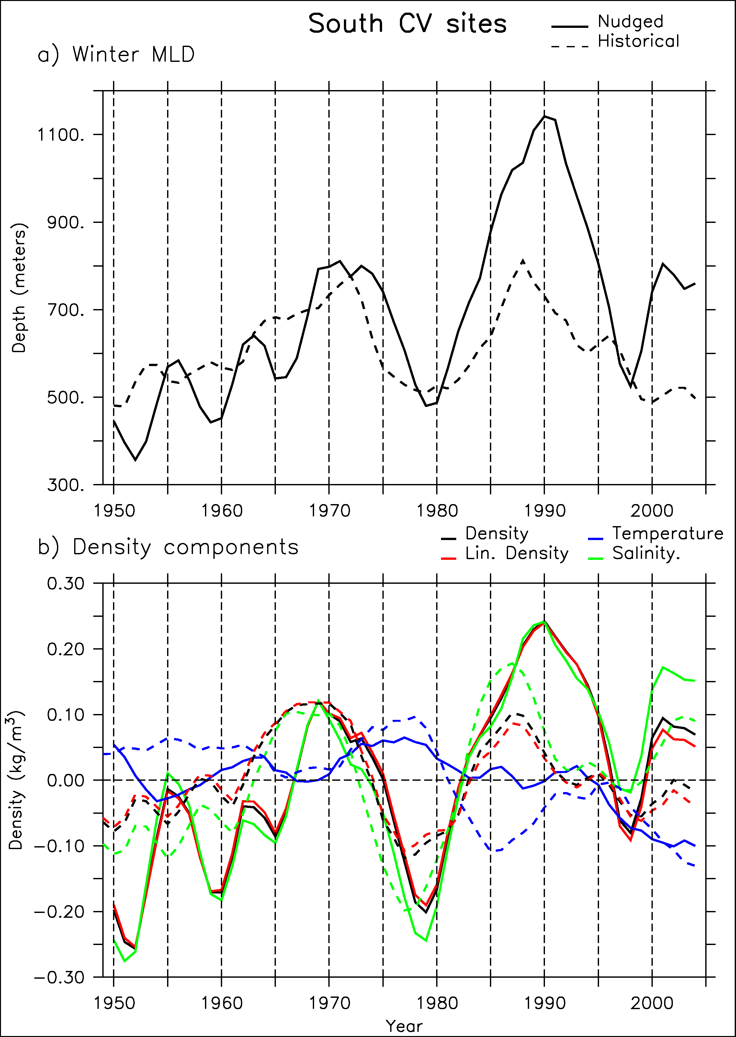
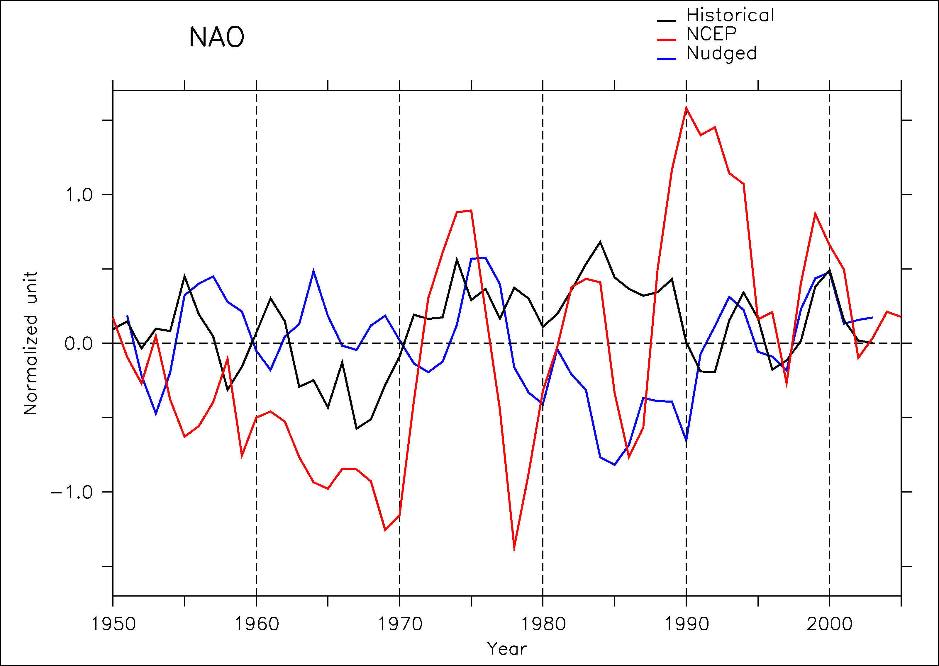
CV sites response
Convection sites explain AMOC variations
Notes:
ce n’est pas la SST mais la SSS qui drive
On ne force pas l’evap et les precip via les SST
origine ano SSS advective à partir du Labrador cf. cycle de Romain
i.e on force la sea ice via la SST en GIN, qui « cale » le cycle

Slide 25
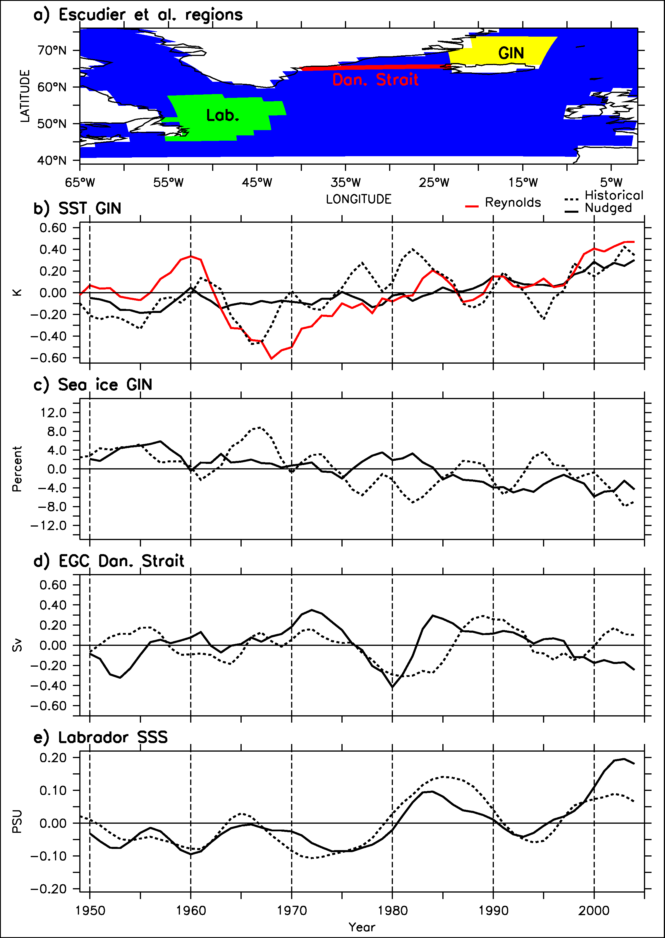
Mechanisms
Agung eruption 1963-1966
GIN SST and sea-ice cover
Wind stress & EGC
SSS Labrador Sea
CV sites
AMOC
Phasing of the second maximum
GSA
GSA
GSA
Labrador Sea SSS = 7-10 years predictor of the AMOC
EGC = more than 10 years predictor
Notes:
ce n’est pas la SST mais la SSS qui drive
On ne force pas l’evap et les precip via les SST
origine ano SSS advective à partir du Labrador cf. cycle de Romain
i.e on force la sea ice via la SST en GIN, qui « cale » le cycle

Slide 26
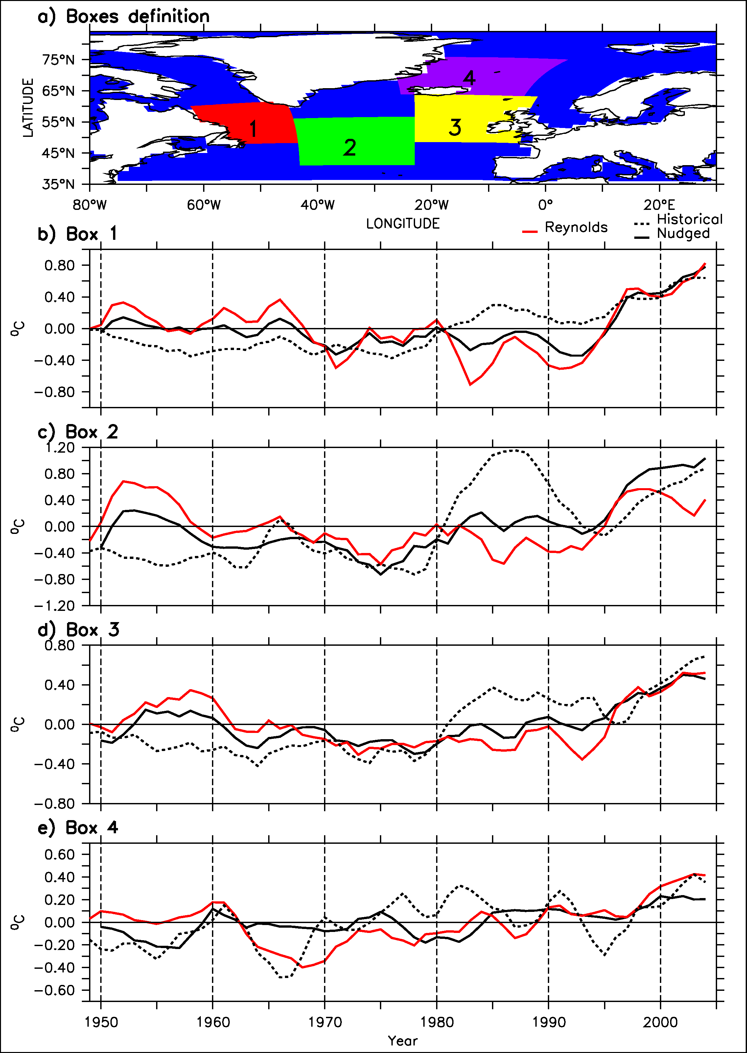
Propagation of SST anomalies
Box 1
GSA
GSA
GSA
We follow the mininimum of SST along the gyre
7 years between Labrador and GIN
True in the model (known)
And in the SST Reynolds data!
Box 2
Box 3
Box 4
Notes:
ce n’est pas la SST mais la SSS qui drive
On ne force pas l’evap et les precip via les SST
origine ano SSS advective à partir du Labrador cf. cycle de Romain
i.e on force la sea ice via la SST en GIN, qui « cale » le cycle

Slide 27
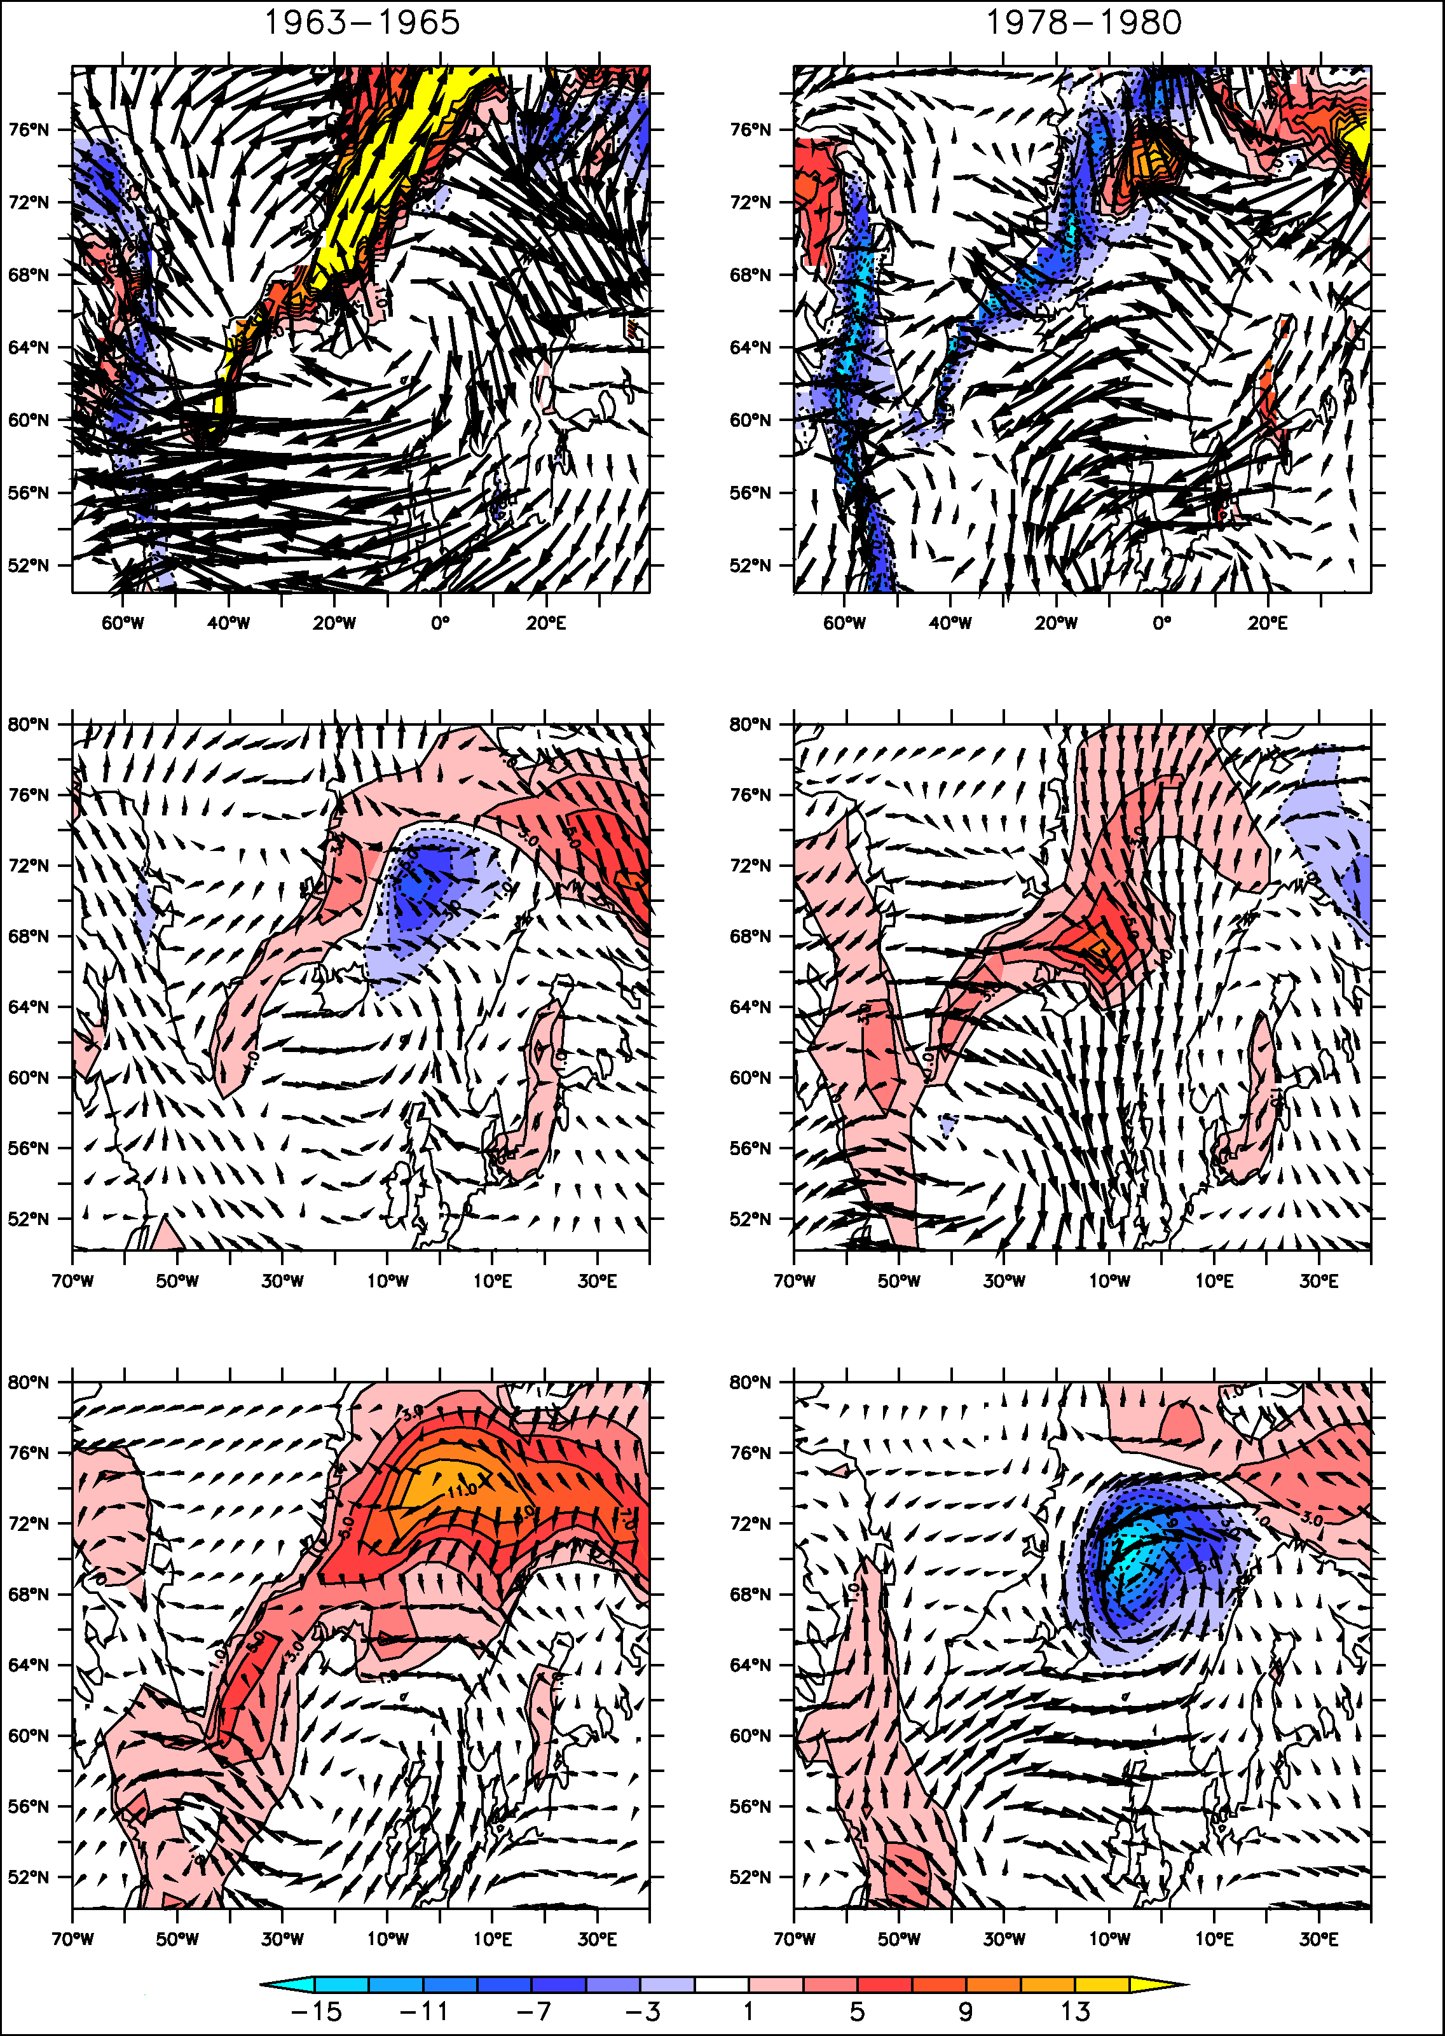
Air-sea ice interactions
NCEP
& HadISST
Anomalous wind stress in the NCEP and HadISST sea ice, similar to what is obtained in the simulations.
An indication of the existence of the air-sea-sea ice interaction from our 20-yr cycle.
Nudged
ensemble
Historical
ensemble
% sea ice cover
Notes:
ce n’est pas la SST mais la SSS qui drive
On ne force pas l’evap et les precip via les SST
origine ano SSS advective à partir du Labrador cf. cycle de Romain
i.e on force la sea ice via la SST en GIN, qui « cale » le cycle

Slide 28
Initialisation of the 1980 maximum
Agung volcanic forcing
Notes:
pb : unrealistic as compared to sea ice in the reality

Slide 29
Initialisation of the 1996 maximum
NAO forcing via SST nudging
Notes:
pb : unrealistic as compared to sea ice in the reality

Slide 30
Outlook
Decadal variability of the AMOC in the IPSL-CM5
Initialisation of the AMOC in the IPSL-CM5
Predictability of climate in IPSL-CM5
Impact of Greenland melting on the AMOC: a multi-models evaluation

Slide 31
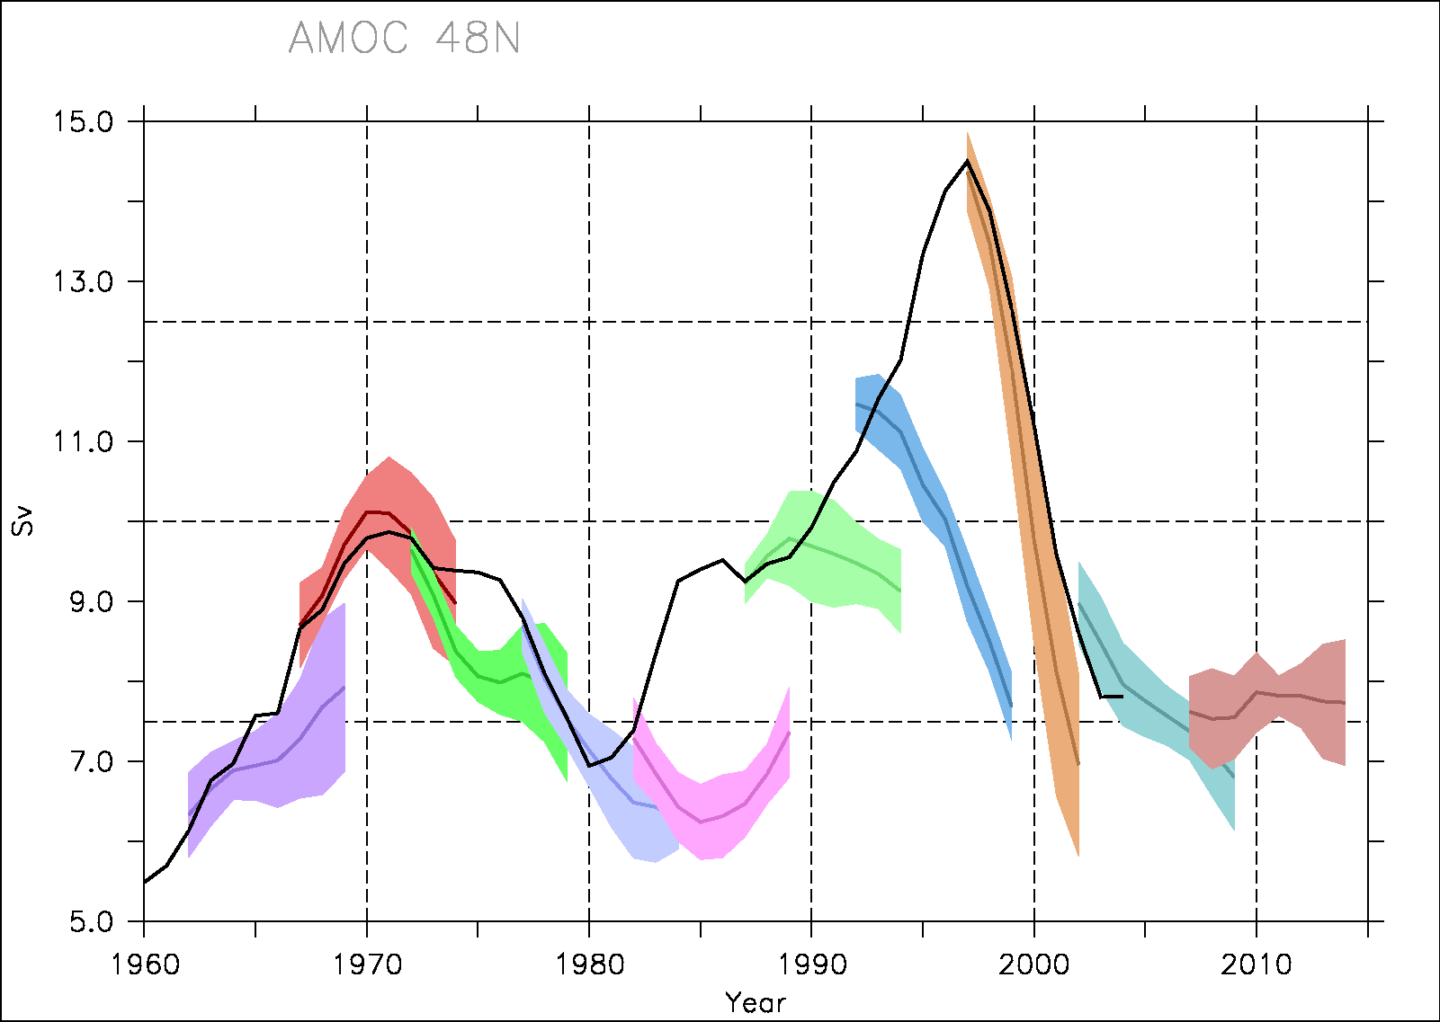
Hindcasts
Only one member of the nudged ensemble (planned to apply to each)
3-member ensemble of free run
Good predictive skill for the AMOC in perfect model analysis (Persechino et al., sub.)
90’s max. missed
AMOC 48°N

Slide 32
Hindcasts
Only one member of the nudged ensemble (planned to apply to each)
3-member ensemble of free run
Good predictive skill for the AMOC in perfect model analysis (Persechino et al., sub.)
90’s max. missed
AMOC 48°N

Slide 33
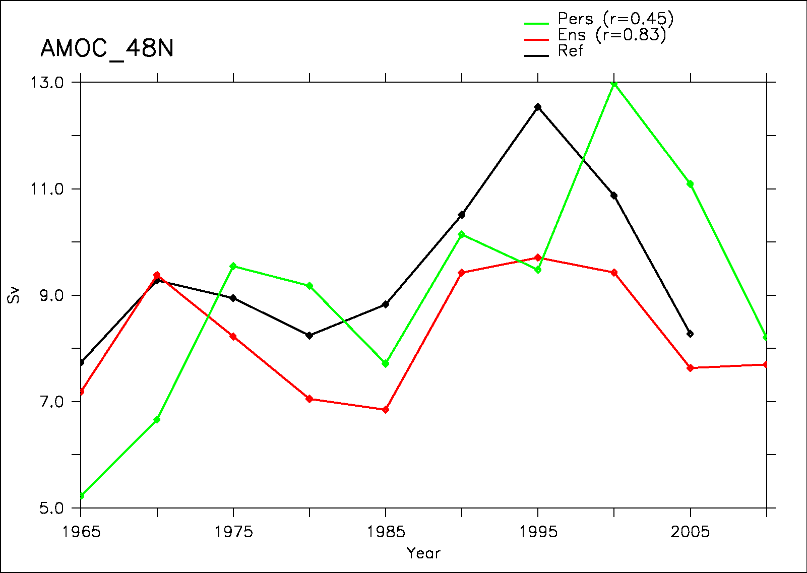
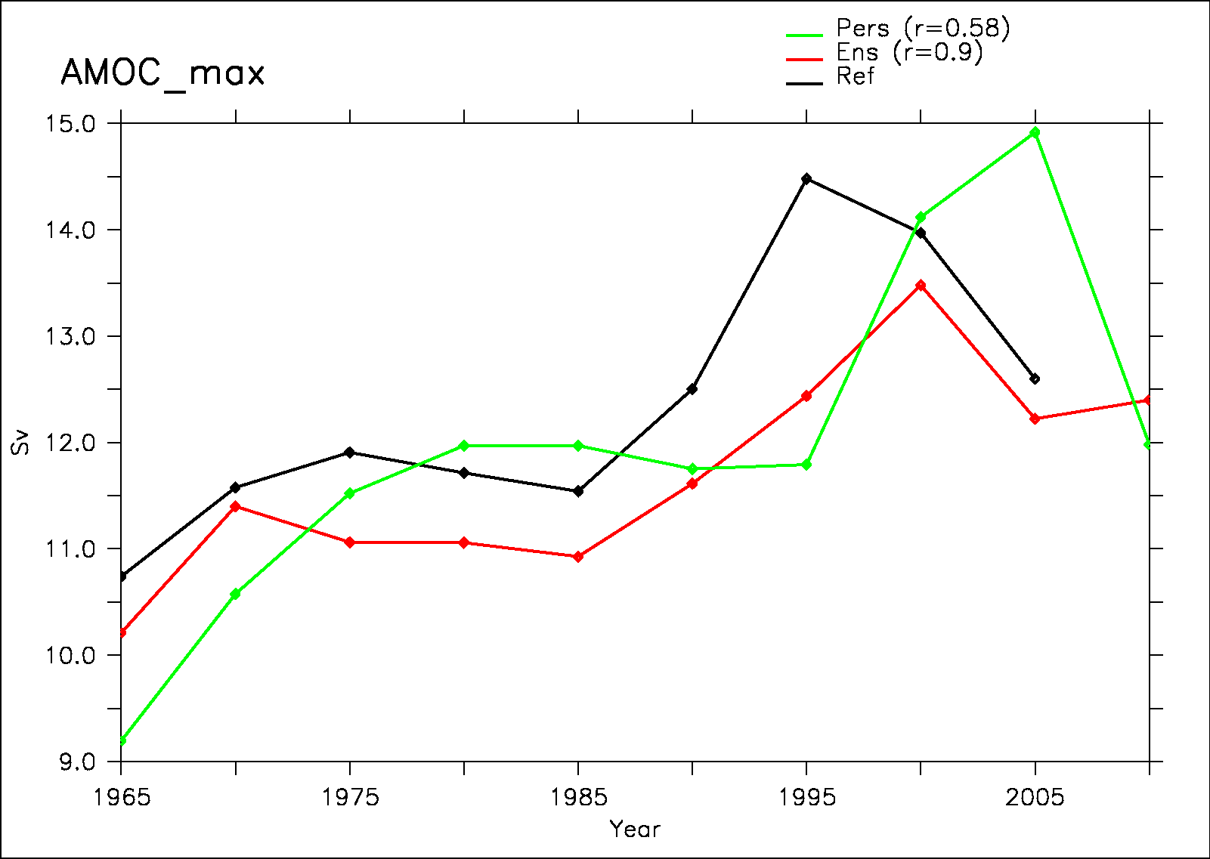
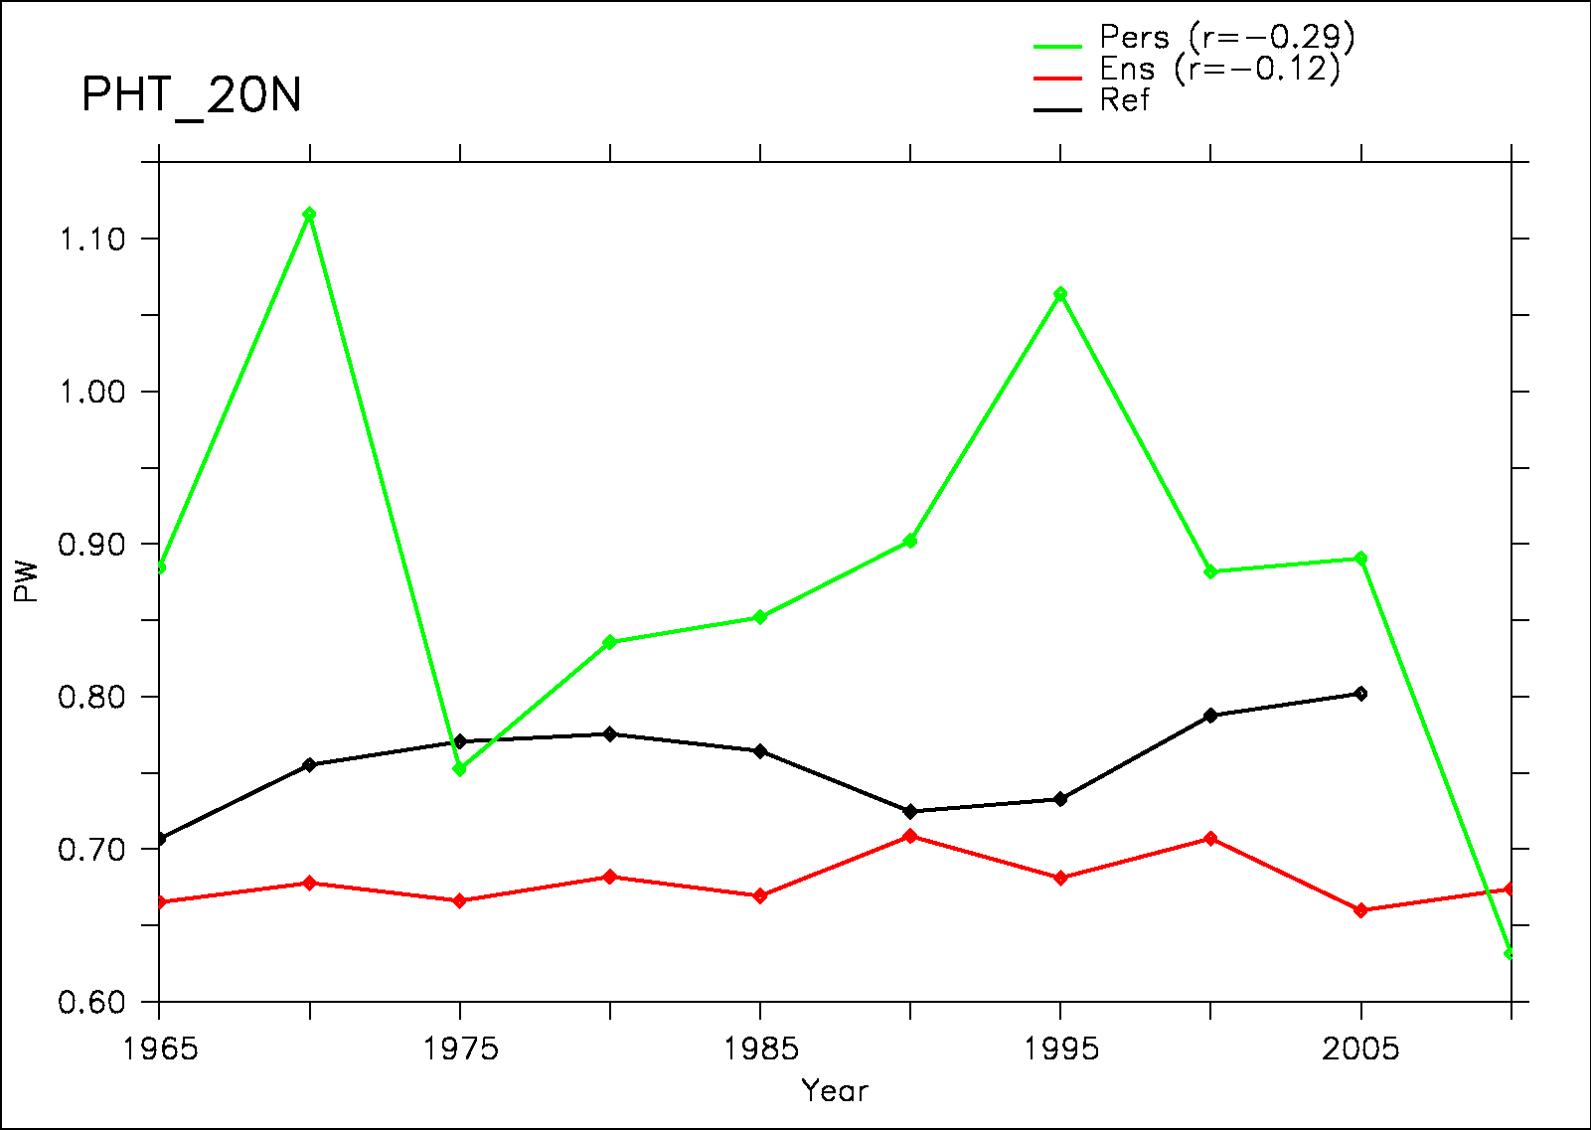
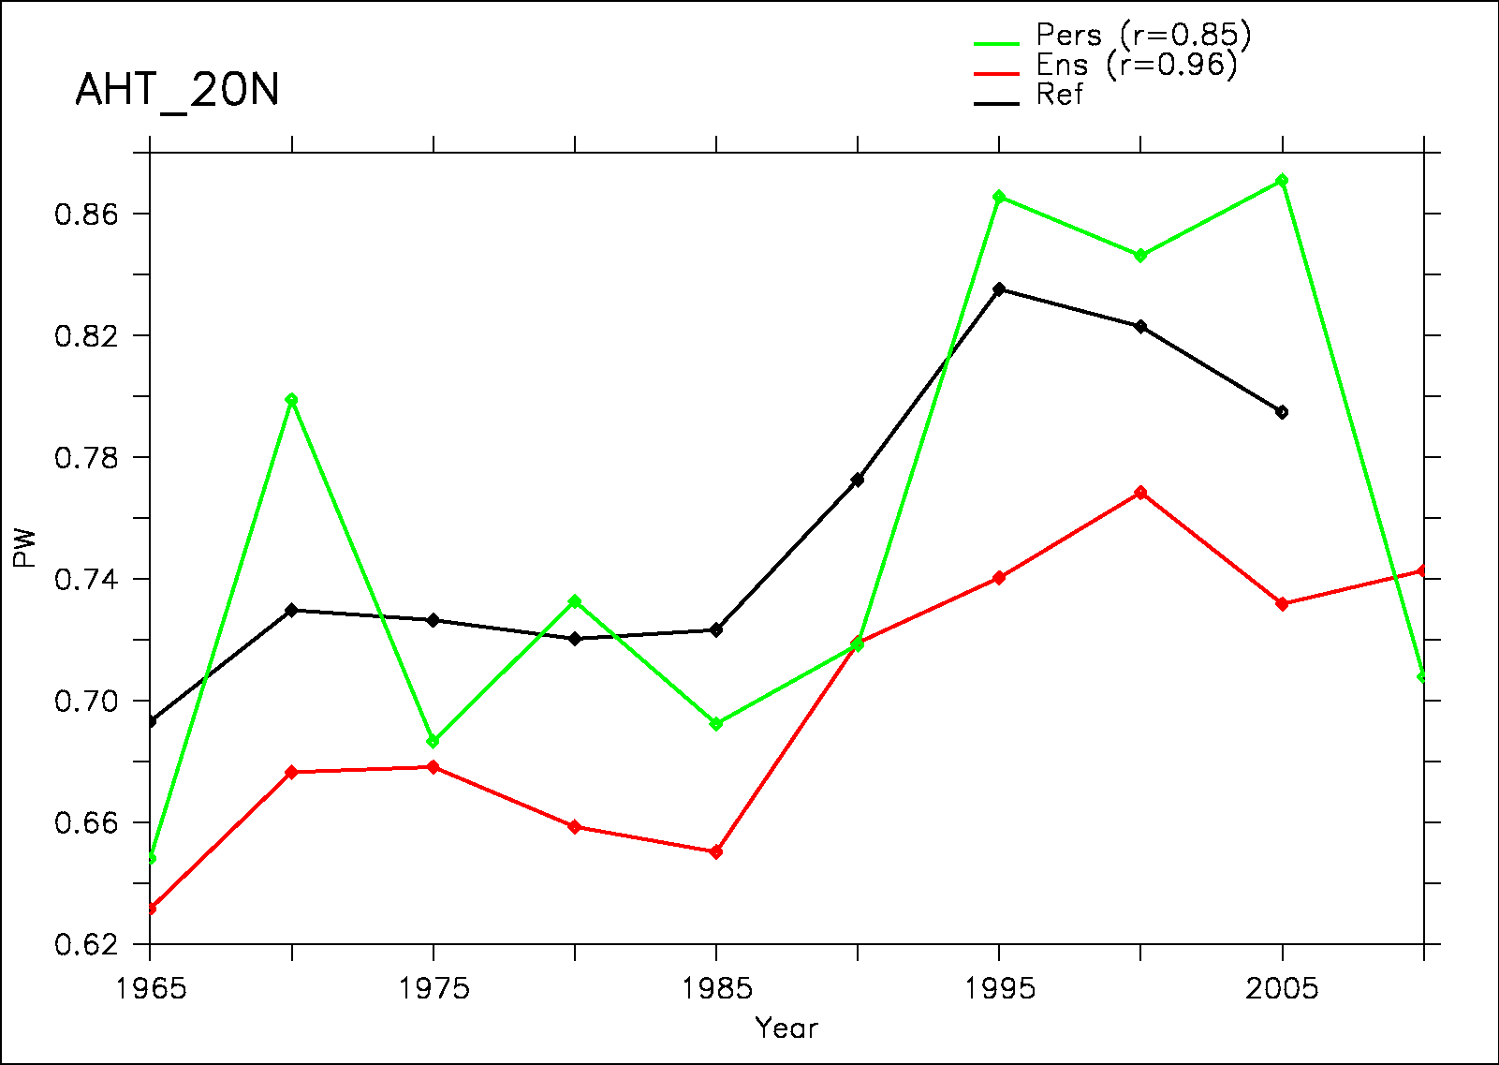
Hindcasts
AMOC 48°N
AMOC max
Pac. HT 20°N
Atl. HT 20°N

Slide 34
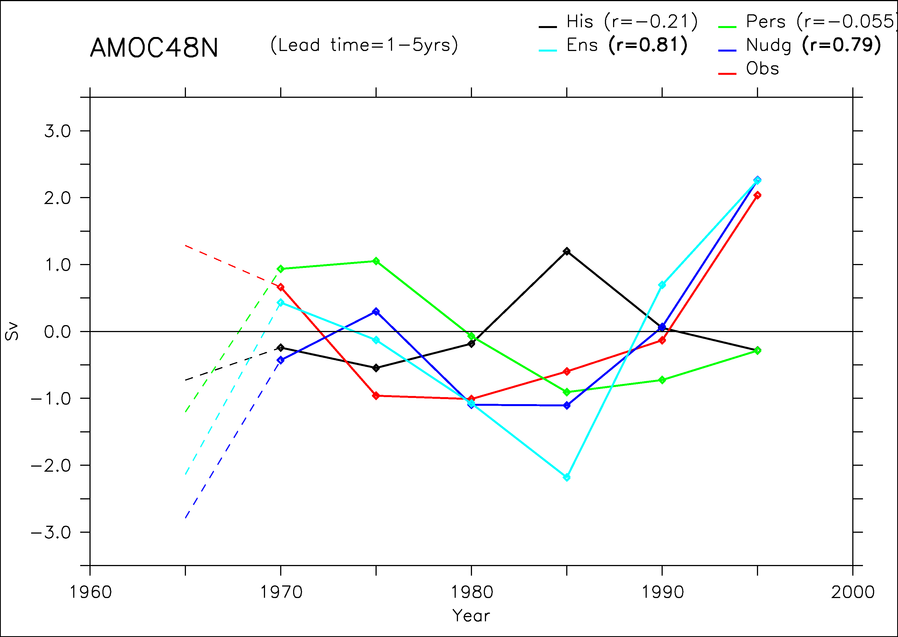
Hindcasts

Slide 35
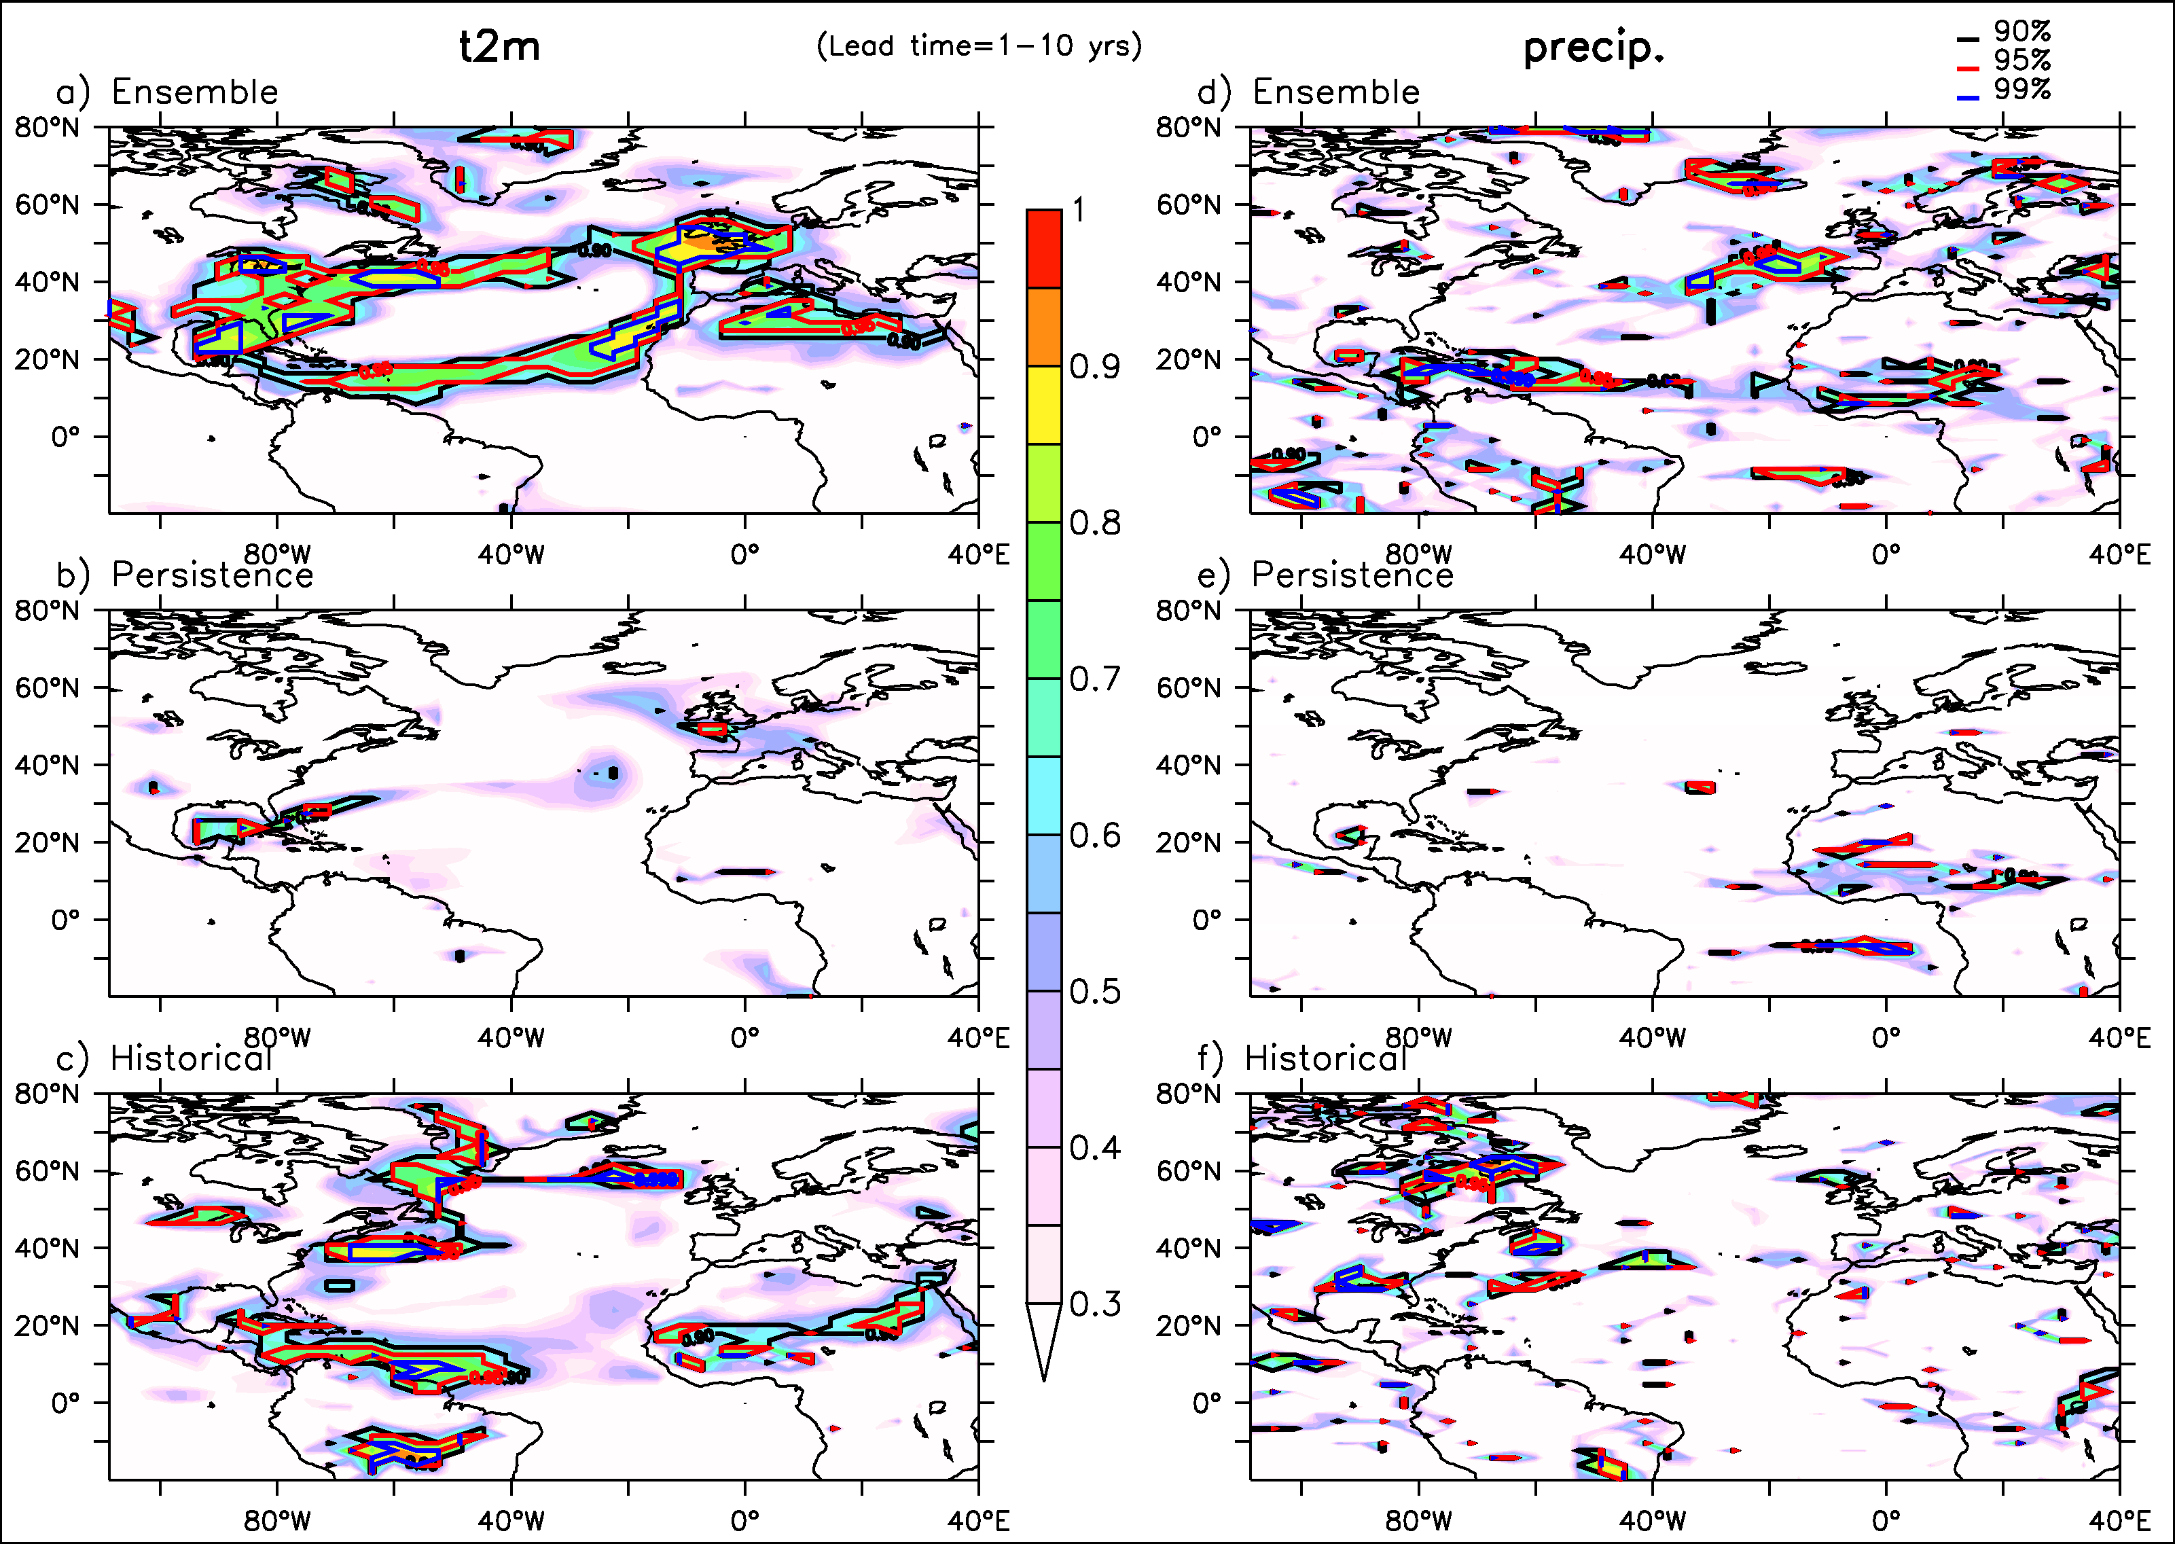
Hindcasts

Slide 36
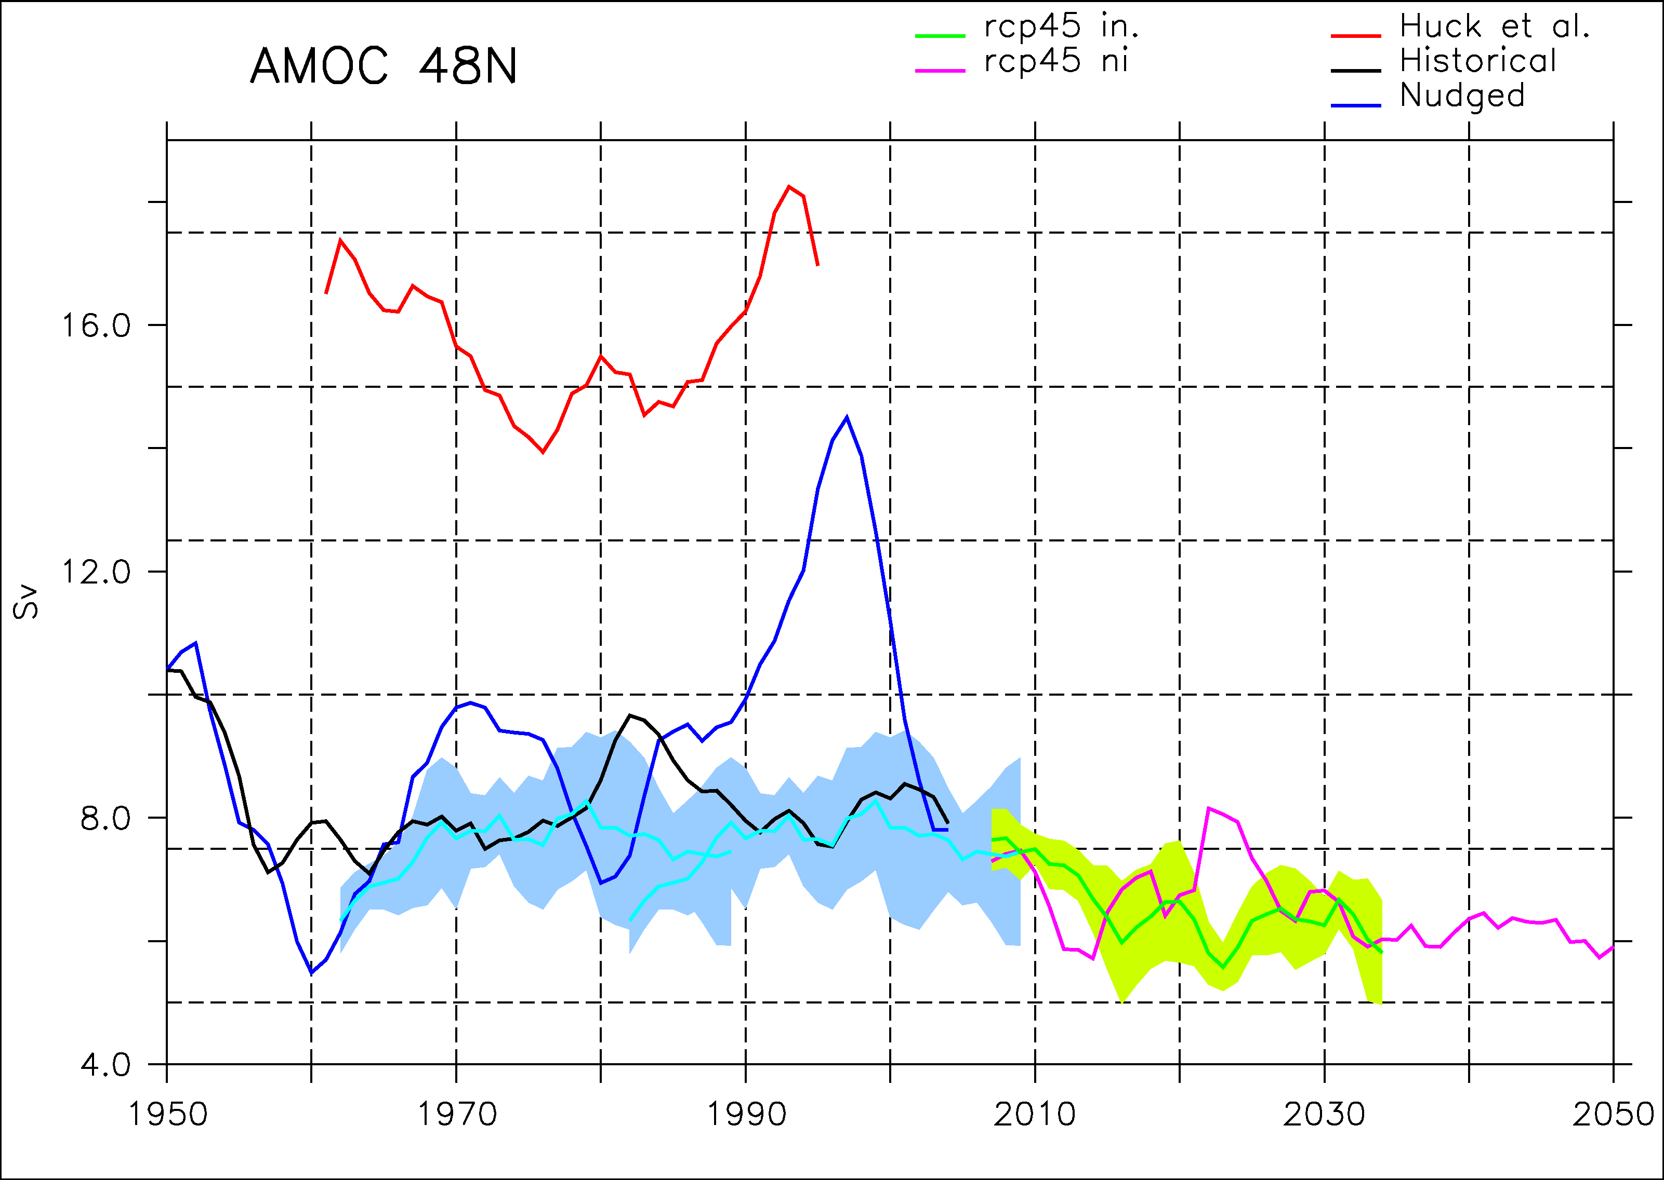
Forecasts

Slide 37
Outlook
Decadal variability of the AMOC in the IPSL-CM5
Initialisation of the AMOC in the IPSL-CM5
Predictability of climate in IPSL-CM5
Impact of Greenland melting on the AMOC: a multi-models evaluation

Slide 38
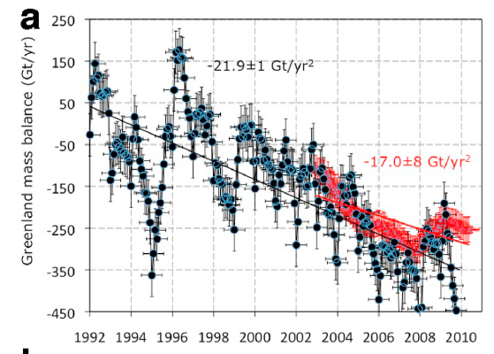
Background
Greenland ice sheet (GIS) is melting at an increasing rate (Rignot et al. 2011)
Potential impact of GIS melting in the future on the Atlantic Meridional Overturning Circulation(AMOC)?

Slide 39
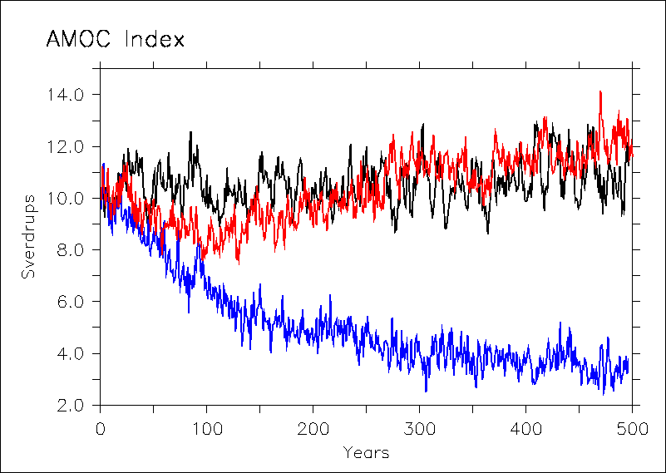
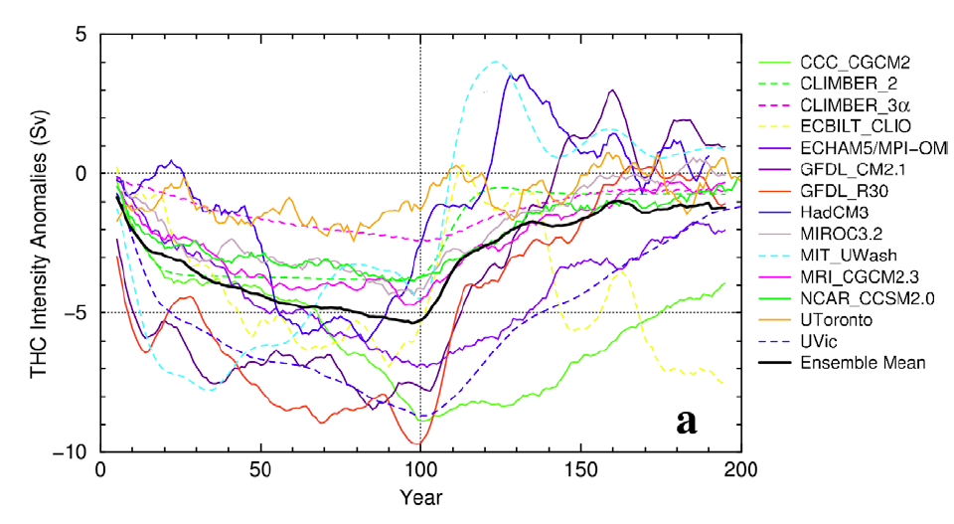
Background
MOI
NoGIS
Swingedouw et al. (2007): potential large effect of GIS melting
Stouffer et al. (2006): spread of AMOC response to fresh water input. Why?
CTRL
GIS

Slide 40
Experimental design
0.1 Sv released around Greenland for the period 1965-2004 (ocean-only model)
Model | Type | Ocean | Atmosphere
HadCM3 | AOGCM | NoName 1.25°– L20 | HadAM3 2.5° x 3.75° – L19
IPSLCM5-LR | AOGCM | NEMO_v3 2° – L31 | LMD5 1.8° x 3.75° – L39
COSMOS | ESM | MPI-OM 1.5° – L40 | ECHAM6 T63 – L47
EcEarth | AOGCM | NEMO_v3 1° – L42 | IFS T159 – L67
BCM2 | AOGCM | MICOM 2.8° – L35 | ARPEGE T63 – L31
ORCA05-Kiel | OGCM | NEMO_v3 0.5° – L46 | X

Slide 41
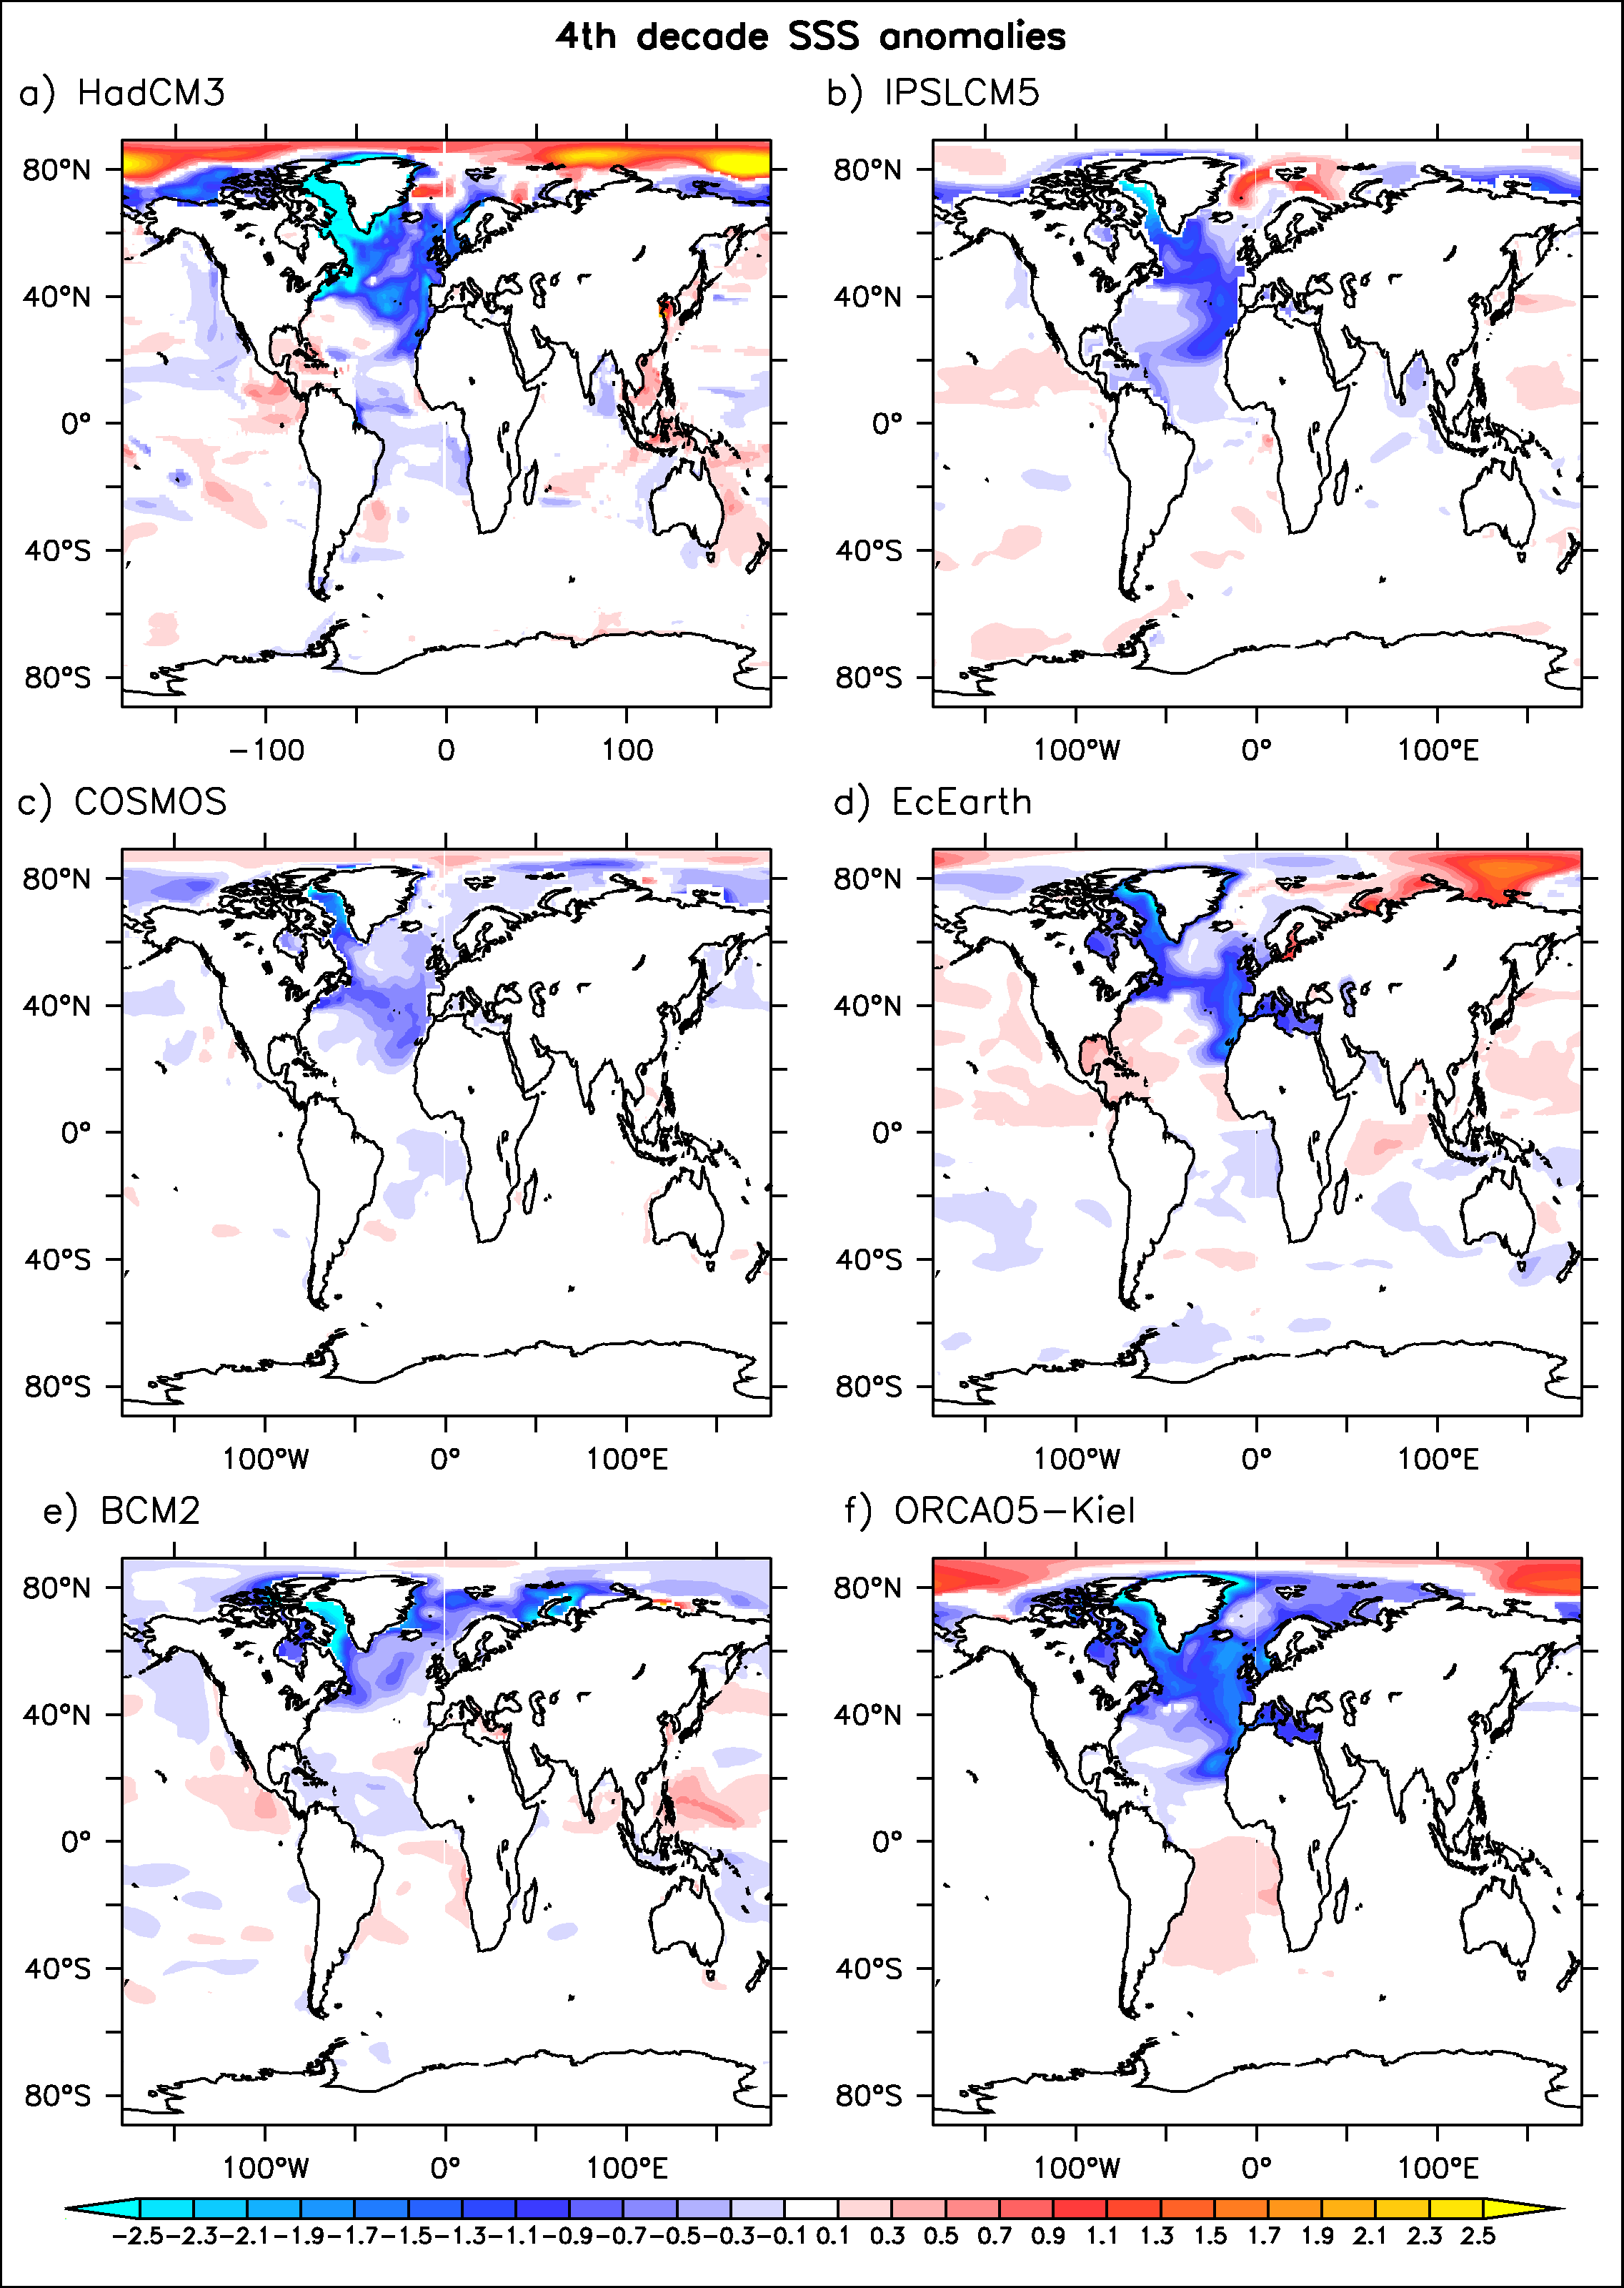
SSS spread
Negative anomaly in the subtropical gyre (fresh water leakage)
Positive anomaly in the Arctic

Slide 42
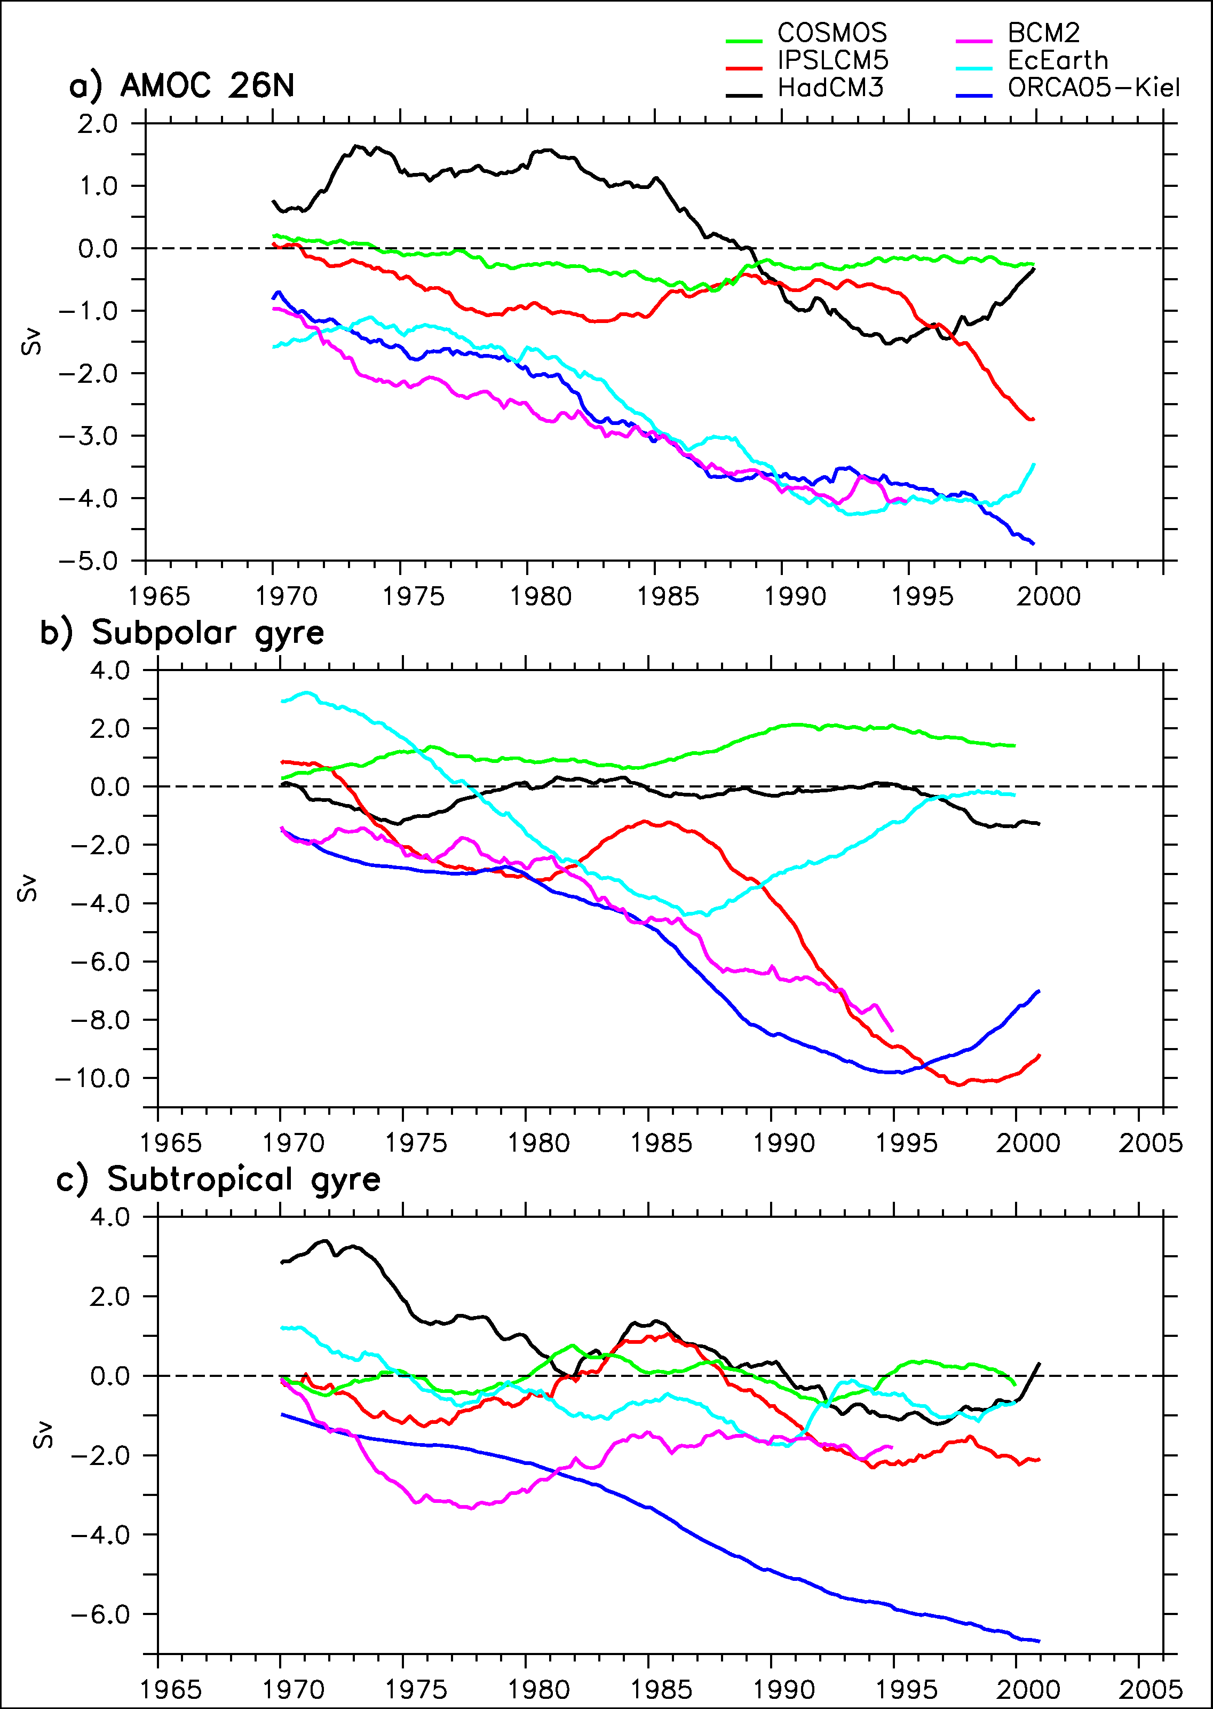
Ocean circulation response
Weakening of barotropic and meridonal overturning circulation in the North Atlantic in most models

Slide 43
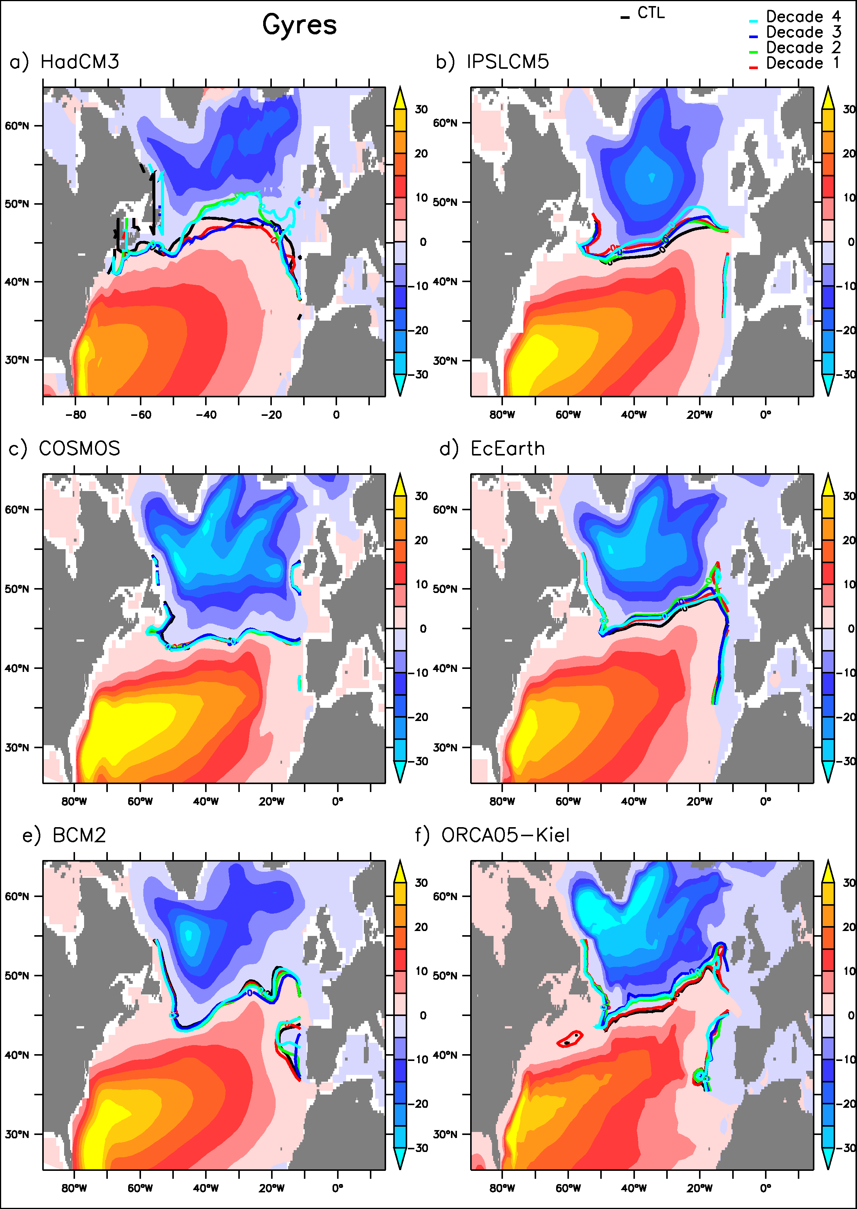
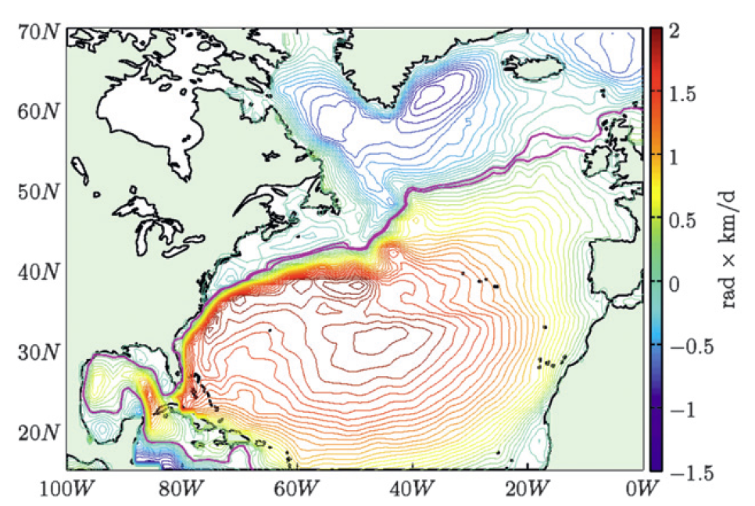
Barotropic response
No clear change in the shape of the gyres
Very different shape for the asymmetry between the gyres in the control simulations
Rypina et al. 2011

Slide 44
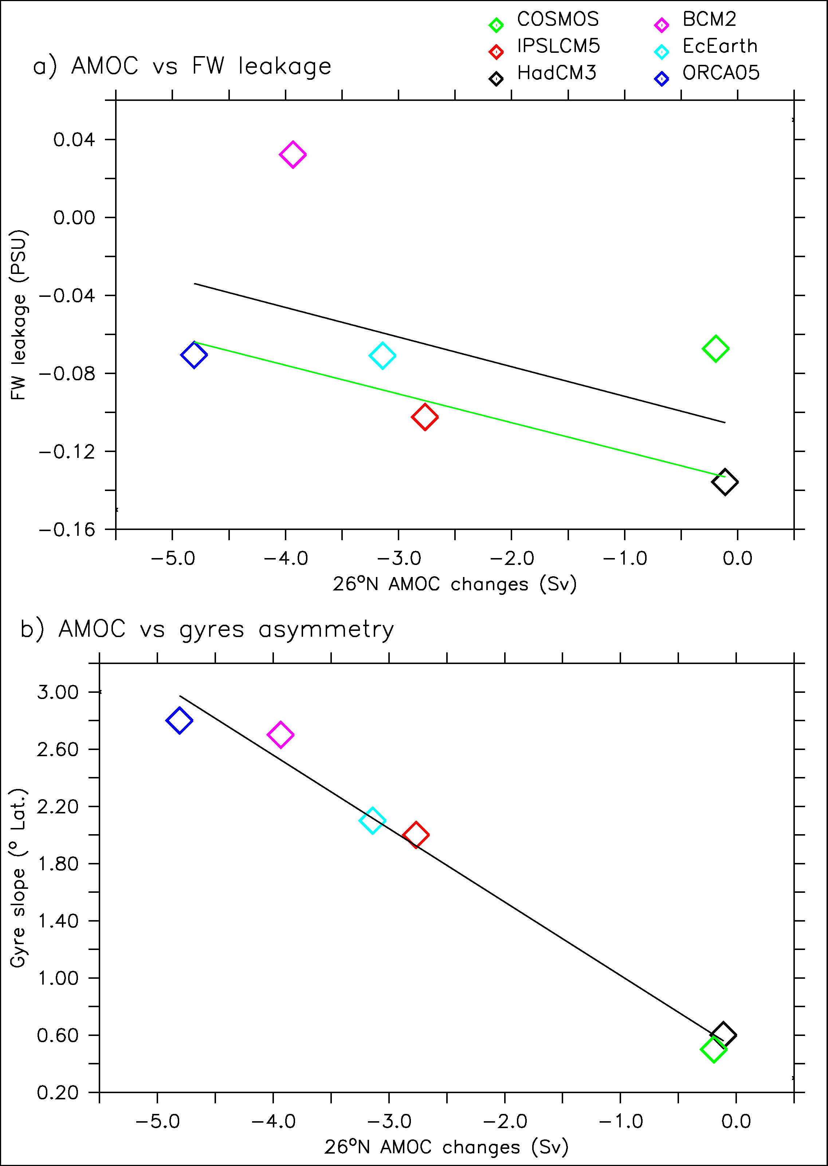
Explanation for the AMOC spread
AMOC weakening depends on the fresh water leakage intensity

Slide 45
Explanation for the AMOC spread
AMOC weakening depends on the fresh water leakage intensity
This intensity depends on the gyre asymmetry in control simulations (influencing the FW leakage towards the subtropical gyre)

Slide 46

Summary scheme for AMOC response
Subtropical
Subpolar
Nordic Seas

Slide 47
Summary scheme for AMOC response
Subtropical
Subpolar
Nordic Seas

Slide 48
Summary scheme for AMOC response
Subtropical
Subpolar
Nordic Seas

Slide 49
Summary scheme for AMOC response
Subtropical
Subpolar
Nordic Seas

Slide 50
Summary scheme for AMOC response
Subtropical
Subpolar
Nordic Seas

Slide 51
Gyres asymmetry and FW leakage
Rypina et al. 2011

Slide 52
Discussion
Previous studies may have understimated the impact of GIS melting (Ridley et al. 2005, Jungclaus et al. 2007, Mikolajewicz et al. 2007, Swingedouw et al. 2006)
With the observed asymmetry (if the linear relationship holds): at least 5 Sv (≈25-30%) of weakening for 40 years of 0.1 Sv FW release (≈5% of GIS volume, ≈35cm of SLR )

Slide 53
Conclusions
A 20-yr favored frequency in the North Atlantic in IPSLC-CM5: agreement with a few data
Simple intialisation technique succeeds in synchronizing the AMOC
Due to volcanic triggering of the 20-yr cycle
And the effect of NAO in the 1980s and 1990s
Correct predictive skill for the AMOC and then for the North Atlantic Sector
Impact of a FW release on the AMOC may be larger than previously thought in AOGCMs because of incorrect representation of gyres asymmetry and FW leakeage in previous work
Large weakening in the second part of century?

Slide 54
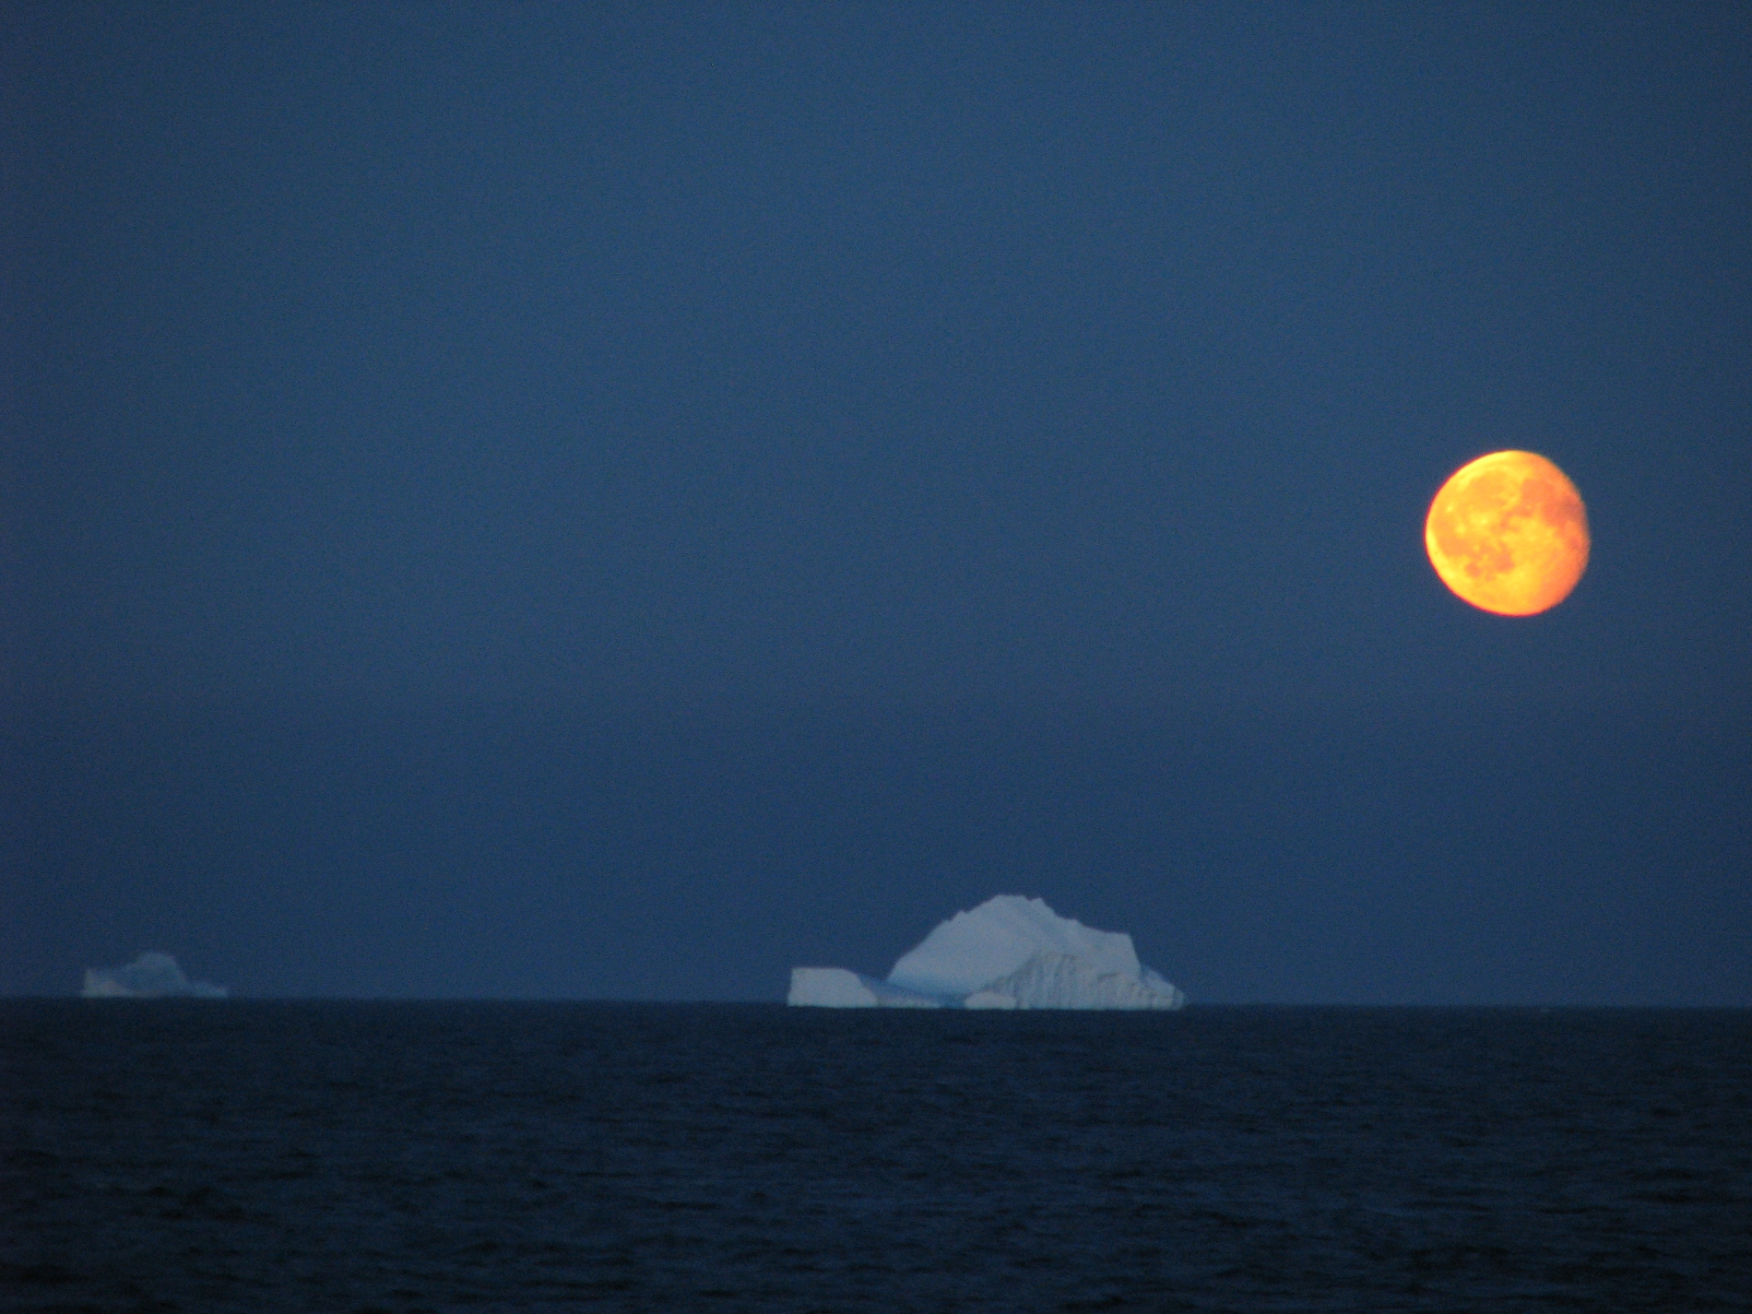
Thank you
Didier.Swingedouw@lsce.ipsl.fr

Slide 55

Thank you
Didier.Swingedouw@lsce.ipsl.fr

